Slide 1
Health Regions: Delivering Integrated Care
Health Regions Programme Update
5 September, Convention Centre Dublin
5 September, Convention Centre Dublin
Liam Woods
National Director, Organisational Change, Health Regions Programme

Slide 2
Agenda
Health Regions: Delivering Integrated Care
Health Regions Strategic Objectives and Health Regions Programme
Progress to Date
Integrated Care
HSE Structures
Proposed Regional Patient and Service User Partnership Structures
HSE Health Regions webinar
2

Slide 3
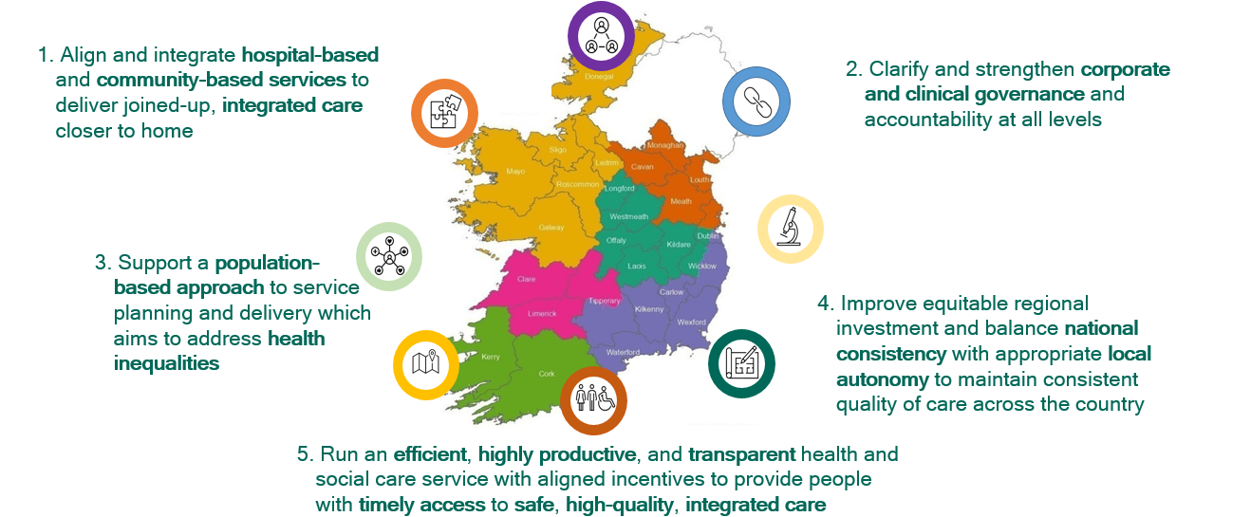
Health Regions Programme
Strategic Objectives
3

Slide 4
Health Regions Programme
Progress to Date
4

Slide 5
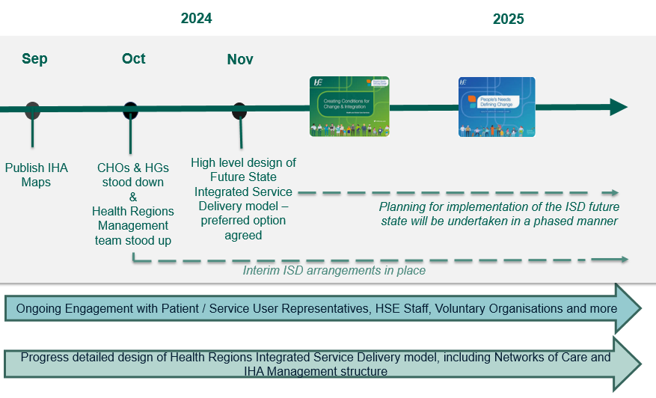
Health Regions Programme –
Key Upcoming Milestones
5

Slide 6
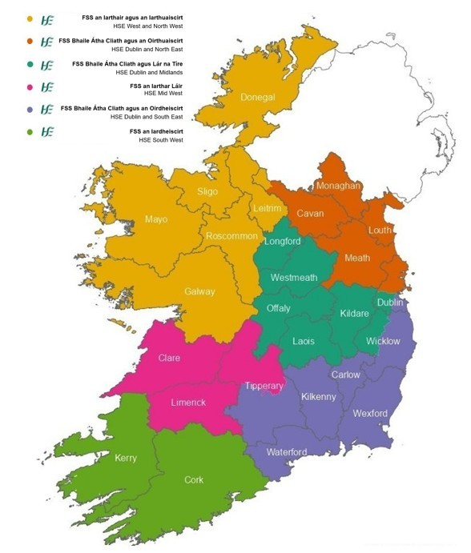
What’s Decided?
We will still be a single HSE organisation with 6 health regions. Services will be integrated across hospitals and community in these health regions. Health Regions are not separate statutory bodies.
Health Regions will use the HSE logo and be under the governance of the HSE Board
Regional Health Forum structure to remain but will be aligned to Health Regions
On October 1st, the Health Region management structure will replace existing CHO and HG management structures
Operational focus to move from HSE Centre to the Health Regions and Integrated Healthcare Areas (IHAs).
20 IHAs have been agreed as geographic sub-components of the Health Regions. The IHAs will have responsibility for operational service delivery and driving integrated care for patients and service users.
HSE Centre will develop and oversee standards and guidelines for implementation at regional level. The focus of HSE Centre will be on planning, enabling, performance and assurance
The HSE Centre and Health Regions structures have been agreed
6

Slide 7
What is Integrated Care?
Integrated care is where people can access the right care, at the right time, in the right place, with the right team.
Designed first and foremost around the needs of the person, integrated care has the dual aim of improving both system efficiency and service user experience and outcomes
In the Sláintecare Report (May 2017) the Committee on the Future of Healthcare defined integrated care:
“Healthcare delivered at the lowest appropriate level of complexity through a health service that is well organised and managed to enable comprehensive care pathways that patients can easily access and service providers can easily deliver. This is a service in which communication and information support positive decision-making, governance and accountability; where patients’ needs come first in driving safety, quality and the coordination of care.”
7

Slide 8
IFIC Pillars of Integrated Care
The Nine Pillars of Integrated Care
International Federation of Integrated Care
8

Slide 9
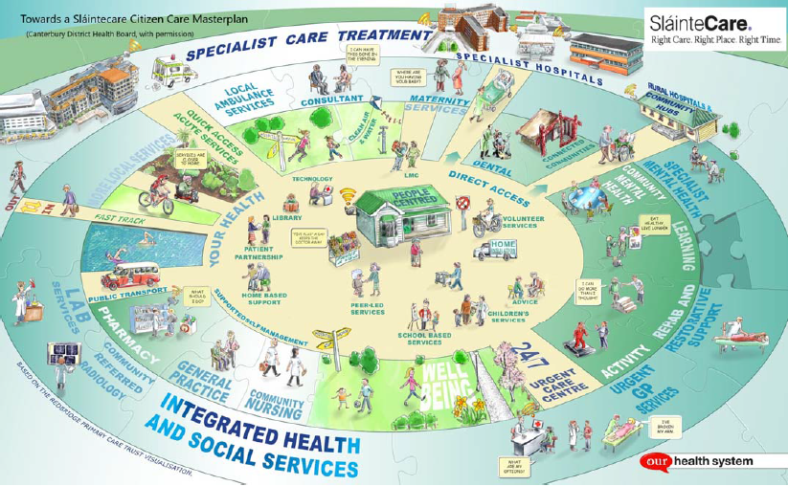
Sláintecare Vision for Integrated Care
9

Slide 10
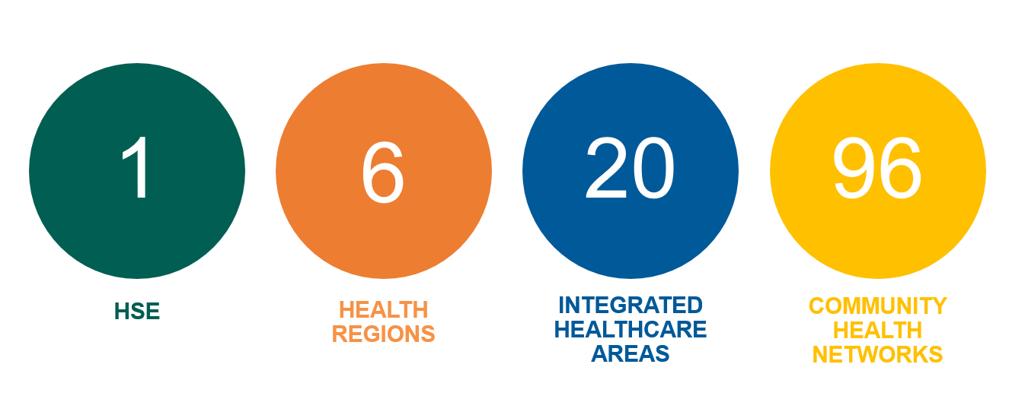
HSE Sub-structures
10

Slide 11
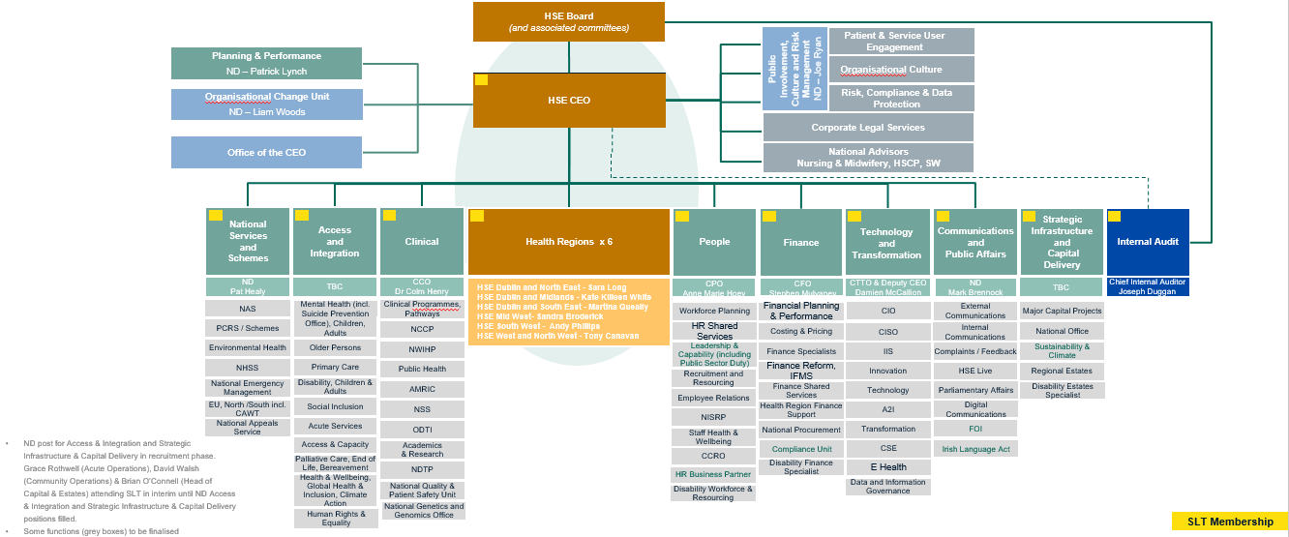
HSE Centre
New Structure
11

Slide 12
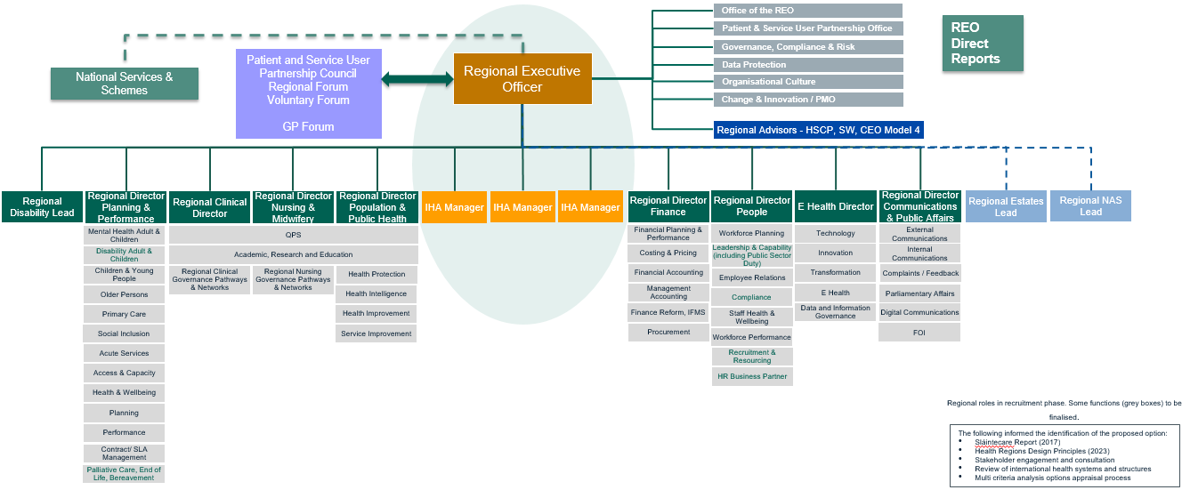
HSE Health Region EMT
12

Slide 13
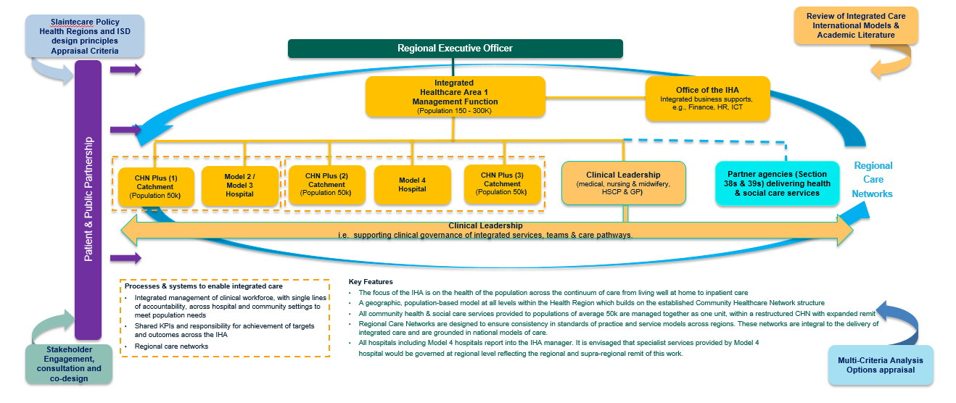
Integrated Healthcare Area
13

Slide 14
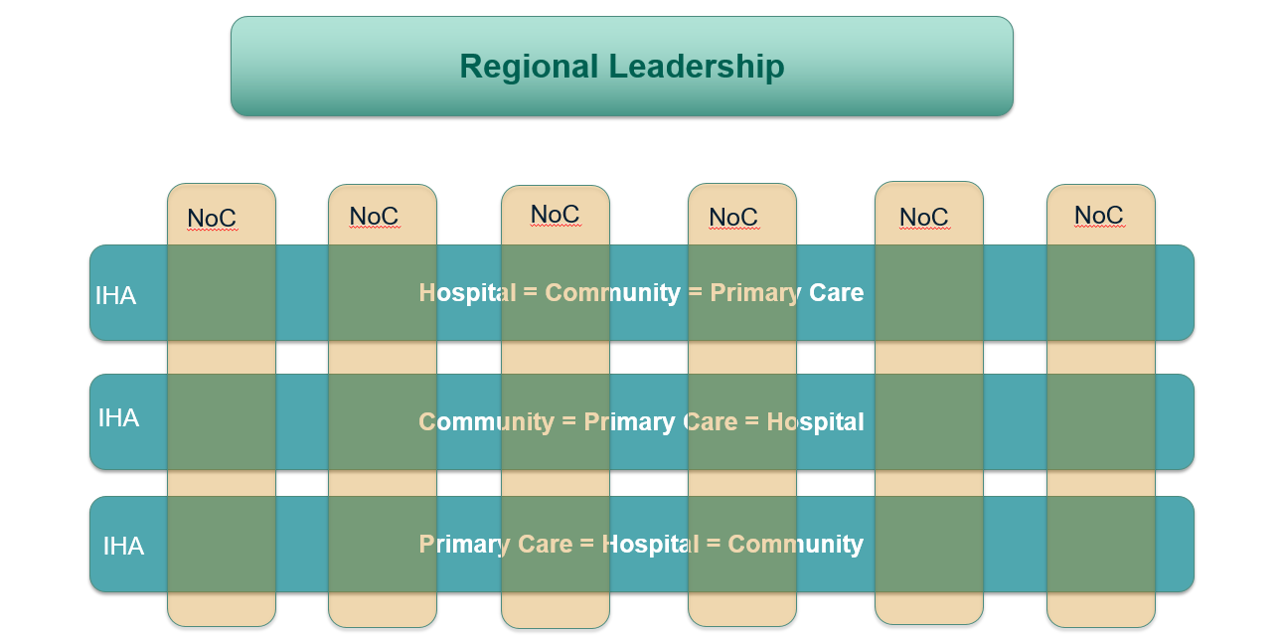
Potential Networks of Care:
Networks of Care (NoC)
Older Persons
Women and Infants
Children and Young People
Disability
Mental Health
Medicine
Diagnostics
Perioperative
Cancer Services
Goals:
Facilitate patient-focused, integrated and multidisciplinary delivery of care for service users and patients across the care continuum within the region
Plan and assure sustainable, quality & safe patient care through continuous improvement within the region
Ensure an appropriate level of national consistency, standardisation and collaboration across all networks, minimising variation throughout the system
14

Slide 15
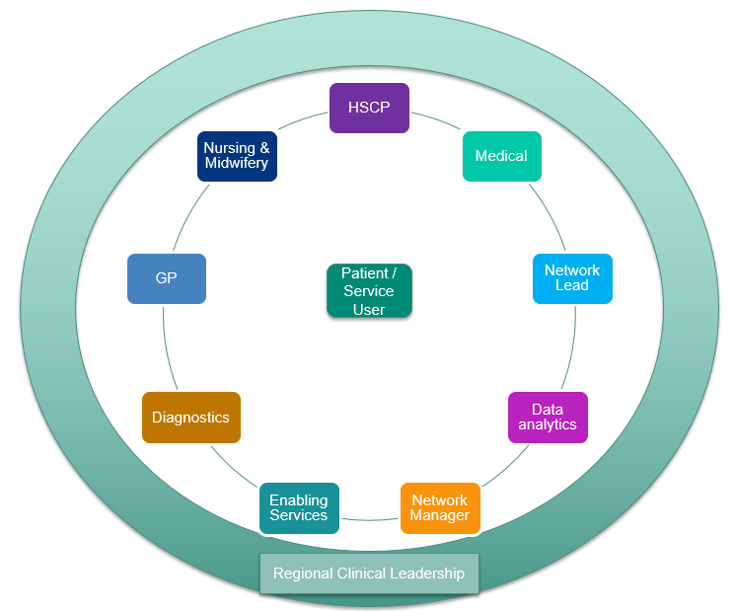
Networks of Care: Proposed Membership
15

Slide 16
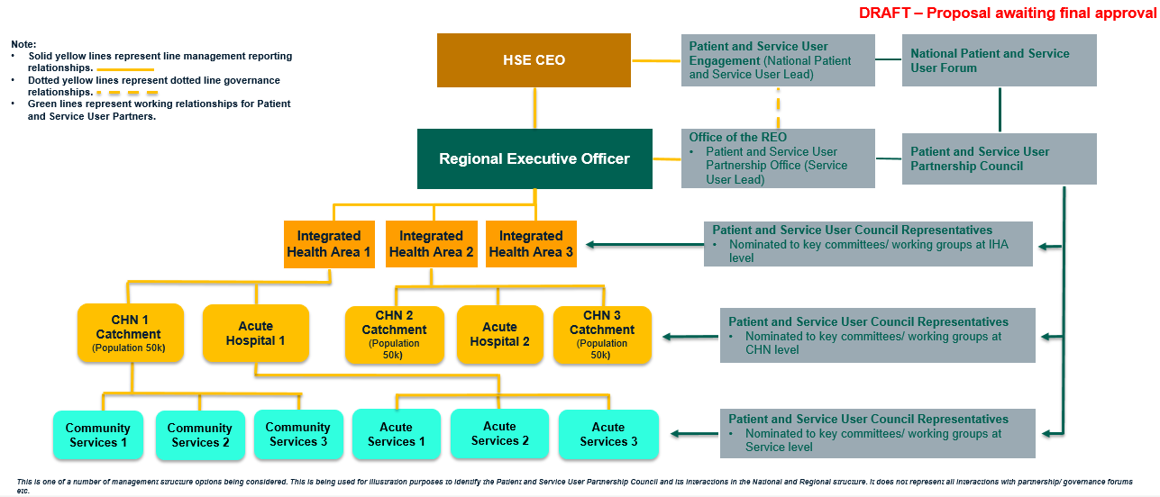
Regional Patient and Service User Partnership Structures
16

Slide 17
Upcoming Webinar: 26th September 2024
Objectives
Update on Health Region implementation
Share reflections and learning from the lived experience of an integrated care team/ service
Identify key considerations for balancing stability with change while creating conditions for integration for individuals and teams / services
Panel Q&A with senior HSE leaders
Signpost key resources and supports
Registration
Registration now open via: https://healthservice.hse.ie/staff/latest-health-regions-updates/
17

Slide 18
Panel Discussion: Supporting Integrated Care Delivery
Liam Woods (Chair), Muiris O'Connor, Dr Andy Phillips, Kate Killeen White, Dr Pat Nash, Dr Shane McKeogh, Dr Vida Hamilton, Eileen Whelan, Ruth Kilcawley
18

Slide 19
Patient Partner
Anne Lawlor (Chair of the HSE National Patient & Service User Forum)
19

