Slide 1
Health Regions: Delivering Integrated Care
Digital for Care 2030
5 September, Convention Centre Dublin
5 September, Convention Centre Dublin

Slide 2
Sláintecare – Supporting Digital
Text in Arial Bold 16 point text
Right Care. Right Place. Right Time.
Improving safe, timely access to care and promoting health and well being
Addressing health inequalities – towards universal healthcare
Sláintecare recognised Digital Health Transformation as essential for reform and implementation of integrated care
2
Notes:
Explain here in full DfC 2030 alignment to policy
Mention year of SC and how prioritised programmes have evolved

Slide 3
Ireland’s Digital Landscape
EU Directive 2030
Data Standards
Public Expectation
Harnessing the power of new technologies, digital and data to transform how health & social care services are delivered for our population.
Mission Statement
Digital for Care – A Digital Health Framework for Ireland 2024-2030
New Technologies
Sharing
Information
Health REGIONS
Innovation
National Policy
DISCONNECTED
systems
Enthusiastic Staff
FEW NATIONAL SOLUTIONS
3
Notes:
Integrated care is not possible on a system wide basis without enabling our staff to share information and integrate the care processes;; needs digital solutions to speed up reform and support integrated care.
Public expectation has increased with advancement in technology in consumers daily lives means that people expect to get improved access to services through digital solutions to interact with health and social care services
New technologies are enabling admission avoidance, reduced lengths of stay, remote monitoring and improvements in transition of care between services – such as between hospitals and community services
Technology advancements in areas such as electronic health records, virtual care and Artificial Intelligence are being deployed across health systems and there is real risk that Ireland is left behind.
National & European Policy – the progression of our digital health transformation journey must be aligned with national healthcare strategies (Sláintecare), upcoming legislation (Health Information Bill) and we must transform our digital health services to fulfil our EU obligations around the use of health information.

Slide 4
Digital Health Transformation – a new era
What are we doing?
In collaboration with the Department of Health, we set about creating a new and exciting ambition for the role digital will play in the future of Health Services in Ireland. This new ambition is set out in two key documents:
Department of Health – Digital for Care – A Digital Health Framework for Ireland 2024-2030: Published 21st May 2024
Health Service Executive - Digital Health Strategic Implementation Roadmap 2024-2030: Published 8th July 2024
What is the Vision for 2030?
Better Health Outcomes enabled by Seamless, Safe, Secure, and Connected Digital Health Services which support Health and Wellbeing for both our Patients and Providers.
4
Notes:
Framework: 'sets out a clear ambition for the future. Such a future that harnesses the power of data, digital technology and innovation, to widen access to health and social care services, provide improved affordable and equitable care, better patient safety and greater productivity”

Slide 5
Digital for Care: 6 Principles
Patient as an Empowered Partner
Workforce and Workplace
Digitally Enabled and Connected Care
Data Driven
Services
Digital Health Ecosystem and Innovation
Secure Foundations and Digital Enablers
5
Notes:
Six strategic Principles (Fig 1) were identified within the Departments Framework. For example: Aligning with the delivery of integrated care, Principle 3: ‘Digitally Enabled and Connected Care’ particularly impresses the vision ‘to deliver connected digital health and social care systems to allow access to a comprehensive view of each patient’s health information, enabling collaborative, evidence-based and timely decision-making, leading to improved patient outcomes’. Such a connected flow of health information for patients will ensure the capacity is available to achieve a fully integrated health and social care model as envisaged in Sláintecare – ensuring ‘the right care, in the right place, at the right time’.

Slide 6
Digital for Care: 48 Initiatives
Our Vision
Better health outcomes enabled by seamless, safe, secure and connected digital health services and which support health and wellbeing for both our patients and providers.
Patient as an Empowered Partner
Workforce and Workplace
Digitally Enabled
and Connected Care
Data Driven Services
11 Key Initiatives
6 Key Initiatives
11 Key Initiatives
4 Key Initiatives
Patient Portal
HSE app
HSELive - Contact Centre
Patient Feedback Platform
Remote Care Monitoring and Digital Therapeutics
Benefits and Schemes access
Public Facing Engagement and Digital Literacy Development Programmes
Public Website Content Management
Open Health API Framework
Contact Care Platform
Telehealth
Reliable Secure Connectivity
Modern Workspace and Productivity Tools
Improve Employee Experience
Mobile Ecosystem for Front Line
Employee Feedback Platform
Digital Finance and HR
Shared Care Record
Population Health Management
Care Coordination
Medication Management*
Diagnostics
Order Comms and Care Delivery*
Patient Safety and Quality of Care*
EHR Procurement and Delivery
Digitisation of Health Care Records*
National Clinical Information Systems*
Medical Device Integration
Patient Journey Analytics
Healthcare Data Analytics
Integrated Referral Management
Scheduling, Rostering and Resource Management
Digital Health Ecosystem and Innovation
4 Key Initiatives
Precision Medicine Support
Healthcare Research
AI in Healthcare
Open Innovation and Ecosystem
Secure Foundations and Digital Enablers
Legislation, Regulation, Standards, Governance
Patient Identity Management
Healthcare Worker Identity and Access Management
Architecture, Service Design and Knowledge Management
Culture, Change and Agile Delivery
Talent Identification and Development
Integration, Interoperability, Data Engineering
Crisis-Responsive Healthcare
ICT Cyber Programme
Foundational Infrastructure
Regional Strategic Implementation
24/7 Support Function
12 Key Initiatives

Slide 7
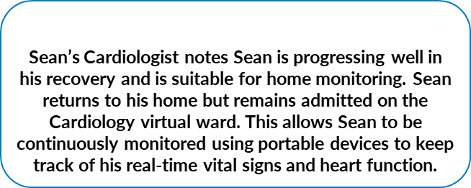
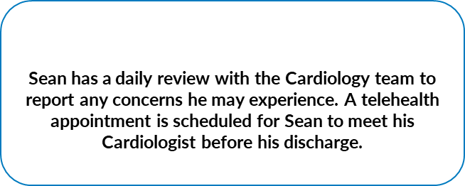
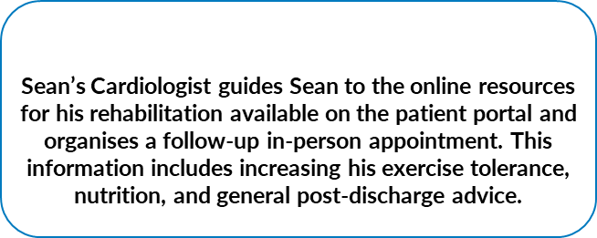
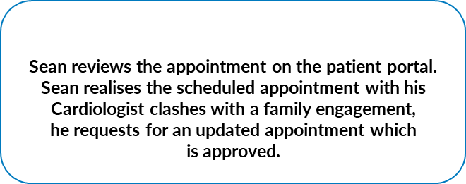
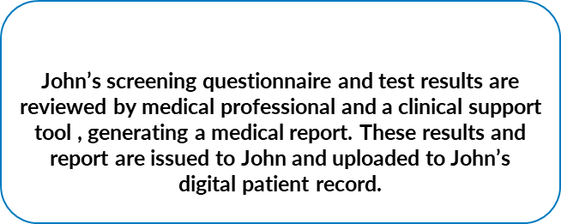
Digital for Care
Sean Conroy, from West Cork, diagnosed with a heart attack
John Walters, from Meath, diagnosed with high blood pressure
'Digital health technology has improved my care journey '
'I can receive treatment from comfort of my own home'

Slide 8
Digital for Care 2030
Some Major Programmes
8

Slide 9
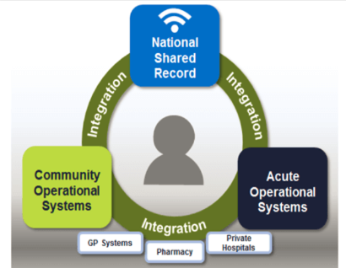
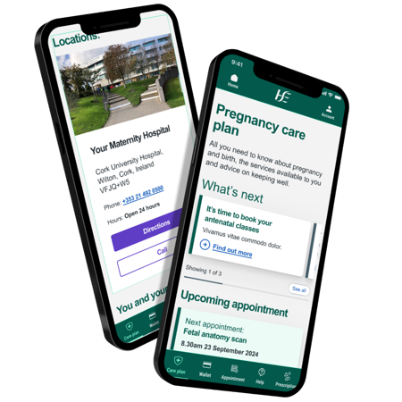
Digital for Care 2030
Some Major Programmes
HEALTH APP
A secure mobile App to give patients access to their own health information and to make it easier to manage their own health care.
Appointments management
Digital cards and credentials
Medications and prescriptions
Access to my health records
Primary channel for transacting and communicating with health services
Personalised, relevant communication, information and self-care support
Help other people to manage their care
SHARED CARE RECORD
A digital record of a patient’s key healthcare data aggregated from various electronic data sources and settings and presented to clinicians, patients and carers in a secure and structured way. The NSCR will support:
Better, safer clinical decision-making
More informed and engaged patients and citizens
Improved care coordination between healthcare providers
Improved patient experience and outcomes
More time released to care
Secure sharing of health information
Enables sharing of data across the EU to meet EU target of 2030
Current Status
Tender Complete 2024
Next Steps
First Phase Live end 2025
Current Status
First Phase live end 2024

Slide 10
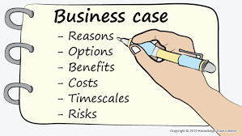
Digital for Care 2030
Some Major Programmes
ELECTRONIC HEALTH RECORD (EHR) PROGRAMME
EHR is about helping health and social care professionals provide safe quality care, improve efficiency and healthcare outcomes for people that use our services.
Provide a full electronic health record across the entire region
Focus on the patient and not the provider
Electronic Health Record will include services across both hospital and community
Introduce best practice workflows
Rollout EHR across each health region with access independent of region
Children’s Health Ireland EHR well advanced
DIAGNOSTICS PROGRAMME
National Laboratory and Imaging Programmes will deliver a modern efficient diagnostics system for health professionals that will standardise data and reporting to enable data to be shared with staff and patients.
Modern integrated solutions for staff
Standardise data to facilitate sharing
Integrates national patient identity
Improves patient safety using services such as bar coding
Integrated with EHR and Shared Care Record
Current Status
Business case in Train
Next Steps
Approval & Tender 2025 with first site in 2026
Current Status & Next Steps
Laboratory first site live with rollout plan to 2030
Imaging project being expanded to all hospitals with an ability to share private providers imaging

Slide 11
Digital for Care 2030
Some Major Programmes
ENTERPRISE WIRELESS PROGRAMME
Enterprise wireless programme will rollout wireless access for staff and patients in all HSE facilities.
Wireless infrastructure deployed in all HSE facilities
Consistent access for patients in all HSE facilities
Consistent access for staff in all HSE facilities
Remote access model for mobile healthcare staff
RESOURCE MANAGEMENT PROGRAMME
Programmes in HR and Finance to deploy the SAP product across the organisation to improve resource management function.
Single financial management system
Greater visibility of our management accounts
Single integrated HR and Financial management system
Staff access to their own employment record
National human resource records and payroll system
Next Steps
Full rollout by end 2025

Slide 12
Digital for Care 2030
The vision of success
Patients' voices are heard – ease of access to their health information
Integration and responsiveness to the changing needs of patients
Digitally skilled and literate workforce who are supported to welcome new technologies through ongoing training
Continuous engagement with all stakeholders to help adopt digital health by understanding it's values and benefits
Leaders capable of driving the digital agenda, effective change management, cultivating innovation
Clear Governance structures that support effective decision making
Harnessing of data to drive improvements
Compliance with data protection and safeguarding standards
Sustained investment is essential
Collaborative working across the Health Service sharing digital infrastructure and data
One single health record - EHR incorporating medication management tools, and the digitisation of the whole health care record
Notes:
Leaders across the health service collectively own and drive this digital health transformation journey; Governance structures will ensure delivery of digital strategies
Improved care & pathways to give patients right care at right time
Strong Leadership & established Governance
Foundations: Workforce – attain, retain, expertise to deliver ambitions, work optimally with data and technology – DIGITAL HEALTH PASSPORT
Standardisation – Maintain standards for delivery of safe healthcare
Consistent & coherent user experience
Data & analytics will redesign care pathways and promote wellbeing, prevention and independence

Slide 14
Digital for Care 2030
Right Care. Right Place. Right Time.
Get involved…..
e: digitalforcare@hse.ie

Slide 15
Patient Video
Service user maternity example
15

Slide 16
Panel Discussion: Digital Transformation to Support Service Delivery Q&A
MC: Derek Tierney
Panellists: Damien McCallion, Prof. Richard Greene, Sara Long, Paul Griffin
16

Slide 17
Patient Video
S.Foley
17

Slide 18
AI Presentation
Neil O’Hare
18

