Slide 1
General Practice
Integrated Healthcare: Advancing Health Service Reform
5 September, Convention Centre Dublin
Pat Healy
National Director, National Services
1

Slide 2
General Practice – Facts & Figures
c.3,200 GPs
with a public contract
(c2500 GMS and c700 others)
c.800 GPs, including
those who work privately,
GPs in training (year 4)
& IMG participants
c. 1,400+
GP Practices
c. 29 million
consultations per year
Almost 7.5m
individual claims paid to GPs
c. 1.3million
Out of Hours attendances
Contractual retirement age: 72
Average Retirement age: 67
24% GPs aged 60+
14% GPs aged 65+
5% GPs aged 70+
10% increase in GPs taking on a public contract since 2011
c. 5m
COVID vaccines administered
GP Training Places increased from 120 a decade ago to 350 a year now
Increasing numbers of GPs working part-time (c26%)
**Irish Med Council
2

Slide 3
Progress to Date in the Reform and Development of General Practice
The GP Agreement 2019 resulted in:
€210 million investment in general practice (2109-2022)
€80 million for new services including structured chronic disease programme.
Establishment of GP lead for each Community Healthcare Network.
Full rollout of the GP-led Structured Chronic Disease Management Programme.
eHealth Agenda.
The GP Agreement 2023 resulted in:
€130 million investment from Budget 2023.
Expansion of GP Visit Cards to over half a million people in 2023.
Support for general practice in rural and deprived urban areas.
Free contraceptive services for 17-30 year olds.
€30m in additional practice supports to enable the expansion and retention of staffing within general practice.
Other Progress is as follows
Expanding our workforce
GP training places have more than doubled from 120 over a decade ago, to 350 this year. Total in training from current 1,044 to 1,300 in 2026 – 25% increase.
International Medical Graduate (IMG) programme for rural general practice and areas of urban deprivation has see 121 candidates enrolled in 2023 with a target of 250 in 2024.
82% of GP trainees are planning to remain in Ireland and 86.5% of recent GP graduates are planning to stay in Ireland which is an increase from the 2019 survey (65% and 81%).
Over two-thirds of GP graduates (69.1%) plan to become a GP principal/partner in 5 years’ time.
Wider Community Supports
ECC has seen 2,800 additional staff in the community supporting GP’s through 96 CHNs, 30 CSTs for ICPOP and CDM.
Expansion of Direct access for GPs to community diagnostics (€35m) saw an increase from 3% to 59% of cases being dealt with in General Practice and a 53% reduction in referrals to public Outpatient Clinics/Consultants.
Healthlink technology in place and ePrescribing technology in development.
91% of patients with chronic disease now being managed in Primary Care.
3

Slide 4
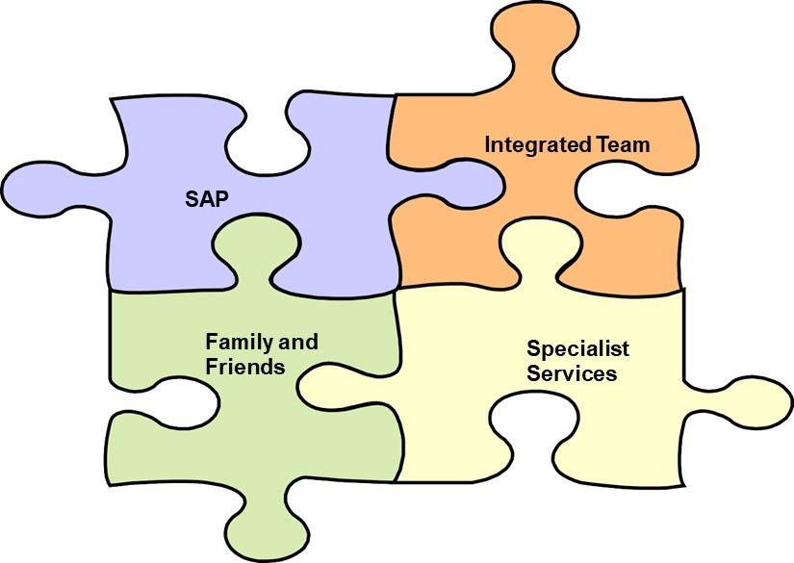
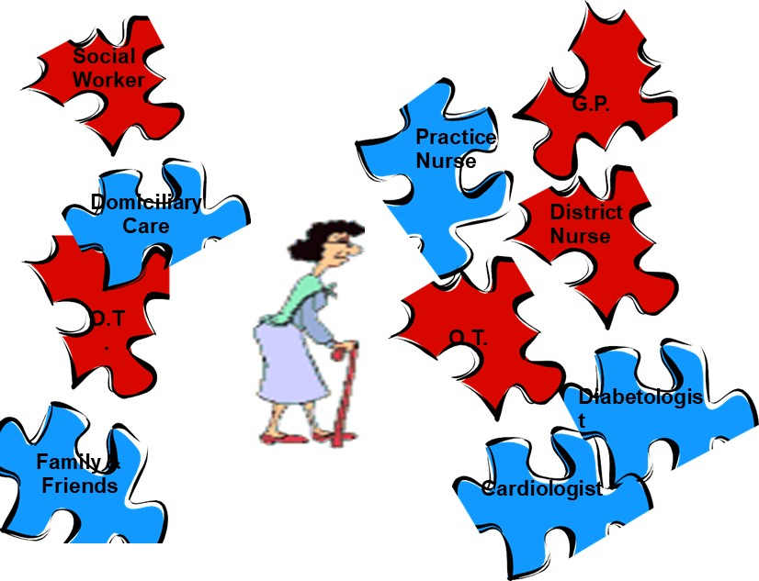
Our GMS Journey
1972: GMS contract introduced
1989: GMS Amendment
GMS contract established based upon a fee-per-consultation fee structure
2005: GP VC introduced
GMS contract amended to a capitation-based model
2014: Framework Agreement
GP Visit Cards introduced following Government’s policy commitment
2015: Under 6s
Framework Agreement 2014 (& subsequently updated in 2017)
2019: GP Agreement
Government’s policy commitment to extend free GP care to all children aged under 6 years.
2023: GP Agreement
GMS contract Agreement completed with Service developments and modernisation and reform measures introduced
Expansion to Under 8s & median income households
Rural / Urban GP deprivation support
Integrated Care – ‘right service, right time , right place, right team’
4

Slide 5
Looking to the Future
The Strategic Review provides opportunities look at what we’re doing and to learn from international best practice as we move towards integrated care models in line with Sláintecare.
We are looking at:
GP workforce & Capacity
Practice structure, locum use & Panel size
Expanded GP team
Access to expanded community supports
Interface and integration with wider health services
eHealth – shared care record, eprescribing, Health App
Practice Premises - Amalgamation & Partnership Model
Sustainable Out of Hours model
The financial and contractual model
Patient expectations
Emerging trends - Doctor on call, large corporates, company's offering online medical supports
GP Capacity
General Practice Support Model
GP Training
2024
Strategic Review
eHealth
OOH
5

Slide 6
Panel Discussion
Pat Healy (Chair), Dr David Hanlon, Niall Redmond, Dr Madeline Ní Dhálaigh, Sandra Broderick, Dr Diarmuid Quinlan
6

Slide 7
The Chronic Disease Management Programme in General Practice (CDM)
5 September, Convention Centre Dublin
Dr Orlaith O’Reilly
Clinical Lead, CDM Programme

Slide 8
Aims of the CDM Programme
Text in Arial Bold 16 point text
Prevention of chronic disease
Comprehensive care for people with chronic disease in the community
Reduction in exacerbations of chronic conditions
Hence reduction in ED attendance and hospital admissions
8

Slide 9
CDM Programme - 3 Elements
Text in Arial Bold 16 point text
Opportunistic Case Finding (OCF) Programme
Patient attends for another reason
GP thinks they maybe high risk
GP does assessment
Prevention Programme
Programme for people at high risk of CVD/diabetes
Treatment Programme
Scheduled management of 8 selected chronic diseases
9

Slide 10
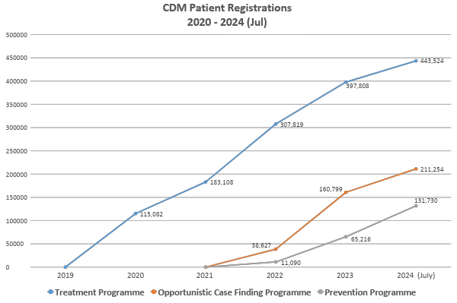
2020 – 2024 CDM Patient Registrations
Text in Arial Bold 16 point text
Uptake
95% of GPs
80% all patients
89% over 65 year olds
Cumulative patients registered on CDM Programmes
10

Slide 11
Opportunistic Case Finding Programme
Text in Arial Bold 16 point text
Patient attending GP for another reason
GP thinks they may be at risk e.g. obesity, smoker, hyperlipidaemia etc.
GP does assessment and blood tests.
Assessment Outcome
Normal – Retest in 5 years
High Risk – Enrol in
Prevention Programme
New Diagnosis – Enrol in
Treatment Programme
11

Slide 12
Prevention Programme
“At High Risk” defined as;
Qrisk ≥ 20
Pre diabetes (HbA1c – 42 – 47 mmol/mol)
NT pro BNP
(NT pro BNP ≥ 125 pg/ml)
Entry from OCF for above for 45 year olds only
Since 2024 direct entry for 18 + year olds for;
Hypertension
GDM/pre-eclamptic pregnancy since January 2023.
Text in Arial Bold 16 point text
12

Slide 13
Treatment Programme Selected Conditions
Text in Arial Bold 16 point text
Diabetes Type 11
COPD
Asthma
IHD
CVA
TIA
Heart Failure
A.Fib
13

Slide 14
Programme Elements
Treatment PGM - 2 scheduled visits per annum to Dr and Nurse
Prevention PGM - 1 scheduled visit per annum, Doctor and Nurse
Physical exam
Specific blood tests
Appropriate referrals e.g. QUIT.
Medication review if appropriate
Patient care plan
Self management support e.g. Diabetes Prevention Programme
Clinical data return
Text in Arial Bold 16 point text
14

Slide 15
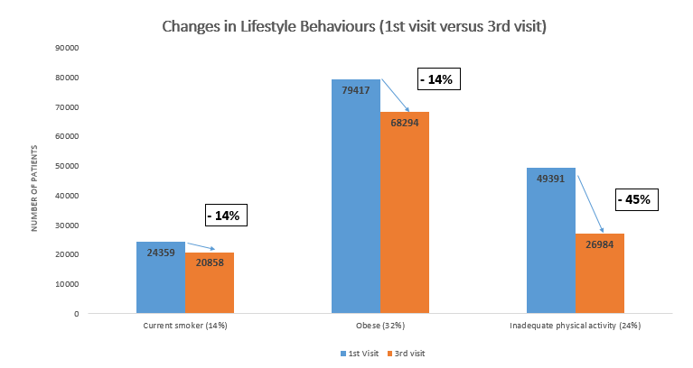
Lifestyle Outcomes
Text in Arial Bold 16 point text
N = 210,000
15

Slide 16
Clinical Outcomes
Text in Arial Bold 16 point text
N = 210,000
16

Slide 17
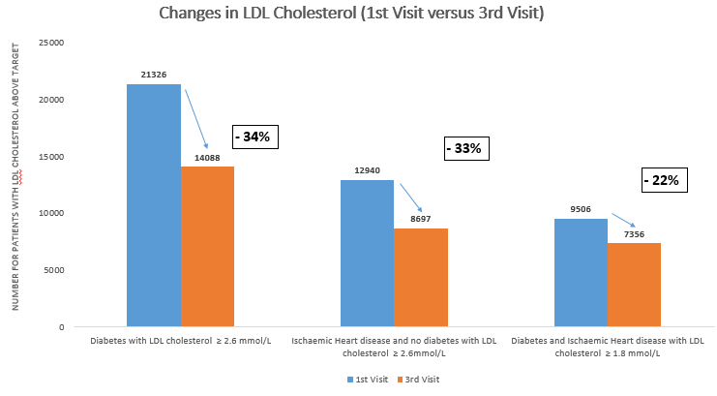
Clinical Outcomes
Text in Arial Bold 16 point text
N = 210,000
17

Slide 18
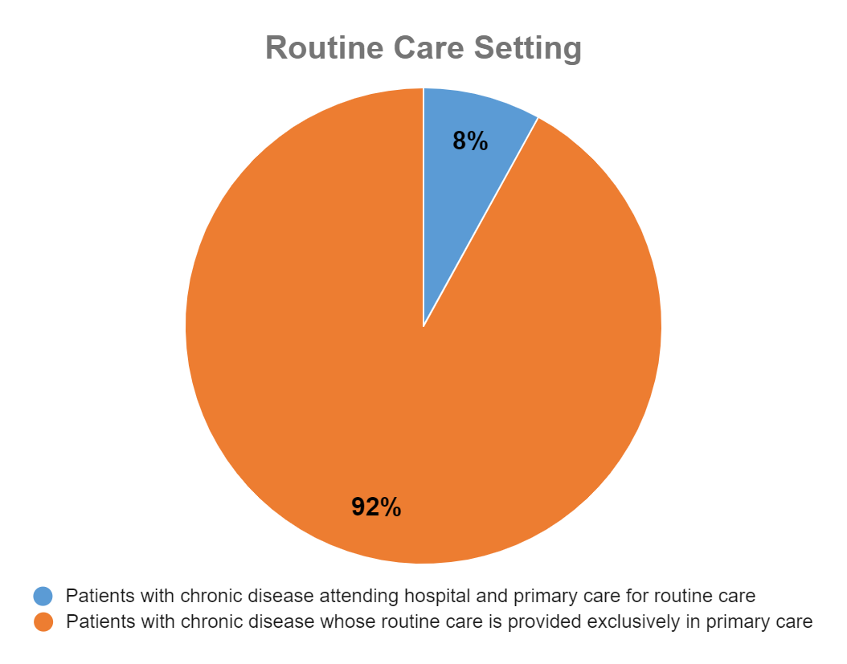
Service Impact – Care Close to Home
Text in Arial Bold 16 point text
18

Slide 19
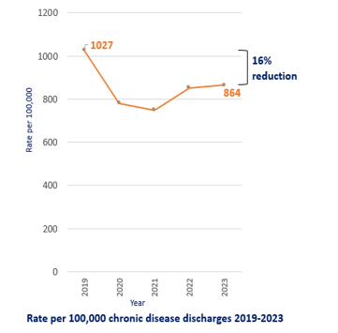
Impact on Hospitalisation – Shift Left Chronic Disease Admissions
Text in Arial Bold 16 point text
HIPE Data
Dramatic reduction in all non-covid hospital admissions in 2020
Rate for all medical discharges is now back at pre-covid level, rate for CD discharges has stabilised at a lower level (16% reduction)
ICGP Audit 2019 Vs 2023
30% reduction in ED
26% reduction in admissions
33% reduction in GP OOH
19

Slide 20
Opportunistic Case Finding Results
Text in Arial Bold 16 point text
Report released today
198,972 patients assessed since January 2022
60.4% positive pick up rate
6331 patients newly diagnosed with chronic disease
105569, patients found at high risk and enrolled in Prevention Programme
Link to 1st OCF Report
https://about.hse.ie/publications/opportunistic-case-finding-programme
20

Slide 21
Newly Diagnosed Conditions
Text in Arial Bold 16 point text
Diabetes Type 2 – 42%
IHD – 29%
A. Fib – 13%
CVD – 9%
Heart Failure – 7%
21

Slide 22
Chronic Kidney Disease (CKD)
Text in Arial Bold 16 point text
26,334 newly identified patients with stage 3 CKD
1,917 newly identified patients with stage 4/5 CKD
No CKD Treatment Programme as of yet.
22

Slide 23
Scope for Prevention and Shift Left
Patient Numbers Attending Medical Services Annually
Text in Arial Bold 16 point text
ADM 0.6
ED 1.5 m
OPD 3.5 m
GP 29 m
23

Slide 24
CDM Expansion Proposals 2025
Include the following 5 high risk conditions:
CKD
Peripheral Vascular Disease
Valvular Heart Disease
Familial Hypercholesterolemia
Extend Prevention Programme to 18 – 44 year olds
Level 2
Approximately 120,000 very high risk patients above
Include women with GDM / pre-eclamptic pregnancies for last 5 years (most at risk).
Text in Arial Bold 16 point text
24

Slide 25
Thank You
Over to you…
25

Slide 26
Service User Experience
Liam Griffin
26

