Slide 1
Urgent & Emergency Care (UEC)
5 September, Convention Centre Dublin
1

Slide 2
University Hospital Waterford
Our Unscheduled Care Story, 2019 to Present
Dr Michael O’Connor
Consultant Geriatrician,
National Clinical Advisor Acute Operations
2

Slide 3
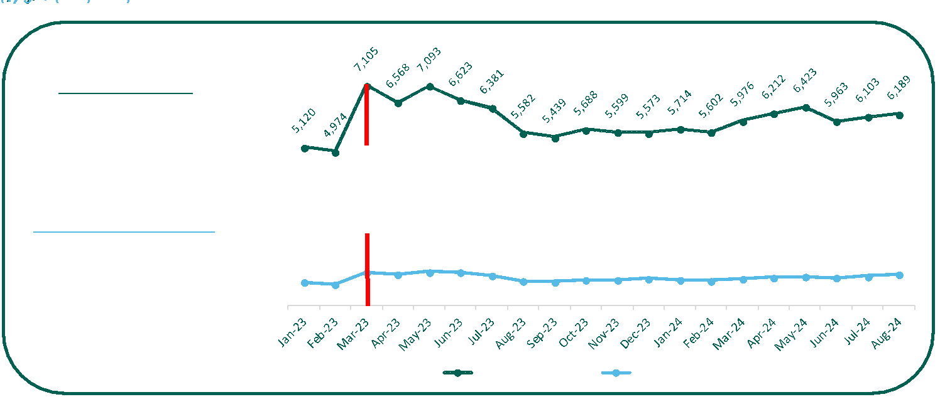
ED Attendances
3

Slide 4
Changing Age Profiles in ED Attendances
in ED attendances ≥75 years YTD compared to 2019
40%
in ED attendances 0-15 years YTD compared to 2019
43%
4

Slide 5
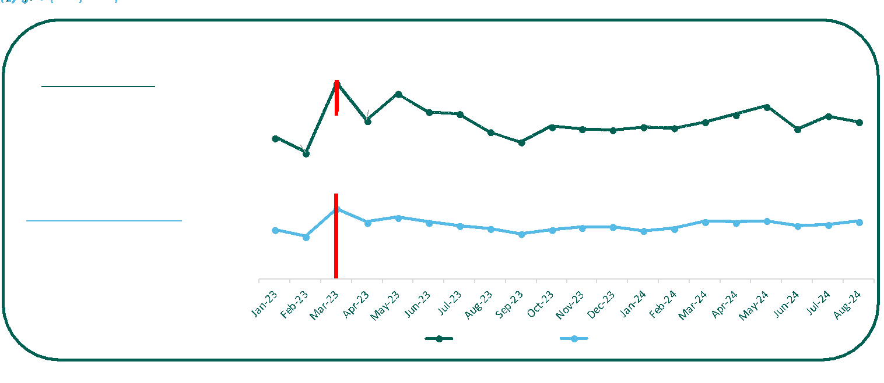
ED Admissions
5

Slide 6
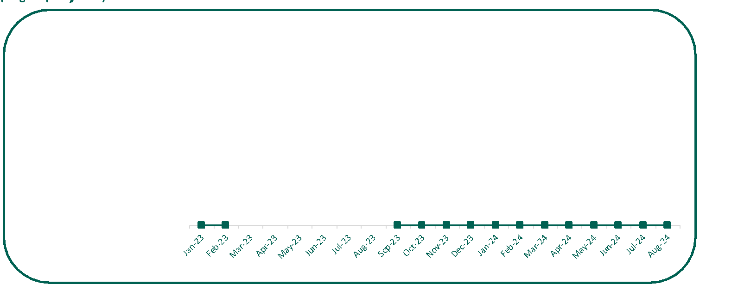
8am TrolleyGAR
6

Slide 7
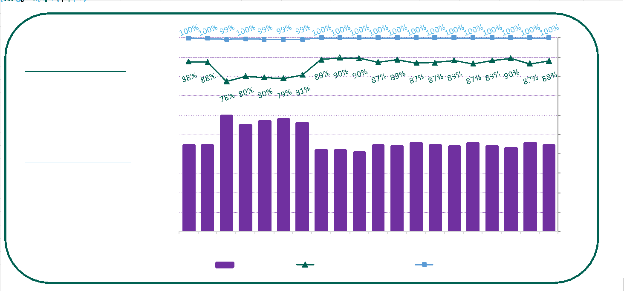
PET Compliance
7

Slide 8
Daily Management of Flow
8

Slide 9
Our Morning Status
10am – ED Status
Current Inpatients
Currently 36 patients in ED
2 patients being reviewed for potential admission
TrolleyGAR = 0
Currently +56 patients
+8 in-house
+34 contracted offsite beds
+14 UPMC
175 patients ≥75 years with aLOS of 13.9 days
25 COVID Positives
12 DToC patients
29 predicted discharges today
ED activity yesterday
226 arrivals yesterday (193 adults; 33 paediatrics)
47 adults admissions (21% conversion rate)
9 hour PET compliance = 88%
Admissions overnight = 24
9

Slide 10
The “Push & Pull” in UHW
Senior Manager assigned to “beds” daily
Know the house - a plan for every patient
Streaming of patients at ED level
Weekly DToC & >7days LOS meetings
Assigned ADoN for Patient Flow
‘Beds’ huddles throughout the day
Manage IP&C and Diagnostics
Use of all capacity ………. PUSH!
Transport to support discharges
Maximise use of CIT, Home First and OPAT
10

Slide 11
Daily Status Reports
11

Slide 12
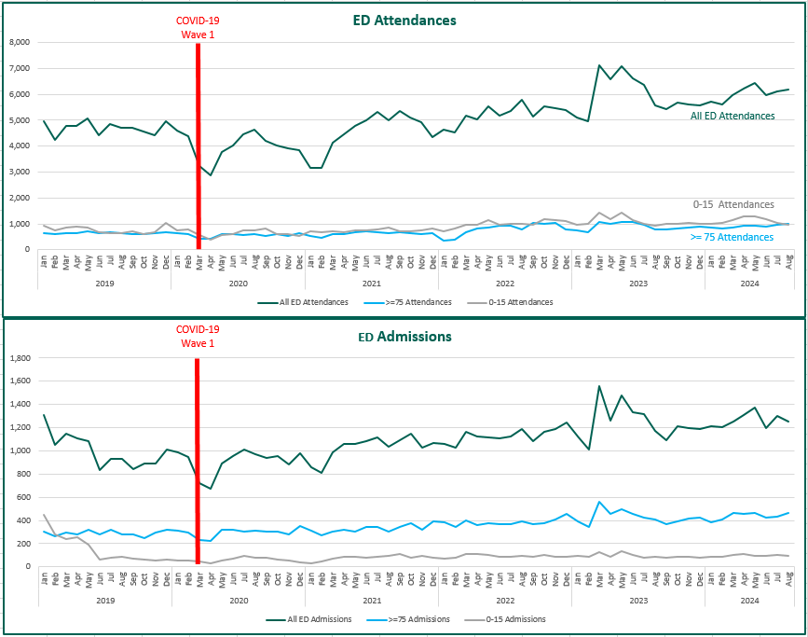
COVID - Our Trigger for Change
Initial fall in demand due to COVID-19 was not sustained and current demand has surpassed 2019 levels
YTD ED Attendances ↑27% (n=10,355)
YTD ED Admissions ↑20% (n=1,703)
12

Slide 13
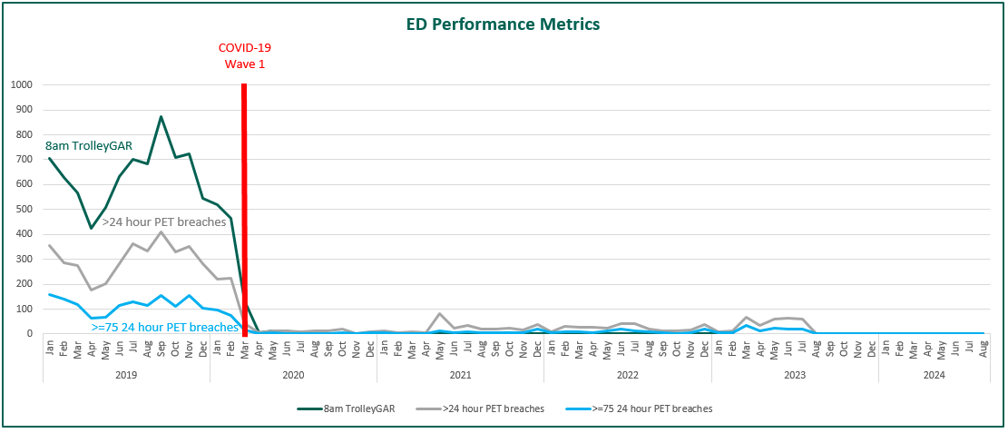
COVID - Our Trigger for Change
Despite continued demand, the improvements introduced for COVID-19 have been sustained – the new standard!
13

Slide 14
“The ability to deliver timely care in emergency departments requires a whole system approach to service improvement”
HIQA Overview Report: Monitoring Programme Against the National Standards in Emergency Departments in 2022
14

Slide 15
The Six Cs
Capacity
Culture
Control
Commitment
Communication
Capability
15

Slide 16
Groundhog Day…Again
16

Slide 17
Panel Discussion: Urgent and Emergency Care
MC: Dr Michael O’Connor
Panellists: Tony Canavan, Ian Carter, Dr Emer Ahern, Dr Anthony Cullen
17

Slide 18
Questions
What is happening to demand?
What is happening with Older Population?
What is happening in Primary Care?
What is evidence for Harm?
Re-design?
18

Slide 19
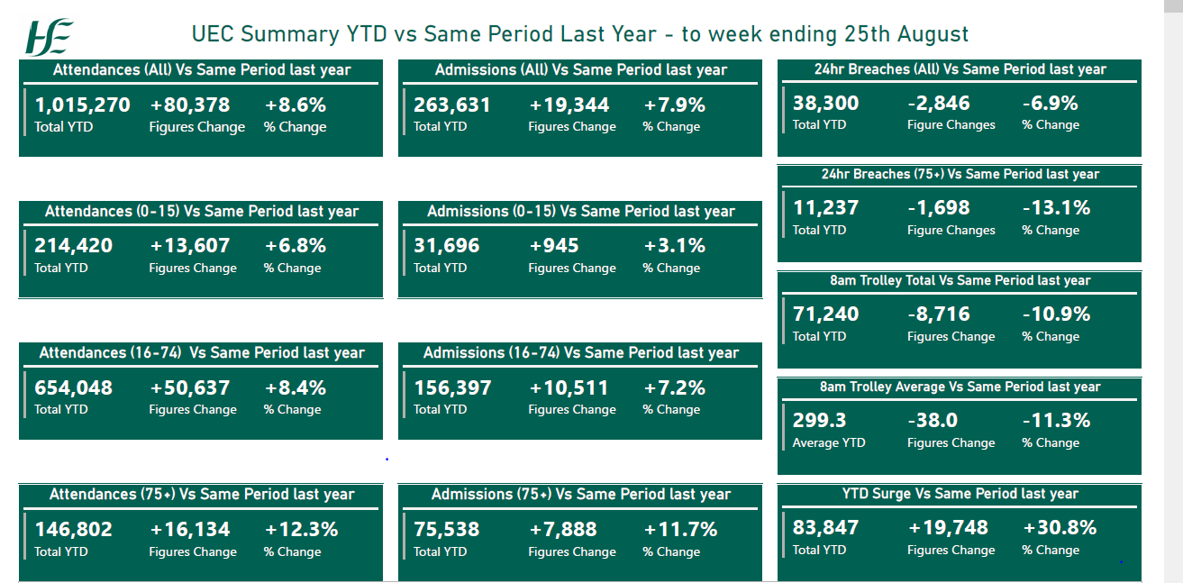
UEC Summary YTD vs Same Period Last Year
To week ending 25th August
19

Slide 20
Questions
What is happening to demand?
What is happening with Older Population?
What is happening in Primary Care?
What is evidence for Harm?
Re-design ?
20

Slide 21
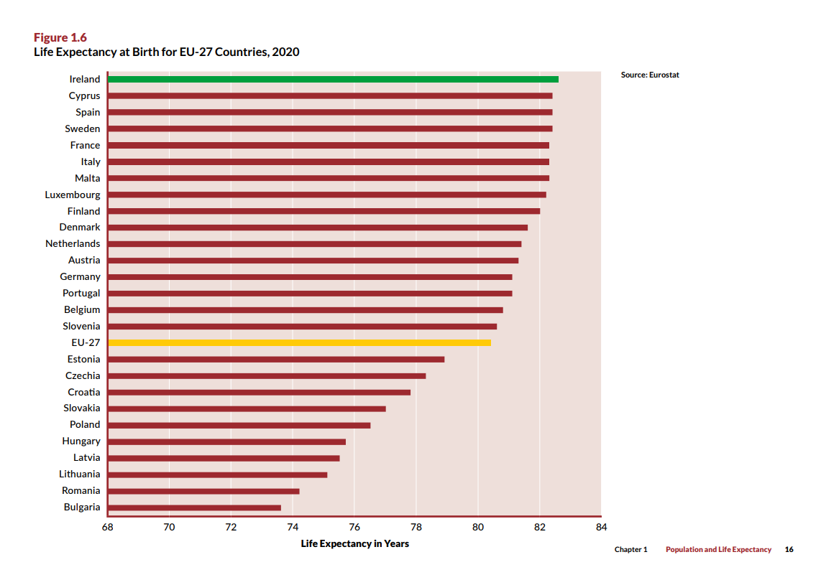
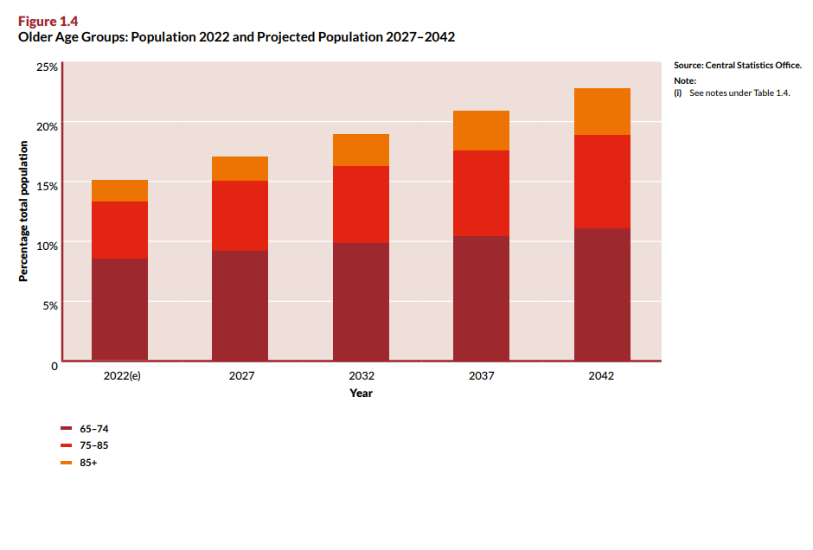
The Need for Change: Demographic Advances
21

Slide 22
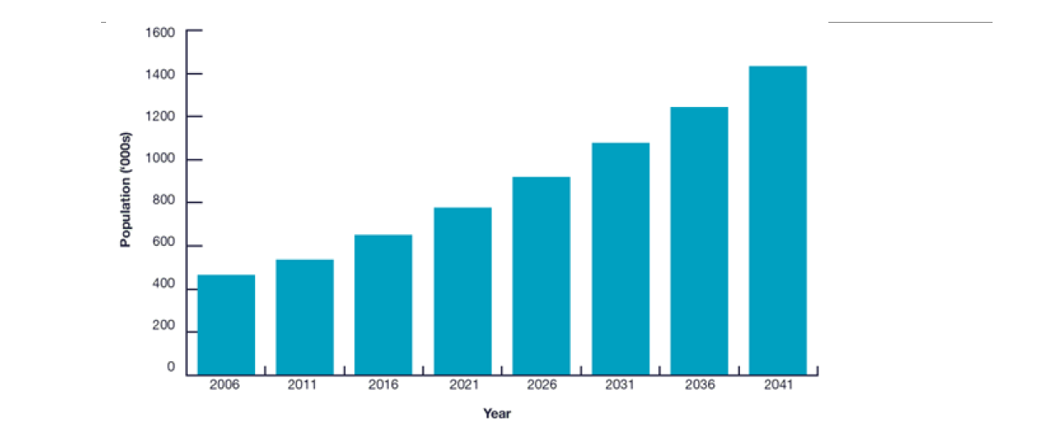
Project Population >65 Ireland
2006 - 2041
22

Slide 23
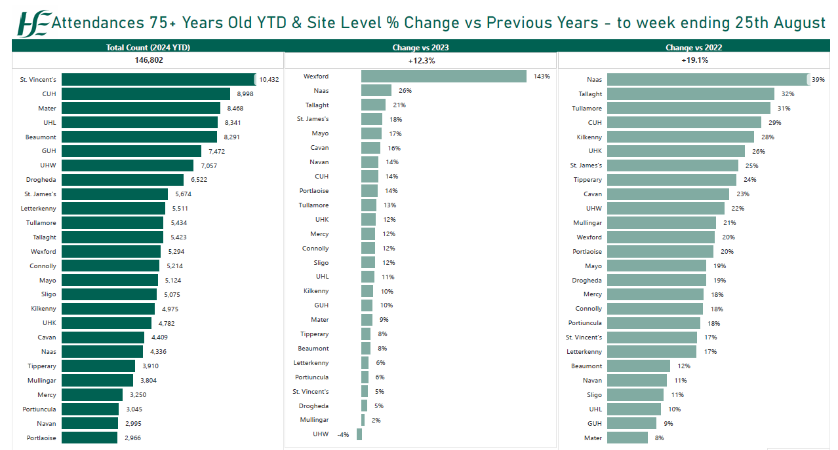
Attendances 75+ Years Old YTD & Site Level % Change vs Previous Years
To week ending 25th August
23

Slide 24
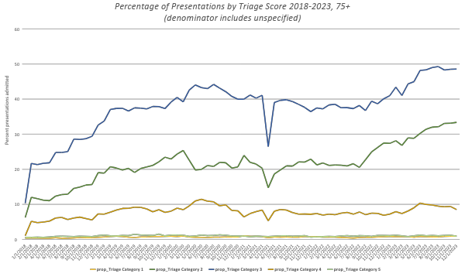
% of Presentations by Triage Score 2018 - 2023, 75+
24

Slide 25
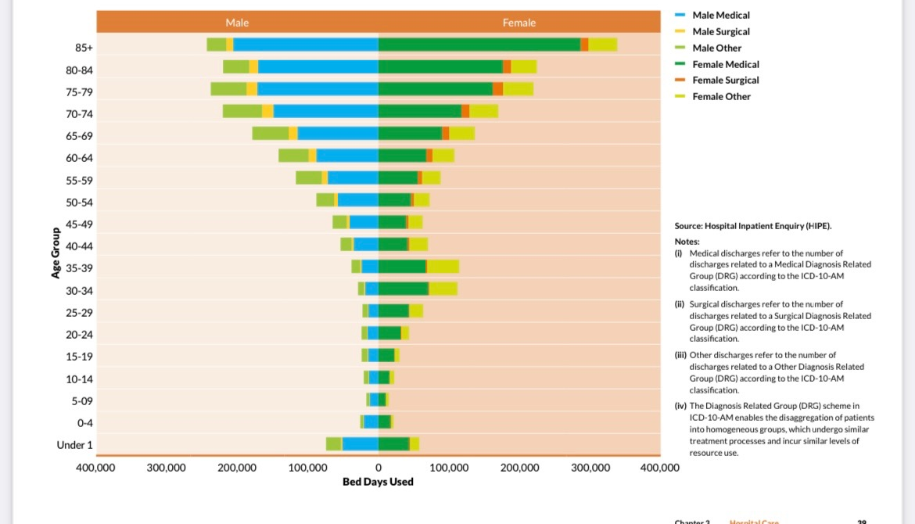
Public Hospital Bed Days Used by Type of Care, Age Group and Gender, 2022
25

Slide 26
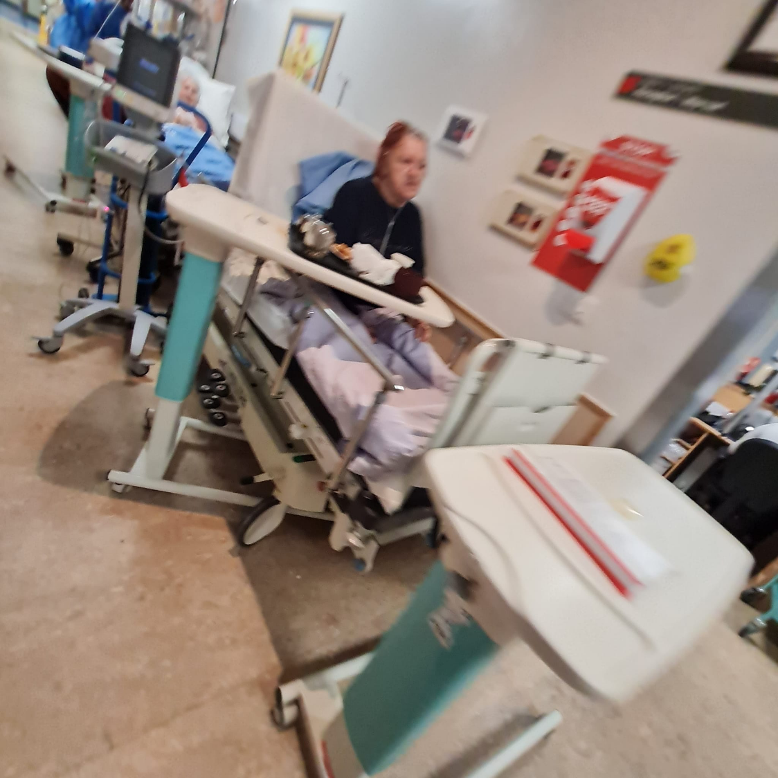
Accessing the Wrong Care, Waiting for the Right Care & Ageism
Longest LoS in ED
Longest LoS in hospital 13 days
30% get sicker in hospital
Delayed Transfers of Care
Higher institutionalisation rate
Higher mortality rate
Higher readmission rate
26

Slide 27
Health System Design
Not for older adults…
Because older adults are not simply people who are just older: they are a cohort with different & age-specific needs:
They present differently when sick
Their bodies, minds and personalities react differently when sick
They need bespoke assessments & treatments to get better
Thy can be harmed by medications & treatments given to make them better
They needs staff who are skilled to recognise these differences
They need age-friendly environments to ensure dignity & reduce harm
They need their families
They need time & access to rehabilitation to recover
27

Slide 28
Service Design
If we design services for people with only one thing wrong at once but people with many things wrong turn up, the fault is not with the users but with the service, yet all too often these patients are labelled as inappropriate and presented as a problem…
Prof Ken Rockwood
28

Slide 29
Population Projections and Healthcare Utilisation
HSE National Clinical Advisor for Acute Operations 2023
29

Slide 30
Questions
What is happening to demand?
What is happening with Older Population?
What is happening in Primary Care?
What is evidence for Harm?
Re-design ?
30

Slide 31
Model 4 Cork University Hospital GP Referrals
To Emergency Department Per Day by Age group
All Ages
>75yrs
31

Slide 32
Questions
What is happening to demand?
What is happening with Older Population?
What is happening in Primary Care?
What is evidence for Harm?
Re-design ?
32

Slide 33
The Need for Change: Voice of Patients
(National Inpatient Experience Survey 2022)
.
Even though older adults value, trust and believe in the healthcare system and its services, there are many poor experiences older adults continue to face
Emergency Department
Stay on the wards
Discharge
72% of patients were given enough privacy when being examined or treated in the ED
57% of patients got answers they could understand from doctors and nurses in the ED
29% of patients were admitted to a ward in less than 6 hours
30% of patients waited over 12 hours for admission to a ward
30% of patients could find someone to talk about their worries and fears
47% of patients got help from staff in time to get to the bathroom or toilet
62% of patients had enough time to discuss their care or treatment with a doctor
60% of patients felt they were involved in decisions about their discharge
37% of patients got information about medication side effects going home
36% of families got all the information needed to help care for patients at home
“Very frightening place”
“Noise levels were very bad and the food was awful”
“I was waiting all day to be told if I was going home“
“I was left on my own from 9am to 9pm not knowing whether I was going to be discharged or not”
“More privacy is needed. I did not like sharing a ward with men”
“Sent me to respite and had to re-admit me a day later”
https://www.hse.ie/eng/about/who/acute-hospitals-division/national-patient-experience-survey/
33

Slide 34
Effect of hours awaiting admission on and ED Trolley on SMR
Cross-sectional, retrospective observational study
Every ED in England April 2016 to March 2018. The primary outcome was death
from all causes within 30 days of admission.
7,472,480 patients admitted relating to 5,249,891 patients
Statistically significant linear increase in mortality from 5 hours after time of arrival
at the ED up to 12 hours (when accurate data collection ceased) (p<0.001)
For every 82 admitted patients whose time to inpatient bed transfer is delayed
beyond 6 to 8 hours from time of arrival at the ED, there is one extra death.
34

Slide 35
Questions
What is happening to demand?
What is happening with Older Population?
What is happening in Primary Care?
What is evidence for Harm?
Re-design?
35

Slide 36
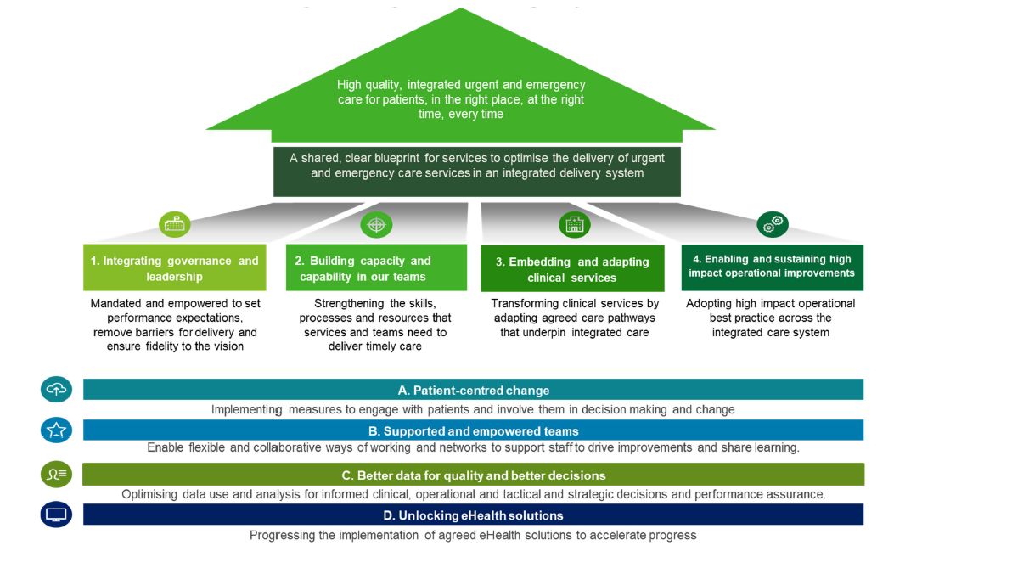
Integrated Urgent and Emergency Care Framework
36

Slide 37
Urgent & Emergency Care (UEC)
5 September, Convention Centre Dublin
IAN CARTER
RCSI Hospital Chief Executive Officer
37

Slide 38
Urgent and Emergency Care for Older Adults
Older Adult Intensive Case Management (OAICM)
Proactive identification, assessment, optimisation & care planning (Comprehensive Geriatric Assessment)
Single point of contact Service and Care coordination
Integrated, early supported discharge
4Ms Framework – designing an Irish Age Friendly Health System
Specialist Geriatric Medicine Ward
4Ms
OAICM
Discharge & ‘Home First’ Principles
Population Health Approach and Prevention
GP/CHN/PC
NAS
CIT
CST OP
Residential Care
OAICM
4Ms
ED/Acute Floor
Screening to identify Older adults @ risk
Early Access to GM & CGA
OAICM
4Ms
Acute episode complete
OAICM
4Ms
Mrs. O’Neill (79)
Diabetes, Heart Failure & Arthritis
Widow
Hospital Wide
Older Adult Intensive Case Management
4Ms
OAICM
Rehabilitation
Ambulatory and residential
OAICM
4Ms
Residential Care (<3%)
OAICM
4Ms
Home
OAICM
4Ms
Early access to specialist in-patient care
Measure: 1) Specialist care - % of older adults @ risk cared for on specialist ward; 2) Hospital wide care - % of older adults @ risk intensively case managed; 3) % of older adults @risk on older adult care bundle based on 4Ms that @ minimum manage Delirium, Deconditioning and Drugs; 4) % of older adults with excessive polypharmacy with med rec.
Early access to GM specialty
Measure: 1) CGA for older adults at risk within 1 hour of arrival; 2) Conversion rate; 3) Trolleys To 0
3
1
2
4
Standards
Early identification of older adults at risk
Measure: Screening for older adults at risk CHN and (ED/ Acute Floor Triage)
Home First and early discharge planning
Measure: 1) Length of Stay; 2) % Home; 3) % Rehab; 4) < 3% LTC
38

Slide 39
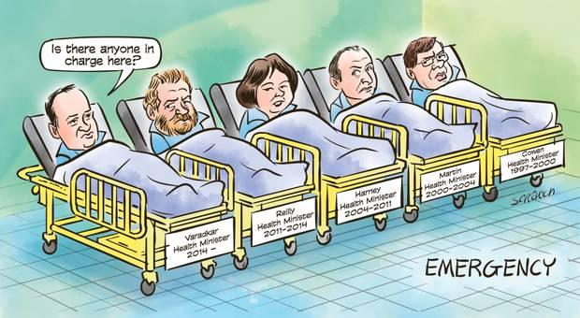
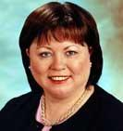
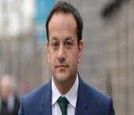
Emergency Access
Emergency Access
“We have been ringing the alarm on this situation for far too long”
Harris
Health Minister
2016 - 2020
Donnelly
Health Minister
2020 -
1997 - 2022
“Angola”
“never see again (569) people on trolleys”
“we have to learn from the mistakes from the past”
“A&E Crisis - a national emergency”
“no reason to believe it won’t be worse than last year… head or heads will need to roll”
“upset and
frustrated”
-
39
39

Slide 40
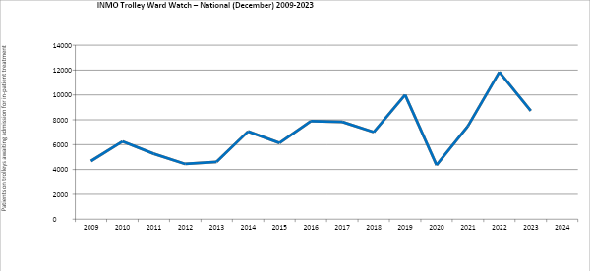
Unscheduled Care Access 2009 – 2024 – Snapshot (National)
_________________________________________________________________________________________________________
Unscheduled Care Access 2009 – 2024 – Snapshot (National)
?
2009 v 2024
National
107% increase
40

Slide 41
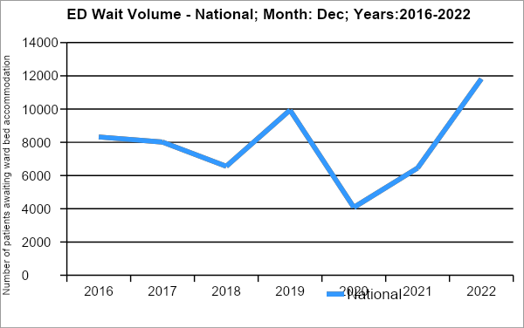
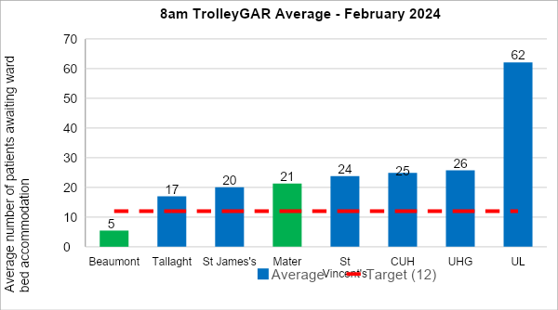
Access - Unscheduled Care (ED) Wait Volume / Wait Time
42% increase 2022 .v. 2016 (n=3,500)
1 achieving target
Observations made:
the need for “further concerted effort by hospital management….to ensure tolerance of (continuing) poor performance does not persist” (HIQA 2023)
poor ED wait times / volumes are persistent and introduced interventions would appear to be largely ineffective (DOH: Clancy et al 2023)
from a patient’s perspective, this is neither Compassionate or Competent
41

Slide 42
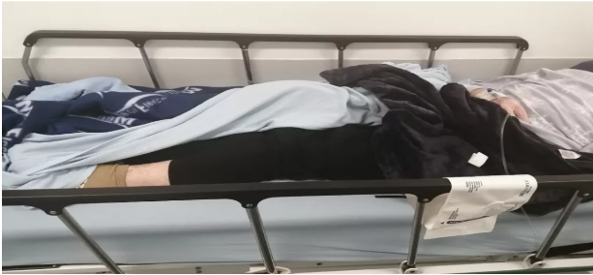
Unscheduled Care - Vignettes of Patient Experience
42

Slide 43
Context
Context - change factors (to be managed) to effect performance / quality improvement
- 4 “C”s - with obvious overlap
CLINICAL PERFORMANCE
CAPABILITY
CULTURE
CAPACITY
CONTROL
CLINICAL
QUALITY
Focus - today
Key outcomes desired
Key actions required
RCSI HG
NATIONAL
BUDGET
43

Slide 44
Panel Discussion
Dr Michael O’Connor (Chair), Tony Canavan (REO), Ian Carter (RCSI HG), Dr Emer Ahern (NCAGL, Older People), Dr Anthony Cullen (University Hospital Waterford)
44

Slide 45
Case Study: Mobile Medical
45

Slide 46
Closing Remarks
Dr Michael O’Connor
46

