Slide 1
The Enhanced Community Care Model
The foundation of local, integrated care
5 September, Convention Centre Dublin
5 September, Convention Centre Dublin
Pat Healy
National Director, National Services

Slide 2
Enhanced Community Care Journey
Where We Began
Introduction is challenging for professionals - Culture Change
Journey
“Mrs O’Neill is a 79 year old widow with diabetes, heart failure and arthritis.
She wants quick responsive services from skilled health and care providers that talk to one another and have a good understanding of all her care needs.”
Strong governance & accountability
Cannot be achieved in totality in one go - must be phased
Integrated Care – Learning
Change process must be supported
Leadership
One model & approach does not fit all
Unique client identifier
Standardised processes are critical
Focus on programmes of care
Service user involvement
Integrated Care - all services work together,
centred on the needs of the person
2

Slide 3
The Enhanced Community Care (ECC) Model
Integrated Ways of Working
Enhanced Community Care
delivering local population based integrated care
Population management and care pathway management
Population Health profiling
End-to-end pathways of care
Managing populations of ~50k through Community Healthcare Networks
Managing at risk populations of ~150k (3 CHNs) through Integrated Care Programme for Chronic Disease and Integrated Care Programme for Older People specialist teams
Care closer to home as possible
Outpatient Dept / Inpatient Impact
Performance metrics and activity tracked across pathways
Community Healthcare Networks
Therapies
Nursing
Integrating Care
Community Intervention Teams
Integrated Care Programme for Older People
Referral Activity
Specialist Pathways Activity
Referral Source
Casemix
Integrated Care Programme for Chronic Disease
Cardiology
Diabetes
Respiratory
Shift to the left of Resources & Activity
Integrated Multidisciplinary Team/s and Way of Working – Right Service, Right Place, Right Time, Right Team
General Practice
General Practitioner Lead
Community Healthcare Network Manager & Team
Chronic Disease Specialist Team Clinical Lead
& Operational Lead & Team
Older People Specialist Team Clinical Lead & Operational Lead & Team
Acute Frailty at Front Door Teams & Community Intervention Teams
Acute Emergency Dept / Outpatient Dept / Inpatients
Integrated Care Framework for Residential Care Facilities
Emergency Department in the Home (EDITH)
Pathfinder
Nursing Homes
Home Support
Underpinned and enabled by robust and effective Clinical Governance, Feedback loops to encourage learning and continuous improvement, and tracking of Performance Metrics and Activity Outcomes to demonstrate value
3

Slide 4
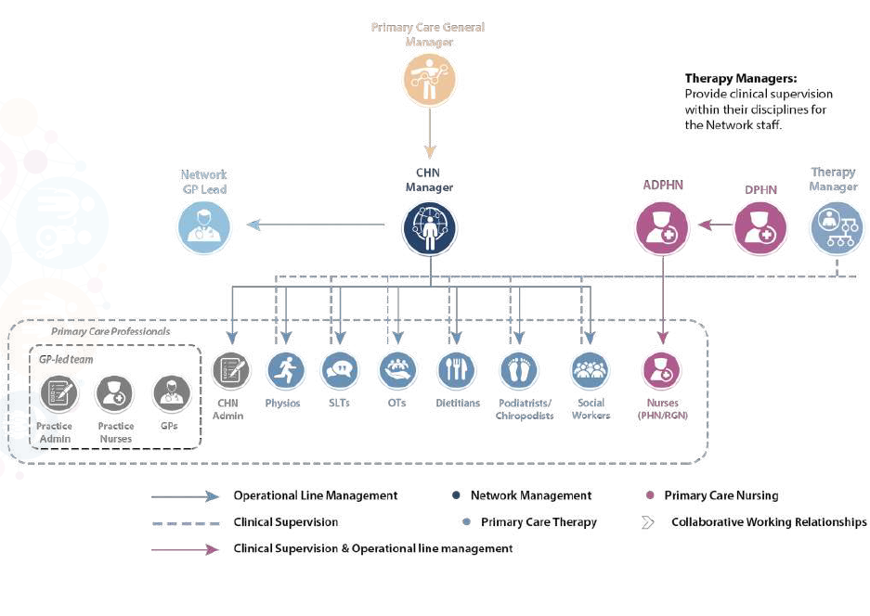
Community Healthcare Networks
96 / 96 CHNs Teams Operational supporting 50K pop on average
Simplifying access to care pathways delivered at the least level of complexity by local teams as close as possible to where people live
CHN key areas of focus are:
Local population needs assessment
Process improvement and multi-disciplinary working
Integration of services between the Network, Specialist Community Teams and Care Group services, acute hospital services and community and voluntary supports
Improved service user experience
Networks are:
Supporting people to live more independently in their community,
Coordinating and integrating services to meet our changing health needs,
Supporting collaborative working together to provide person-centred care,
Ensuring timely access to quality services nationwide,
Championing innovation and accountability.
Community Healthcare Networks are a foundational step in building a better health service to service users and staff
4

Slide 5
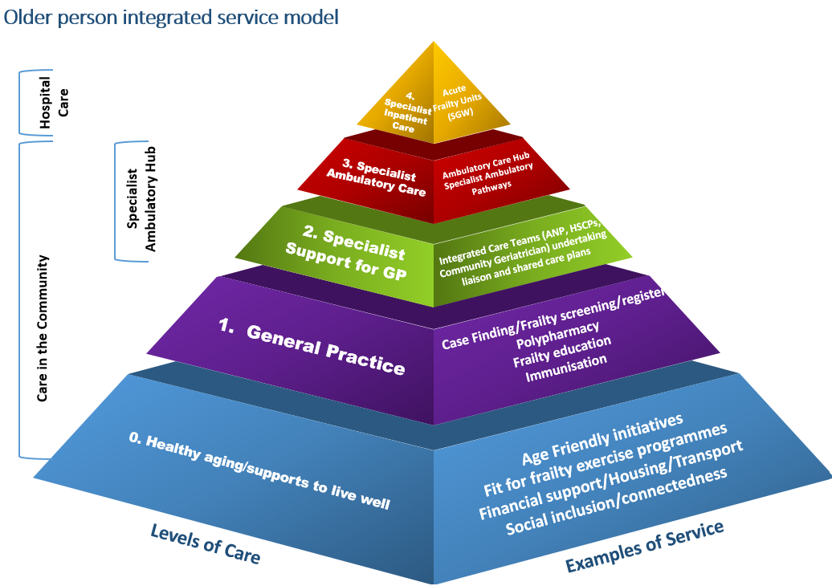
Integrated Care Programme for Older People (ICPOP)
What has been delivered?
27/30 ICPOP teams operational
68% Clinical Frailty score 5-9 (target 55%)
142k Patient contact target 2024, 45% on 2023 outturn of 98k
76k patient contacts Jan-July ‘24, 58% on ‘23
9,552 GP Healthlink referrals accepted Jan-July ‘24
79% discharged home with only 6% admitted to acute hospitals
10% reviewed same day/ next day of referral (target 10%)
5

Slide 6
Integrated Care Programme for Chronic Disease (ICPCD)
What has been delivered?
26/30 Teams Operational
95% GPs have signed up to CDM Programme
92% patients with CD have their care provided in General Practice
320k patient reviews in General Practice
229k Patient contact target 2024 51% on 2023 outturn of 150k
197k patient contacts Jan – July ’24
180% on 2023
16% reduction in CD hospital admissions across 2019 – 2023 v 3.5% for all medical admissions
30 day & 90 day readmission rates per 100k population for CD reduced by 24% & 23% respectively v 5% & 7% for all medical re-admissions
6

Slide 7
Voluntary Supports and the ECC Model - ALONE
Local community and voluntary involvement is crucial to the ECC Model. These supports link with formal and informal carer supports through the voluntary and statutory sectors, providing an invaluable role as “community connectors”. The identification of voluntary supports in the ECC Business Case is testament to their integral contribution to the ongoing implementation and development of the ECC Model.
The HSE has partnered with ALONE as part of the roll-out of the ECC Programme, in-line with Sláintecare. The focus of the Programme is to develop an integrated model to deliver quality-approved support coordination, visitation support and befriending driven by assistive technology.
124 WTE ALONE Staff
have been funded through ECC and are now in place, including:
88 WTE Support coordinators
8 Telephone Support and Befriending coordinators
6 WTE Service Managers
15 WTE Volunteer support coordinators
5 WTE Technical Engagement Officers
5 WTE ICT / Analytics / R&D and Evaluation resources
ALONE and the ECC Model:
ALONE’s support coordination builds the capacity of community services in collaboration with the Community Healthcare Networks to coordinate access to all services including social care, health, local and government services facilitating an integrated system enabled by information and technological supports. ALONE currently supports over 71 services and organisations nationally. Further to this, Telephone Support and Befriending Coordinators have a presence in each CHO Hub.
7

Slide 8
Enhanced Community Care
What has worked well?
Organisation & Team Development
CHNs & ECC Model provide foundation for integrated care pathways - Pathfinder for how shift left can happen
Population Need & Stratification Approach driving more local decision making and involvement
Aligning ECC and UEC approach focusing on hospital avoidance and early supported discharge
Shifting focus from unidisciplinary to multidisciplinary team working
Buy-in and impact of digital innovation - particularly GP Healthlink referrals, Area Finder, piloting use of Apps & local eagerness to progress interim ICT
Leadership & Change
Strong support from senior political, DoH and HSE Board
Comprehensive communication plan – national & local building momentum
National programmatic approach with strong clinical leadership in design, development and oversight
Increased local clinical and management leadership, taking ownership of implementation within agreed national frameworks
Leadership development programme being rolled out to support Regions – 2 ECC Regional Teams in 2023, 4 ECC Regional Teams in 2024
CHNs and ECC have been the foundation for the HSE Health Regions and the Shift Left
8

Slide 9
Enhanced Community Care
Empowering People and Improving Experience as we build consistent system-wide performance
Organisation & Team Development
Governance process is key - where implemented, model flourished
Empowering GPs, CHNs, CSTs and population pathways across Community & Acute – Shifting to the Left
Leverage ECC in IHA development, driving Primary to Secondary Care interface
2024 Consolidation
Focus on productivity & impact with the resources available to deliver agreed activity and outcomes in 2024
Supporting shift from unidisciplinary to multidisciplinary and tech enabled ways of working - constant focus
Regional communication and engagement plan supported by national team
Leadership & Change
RHA leadership & ownership key with support & challenge driving consistent system-wide performance
Through Affinity to the Model
Agreed activity, impact and outcomes will be delivered
Local innovation consistent with the Model will continue (80/20 rule)
Local clinical and management leadership will be built
National and clinical team support and guidance will maintain consistent performance and best practice
Sustaining the Change
Culture is key
Working better together - making this real
Supporting our local communities at the core of everything we do
9

Slide 10
Panel Discussion:
Impact and Outcomes of the ECC Model across CHNs, ICPOP & ICPCD
Sean O’Rourke (Chair), Pat Healy, Dr Sarah O’Brien, Dr David Hanlon, Dr Emer Ahern and Martina Queally
10

Slide 11
Case Study:
Community Specialist Team Chronic Disease, Cuan Aoibheann
Johanna Callaghan (ANP), Barbara Parlon (ANP)
11

Slide 12
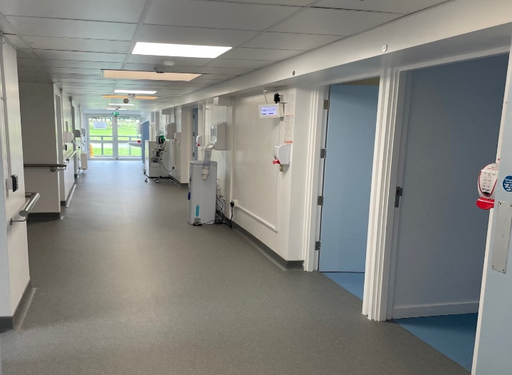
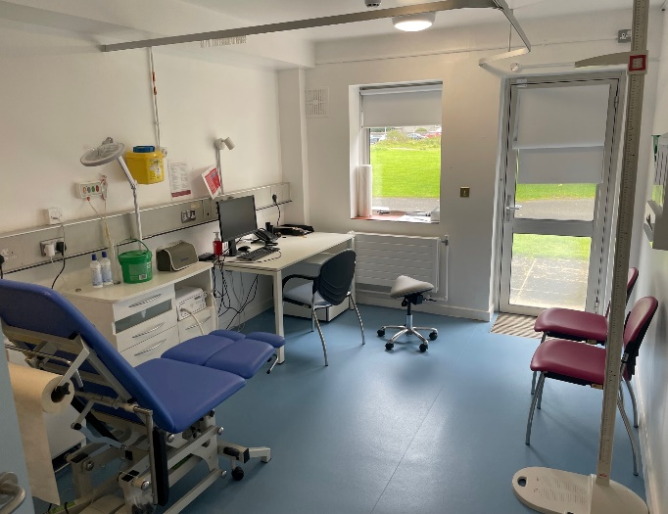
Dublin North West Integrated Care Centre
Cuan Aoibheann in the Phoenix Park
12

Slide 13
Respiratory Team Evolution
Dec 2022 - Clinics in Cuan Aoibheann
2023 - MDT Clinics
- In person PR Classes
- Satellite clinic in PCC
- Diagnostics Lab
Service Expansion
Integrated Care
RIC pre ECC
Apr 2023 - Integrated Cardiopulmonary
Specialist Clinic
Pre-hab Talk introduction
Physio Clinic - Breathlessness management /Dysfunctional Breathing/Oxygen Assessment Clinic
Complex COPD MDT
2016 – CNSp demonstrator post
2021 - Virtual PR
2022 - cANP/ Consultant clinic
- & Integrated Physio in PCC
13

Slide 14
Respiratory Service Overview
Consultant led clinics
Nurse led clinics
Physio led clinics
Episodic care
Letter to GP with consultation outcome
Follow up if required
Discharged if optimised
Comprehensive assessment and treatment optimisation
Inhaler technique review & adherence assessment
Self-management plan
Airway clearance & Breathlessness management
Breathing retraining
Oxygen assessment and review (ambulatory only)
Signposted to Smoking cessation & Living Well programmes
Further investigations as required
(with access to acute hospital resources)
14

Slide 15
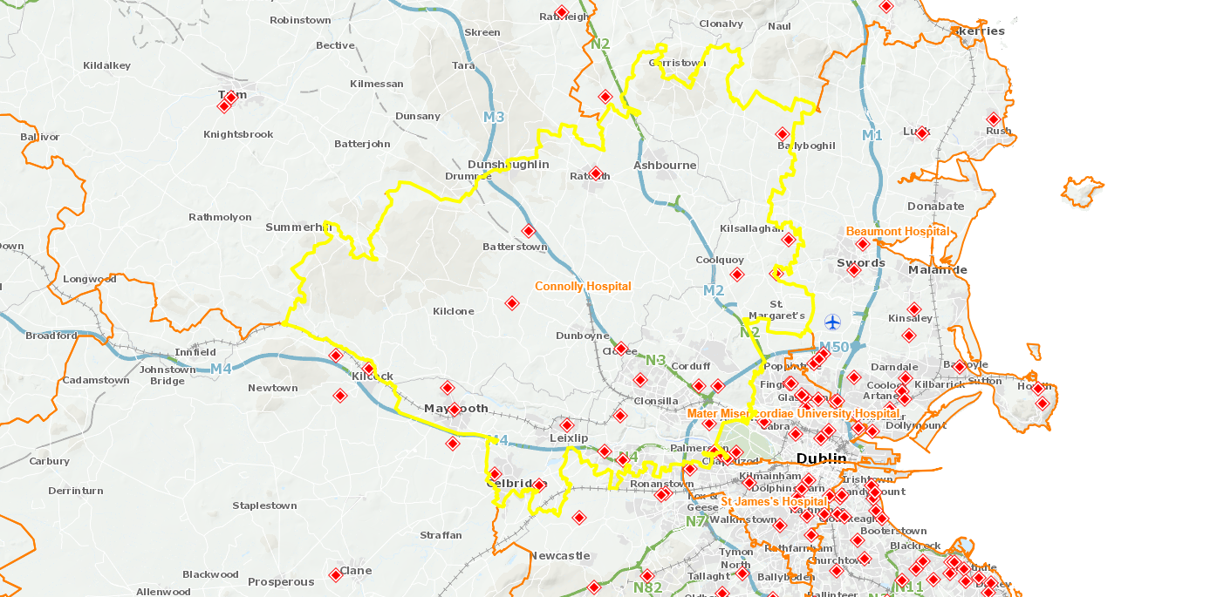
Connolly Hospital OPD Activity
Population over 330,000
West Dublin
North Kildare
South County Meath
Reduced hospital waiting times
13 months to 7 months
(along with NTPF initiative)
10% redirected patients seen ~ 3 months, investigated & optimized
OPD Activity |  | New | Returns | Total
2019 |  | 736 | 3436 | 4172
2020 | In Person | 860 | 1987 | 4468
 | Virtual | 292 | 1329
2021 | In Person | 1503 | 1556 | 5140
 | Virtual | 361 | 1720
2022 | In Person | 1530 | 2479 | 5782
 | Virtual | 118 | 1655
2023 (Jan-Sept) | In Person | 1283 | 2399 | 4979
 | Virtual | 30 | 1269
Source:
Scheduled Care Lead Connolly Hospital
15

Slide 16
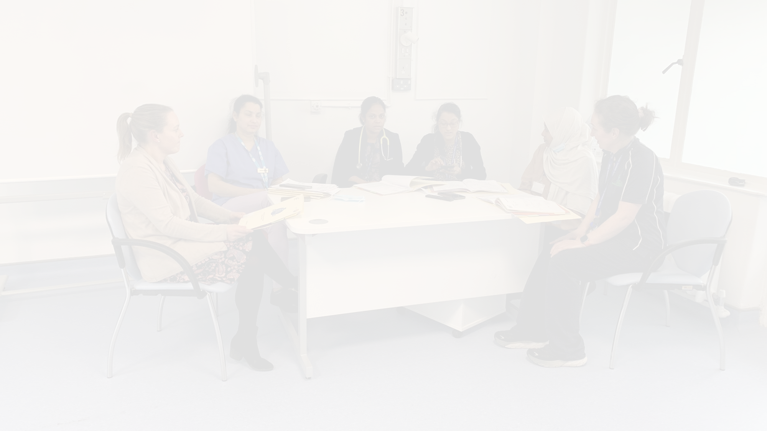
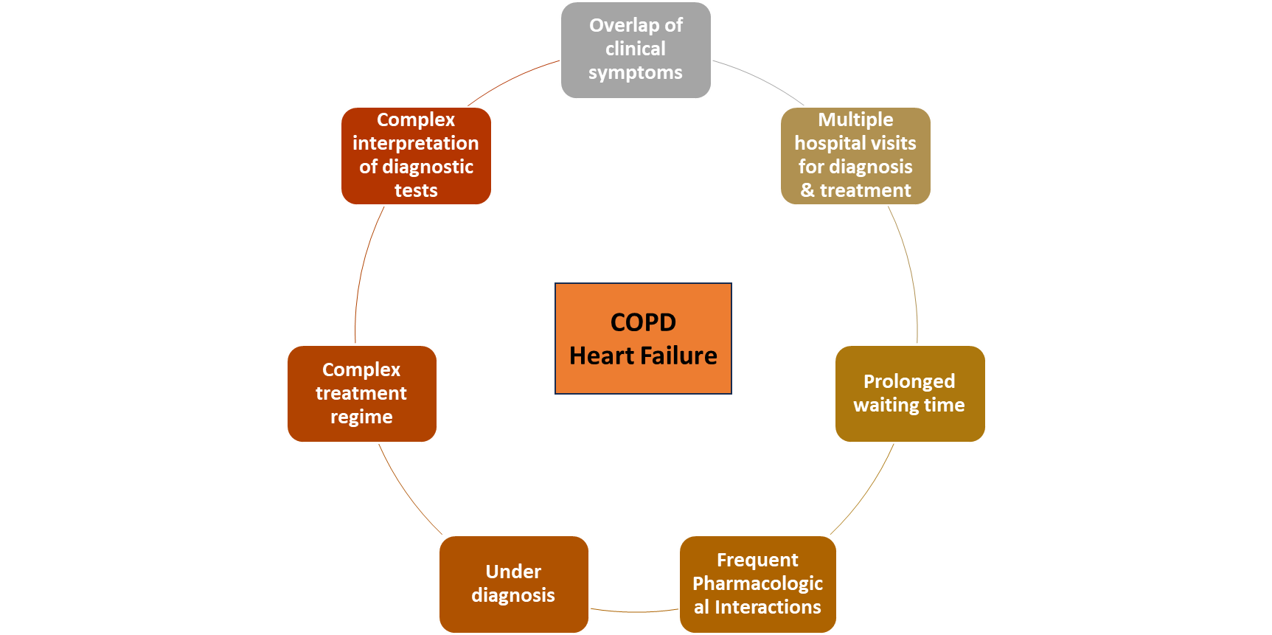
Integrated Cardiopulmonary Specialist Clinic
Diagnostics Interpretation
Palliative care integration for advanced care planning
Interdisciplinary assessment
Complex history and diagnostics
challenges
Recurrent hospitalisations
Advanced COPD and Heart Failure
Oxygen assessment if indicated
Appropriate
medication prescription
Cardiopulmonary Rehabilitation
CHALLENGES
SOLUTION
16

Slide 17
Cardiopulmonary Clinic Outcome
Timely Specialist Access
Improved Patient Experience
Early Diagnosis & Admission Avoidance
Environmental Sustainability
Better Chronic Disease Management
Enhanced Multidisciplinary Collaboration
17

Slide 18
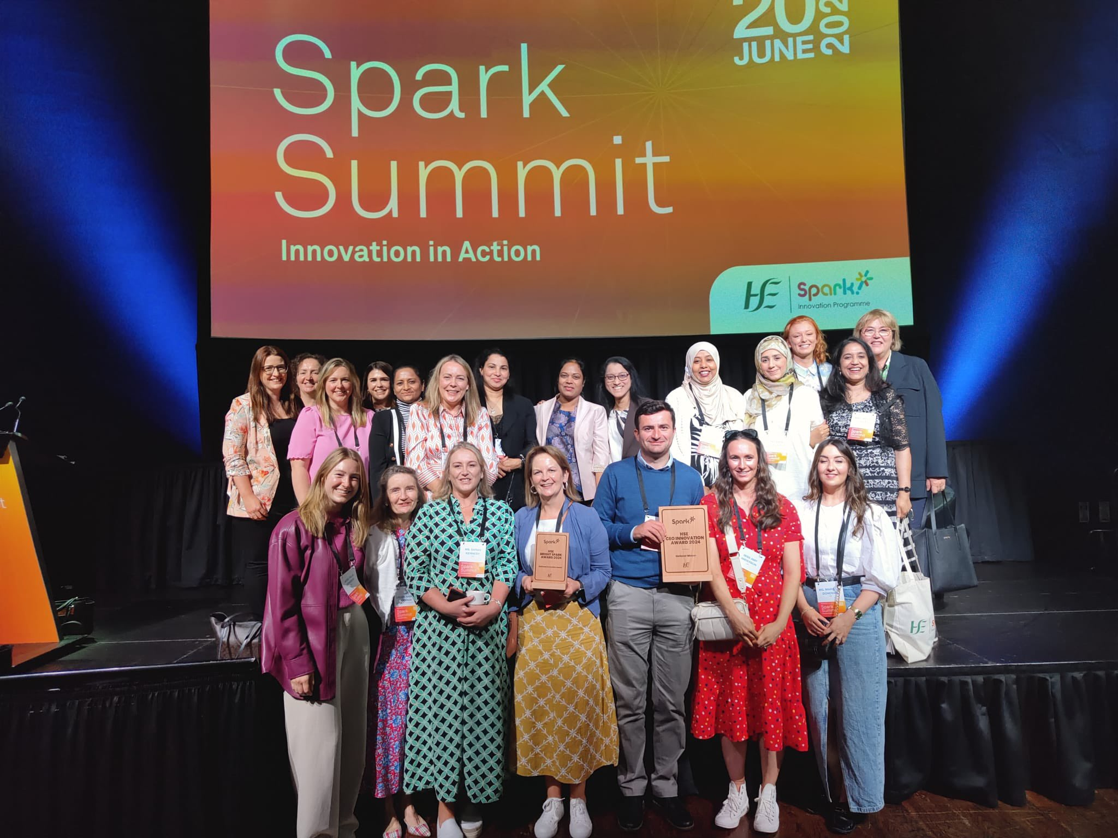
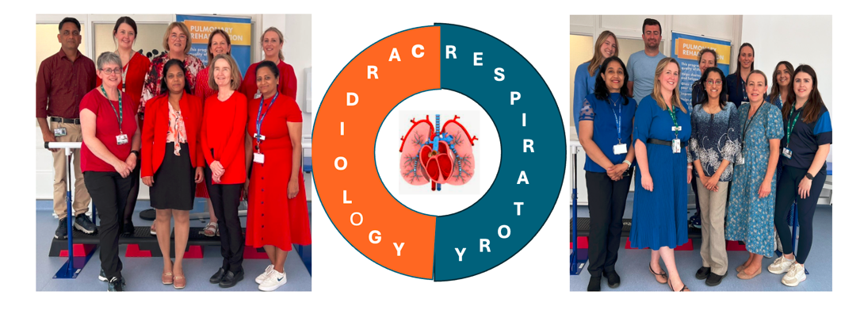
Innovation in Action
18

Slide 19
Integrated Cardiology
Symptomatic Patient
Scheduled care
Complex Patients
Living well with chronic disease
Community specialist care
Hospital care
0
1
2
3
4
General Practice
Acute specialist care
Prevention
Self management
Education
Consultant and Nurse led Clinics
GP Virtual Clinics
Cardiac Diagnostics
Cardiac Rehab
Specialist Nurse education
Patients requiring
Inpatient care
Right care
Right place
Shift Left
Right Time

Slide 20
Cardiology service
CVD Prevention
Clinics
Stable Suspected or established HF
Stable AF/Palpitations
Diagnostics
Cardiac rehab
HFANP
Echo
Cardiac Rehab
HF Drug up-titration
Support GP to manage the patient
GP Virtual clinics
Email Queries
Chronic disease management
Nurse led education
Cardiac Rehab
Shift Left
Notes:
CDM plays a key role in integrated cardiology and we aim to acheive this nurse led education, cardiac rehabilation. We WOULD SUPPORT THE gpS TO MANGE THE PATIENT THRU Email queries, GP virtual clinics.There will be cardiac diagnostics which is mainly providing the echo service to the GPs in selected patients and there will be specialist clinics . `tHESE CLINICS WILL BE MAINLY FOR PTS WITH CVD prevention, Stable suspected or established HF and Stable AF.

Slide 21
Cardiac Diagnostics
Cardiac Diagnostics and Rehabilitation
Cardiac Rehabilitation
Feb 2023 – onsite ECHO 563 & ECG 1,300
Onsite Cardiac Rehabilitation in the hub Phase 3, 61 Patients seen
GP Direct Access ECHO
Connolly Hospital Waiting List ECHO
Alivecor devices (for arrhythmia)

Slide 22
Integrated Cardiology service: Stats and Impact
New Patients Reviewed 950
Current waiting time in the Hub: Urgent referrals 2-3 weeks, Routine within 8 weeks
Urgent ECHO - Within 2 weeks, Routine within 8 weeks
Return Patients 900
Connolly Hospital Waiting List reduced from 14 weeks to 6 weeks
Cardiac Rehab in hub - waiting time 5 weeks
Patients reviewed from Connolly Hospital 468
Rehab in Connolly reduced from 8 -12 weeks to 4 – 6 weeks

Slide 23
Patient Education Sessions
Cardiovascular Prevention: Primary and Secondary
Lipids & BP target management.
Symptoms
Post PCI Clinics
Diet
Exercise
Smoking Cessation
Medication compliance
Heart Failure
Atrial Fibrillation
Pulse check
Symptoms
Device education
DOAC counselling
Lifestyle
Symptom monitoring
Daily weights
Diary

Slide 24
STRENGTHS | WEAKNESSES | OPPORTUNITIES | THREATS
Good Leadership Enthusiastic Staff Common values Stakeholder engagement Clinical governance arrangements | No roadmap Need for Integrated IT infrastructure Staffing - not at full allocation | Increase capacity Multi-disciplinary working arrangements Growth of clinics, on-site and satellite Patient experience evaluation | Lack of IT system / automated processes Recruitment and retention difficulties Admin burden on clinicians Ongoing Funding Climate/Sustainability

Slide 25
Case Study:
Supporting achievement of the WLAP 2024:
reducing wait times and improving access for outpatients referred to cardiology to improve patient experience & outcomes
5 September, Convention Centre Dublin
Dr Susan Connolly
Consultant Cardiologist, Integrated Care
Galway University Hospital & Galway City Hub
25

Slide 26
ECC and Waiting List Action Project 2024
Aim
Develop Standard Operating Procedures to enable the integrated care hub, in partnership with acute cardiology in aligned hospital, to optimise their impact on the OPD waiting lists in four sites.
Objectives
To demonstrate the potential impact of the IC Consultant/team on the existing hospital OPD list
To develop a SOP across acute and hub to (i) sustain improvements and (ii) that would be adopted by other acute/hub services
To identify the barriers and facilitators to implementing the SOP to enable its scale up
26

Slide 27
ECC and Waiting List Action Project July – August 2024
Methods:
Joint approach with National Services & Schemes, Access & Integration & ICPCD at national level
Additional project management support provided by National
Working group established: Chaired by ICPCD, Acute (GUH WL Office/Admin/Business Support), IC Consultant, Hub, iPMS team
Baseline mapping: demand/capacity/existing wait list
Clinical validation of existing hospital OPD waiting list
Funding provided by National Services & Schemes for WL investigations (ECHOs)
27

Slide 28
Baseline Mapping
Cardiology GUH OPD Wait List June 2024
N=1659 waiting
for cardiology
outpatient
appointment
21% (N=350)
waiting
> 1 year
28

Slide 29
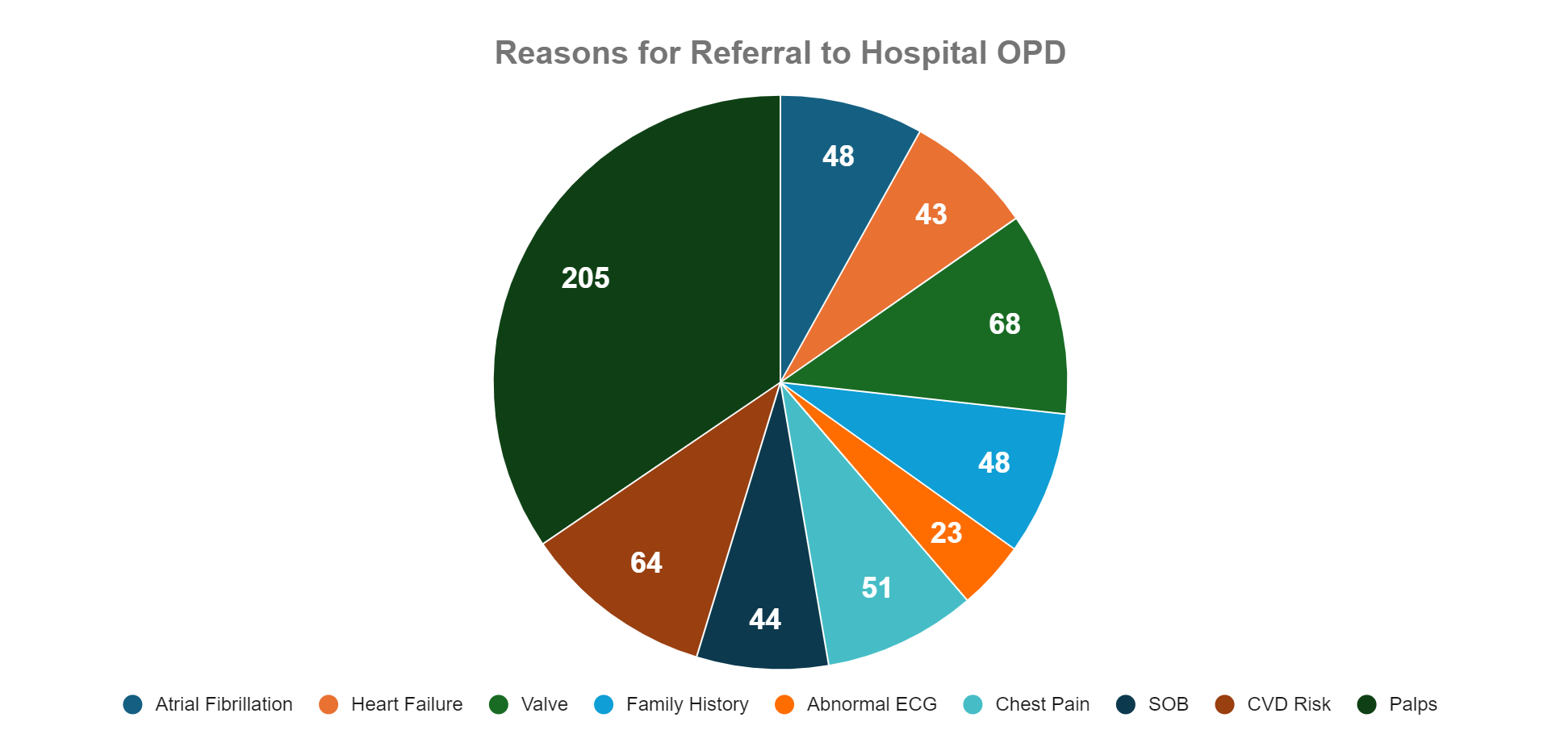
Clinical Validation of N=744 (45% Existing OPD WL)
Performed July-August 2024
35% = Palpitations
29

Slide 30
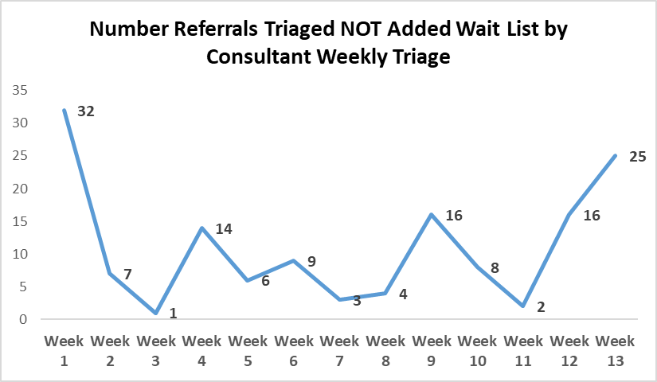
Variation in Weekly Triage Outcomes by Consultant
30

Slide 31
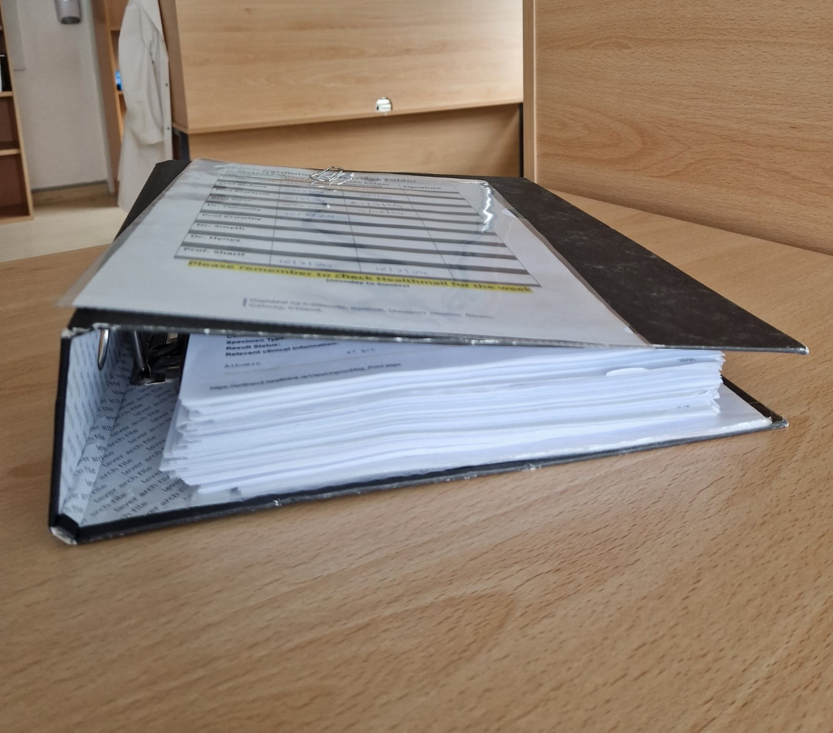
Barriers to Effective Consultant Triage
Unwieldy folder of Health Link hard copy referrals given to different consultant each week
Unpredictable timing
Referral information from GP sometimes brief with omissions (e.g. 12 lead ECG, NT BNP result)
Previous medical information requires separate opening hospital record (Evolve)
Advice back to GP requires formal dictation
31

Slide 32
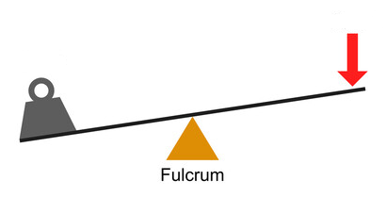
Demand versus Capacity
Weekly Referral Numbers versus New Patient Slots
Capacity
N=40
Demand
N=65
32

Slide 33
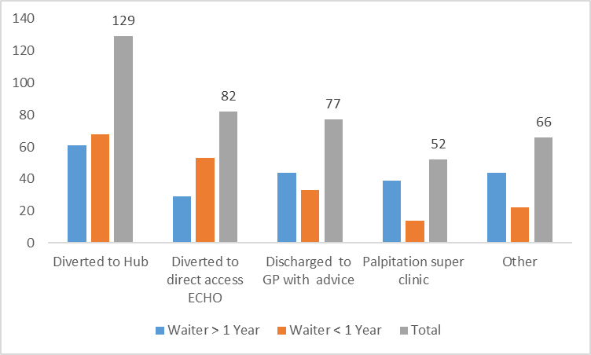
Numbers Diverted to Alternative Pathway / Removed From List
1/3 of those removed were to Integrated Care Hub
33

Slide 34
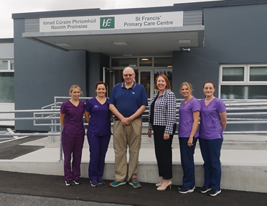
Alternative Pathways: Integrated Care Hubs
(Galway City, Mayo, EGRH)
“What a fantastic service, you get your appointment, no delays, a detailed letter in post after, staff were so helpful and kind”
Short waiting time
Ease of access
Dedicated multidisciplinary team
Holistic focus including education/self management
Improved patient experience
“I cannot emphasise to you how effective this clinic is, it deserves recognition and publicising. The overall benefits to me have been great and the increased sense of wellbeing much appreciated.”
34

Slide 35
Alternative Pathways
Palpitation Superclinic 13th August 24
“It was fabulous and it was very efficient… No faults at all!”
39 new patients booked (2/3 were long waiters)
10 declined review
35 attended (4 DNA) - all seen by consultant
Palpitation information leaflet drawn up and provided
Cardiac monitor required in only 5 patients and done at clinic
>90% discharged
“From entering I was waiting only 5 mins and then straight to stand to start the testing. It was quick and great service… very accommodating”
35

Slide 36
Alternative Pathways: “Discharge with Advice” (E-Consult)
1
2
Information in GP referral reviewed as well as other patient information on Electronic Health Record (Evolve)
Letter dictated by IC consultant and sent to GP and patient with advice/therapeutic plan e.g. BP management.
“Discharge with Advice” (E-Consult)
3
4
Patient removed from WL
E-consults literature– safe, improved access to healthcare, lower rates of ED visits and hospital admissions*.
* Clinician-to-clinician electronic consultation in cardiology is also a digital health technology for cardiovascular care. European Heart Journal - Digital Health (2023) 4, 69–70
Longer-term impact of cardiology e-consults. Am Heart J 2016;173:86-93.
Universal Cardiology Electronic Consultations. Circ Cardiovasc Qual Outcomes. 2022;15:e008709
36

Slide 37
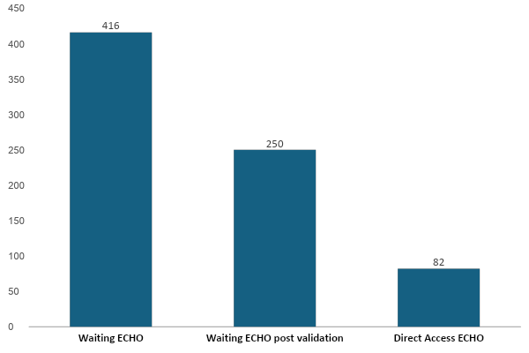
Access to ECHO
A significant Barrier in CV Outpatient Scheduling
N=250 ECHOs scheduled out of hours Aug-Sep 24
N=180 completed so far
↓40%
33% converted to direct access
Numbers
37

Slide 38
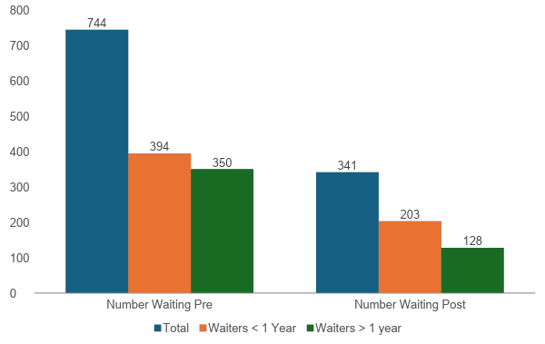
54%
Impact: Numbers (of 744 validated) on WL Pre and Post Action Plan Stratified by Waiting Time: > 1 Year and < 1 Year
Reduction in Total Waiters Validated
48%
Further 75 scheduled for clinic Sep 24
Reduction in Waiters < 1 year
62%
Reduction in Waiters > 1 year
38

Slide 39
Enablers
IC Consultant/
Hub Team
ICPCD Leadership
GUH WL Office & Cardiology Scheduling Team
Improving Patient Access to Cardiology Services
Cardiac Physiology
Funding WLI ECHOS
Project Management Support
39

Slide 40
Sustainable Solutions to WL Management
Reduce Demand through more Effective Triage
Electronic triage system that integrates HL referral/iPMS/patient record with ability to communicate with GP (Saolta iPMS team supporting initial phase)
Dedicated time for consultant triage with e-consults formally recorded as new patient activity
Standardise consultant triage approach to common referrals
Primary care engagement with primary care to enhance referral information and reduce low acuity referrals (e.g. palpitations)
Development of national pathways to support above
Enable direct access investigations (hub physiologist key but post decommissioned)
Improve Capacity
Enable Consultants to see new patients – adequate space, admin, nursing & HSCP support essential
Appropriate Resourcing of Management/Administrative Teams to Increase Efficiency
Hubs resourced as intended – key in offering Alternative Pathway to OPD for Substantial Proportion of Patients
Collective Ownership to Sustain the Changes
40

Slide 41
Acknowledgements
GUH Team
Integrated Care Programme Chronic Disease Team
Marcella Feeley Project Officer, ICPCD, Galway City Integrated Hub Siobhan Woods, Interim Operational Lead, ICPCD, Galway City Hub Sinead Duke, Acute CVD CNS, Galway City Hub
National Support Team
Jean Boyle | Business Manager, Waiting List Office |  | Connie Lambert | Cardiac Investigation Secretary
Tim Cameron | Outpatient & Inpatient Waiting List Manager |  | Rachel Letsome | Line Manager, Medical Directorate
Beata Czegledi | Clinic coordinator & Medical Secretary |  | Kathleen McDonnell | Cardiac Investigation Waiting List Co-ordinator
Ann Dooley | Directorate Business Manager, Medical Directorate |  | Eileen Nee | Medical Secretary
Carrie Fletcher | Scheduled Care Transformation Programme Manager |  | Caroline Nolan | Cardiac Investigation Receptionist
Nuala Harlowe | Staff Officer, Waiting List Department |  | Liz O'Reilly | Chief Cardiac Physiologist
Dawn Fletcher | ICT Applications Lead, ICT & Digital Health |  | Scott Anderson | Senior Manager, Business Services Support Team
Mary Garvey | General Manager, I/Scheduled Care Lead |  | Maeve Domican | Senior Manager, Business Services Support Team
Mairead Gleeson | General Manager, NCAGL for Chronic Disease, Clinical Design & Innovation |  | Brendan Fitzgerald | Resolver, Business Services Support Team
Lorna Hurley | Change Manager, ECC, ICPCD |  | Ciaran Ward | Mobiliser, Business Services Support Team
Sarah O'Brien | National Clinical Advisor & Group Lead for Chronic Disease
41

