Slide 1
Bernard Gloster
Chief Executive Officer, HSE
Advancing Health Service Reform

Slide 2
When I started …
Text in Arial Bold 16 point text
Access & Performance Improving
Timely Implementation Ensuring
Public Confidence Building
There Has to Be A Now and a Next
2

Slide 3
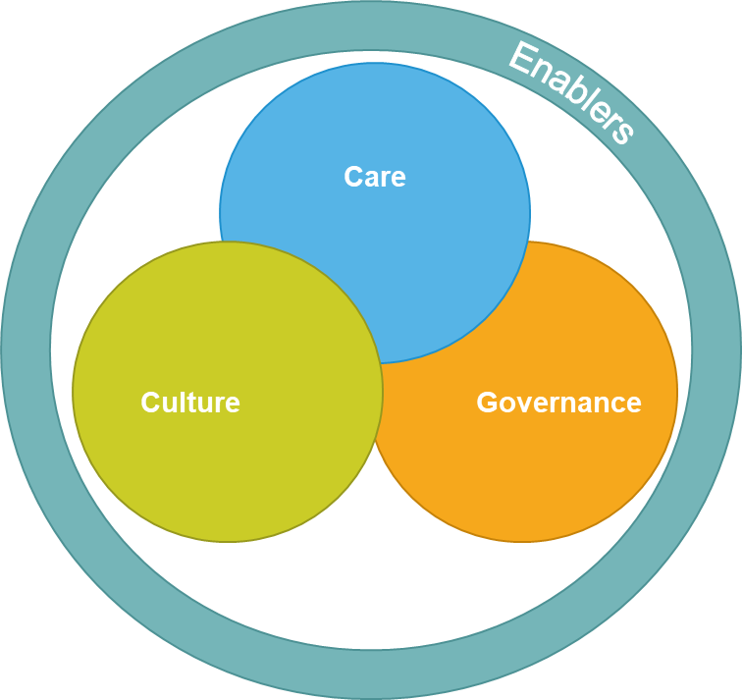
The Framework
Text in Arial Bold 16 point text
3

Slide 4
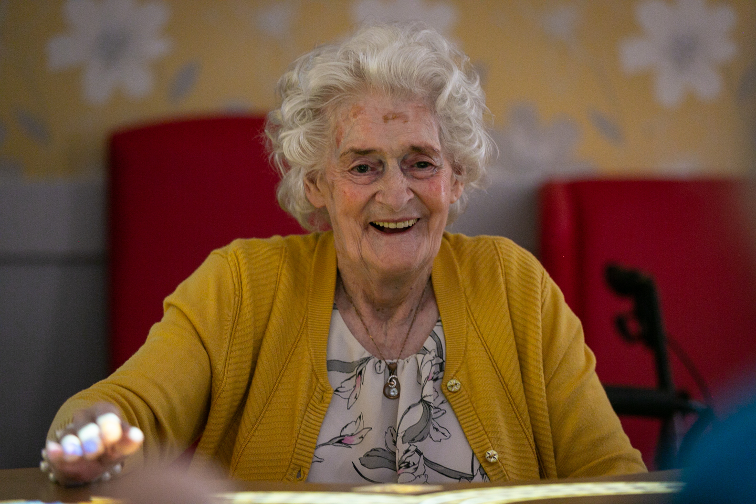
Mrs O’Neill
Text in Arial Bold 16 point text
4

Slide 5
So how did that go…
UEC Trolleys – Up to 20% decrease in numbers waiting against a 10% increase in demand.
DTOC – A consistently maintained reduction from 550 / 600 on any day to 350 / 400.
Avoidance – 92% Patients CDM in primary care programme 320K reviews to date.
Scheduled Care – More patients than ever removed from waiting lists – 180,000 more in 2023 than 2022
Waiting more than 12 months reduced by 1/3
Critical is a consistent reduction in time waiting – 10 months to 7.5 months / Eradication of the traditional 4 year figure – Now focused on weeks
5

Slide 6
The Resource Context
129,750
Health Staff
The greatest ever amount of staff…
The greatest ever level of financial resource…
Stabilising to €23bn in 2024 and
€24bn in 2025
20,000 +
Disability Staff
6

Slide 7
The Change
The Next was the six new regions and a revised HSE Centre.
That Next in 2023 is the Now in 2024
The Next was addressing a significant resource cost challenge Pay/Non Pay
That Next in 2023 is the Now in 2024
The Next was improved access – but…
7

Slide 8
But…
It will be our Next for some time because…
2031 is Here -
8

Slide 9
The response now and next
Productivity in Health Care
It is not a dirty word
It is about how we use what we have differently
It is about resource utilisation, modalities of care, new ways of working
It is about all resource not just new every time
It is about outcomes
It is about patient safety
And…
9

Slide 10
Time
It is about the greatest resource – time
My time, your time, our time…..
But most importantly Mrs O’Neill’s time.
Integrated Care Means More Than Working Together
10

Slide 11
I expect of myself and those I lead…
An improvement in culture
Positive behaviours
Patient/ Service user is central to everything we do
Respect
11

Slide 12
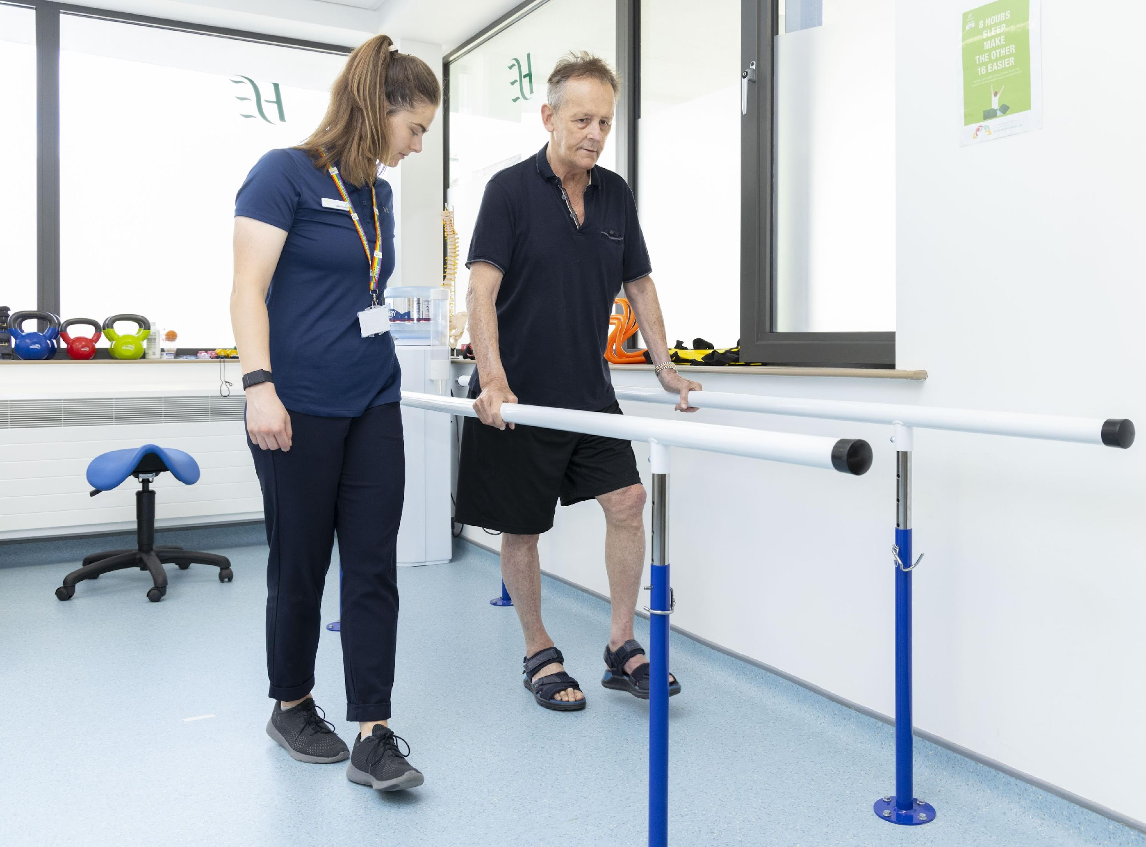
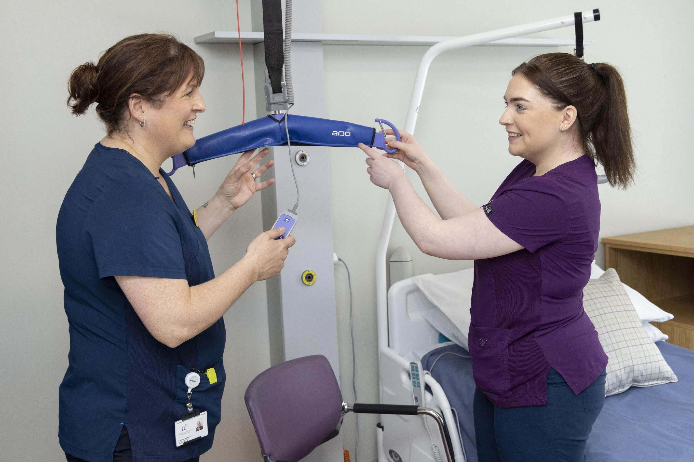
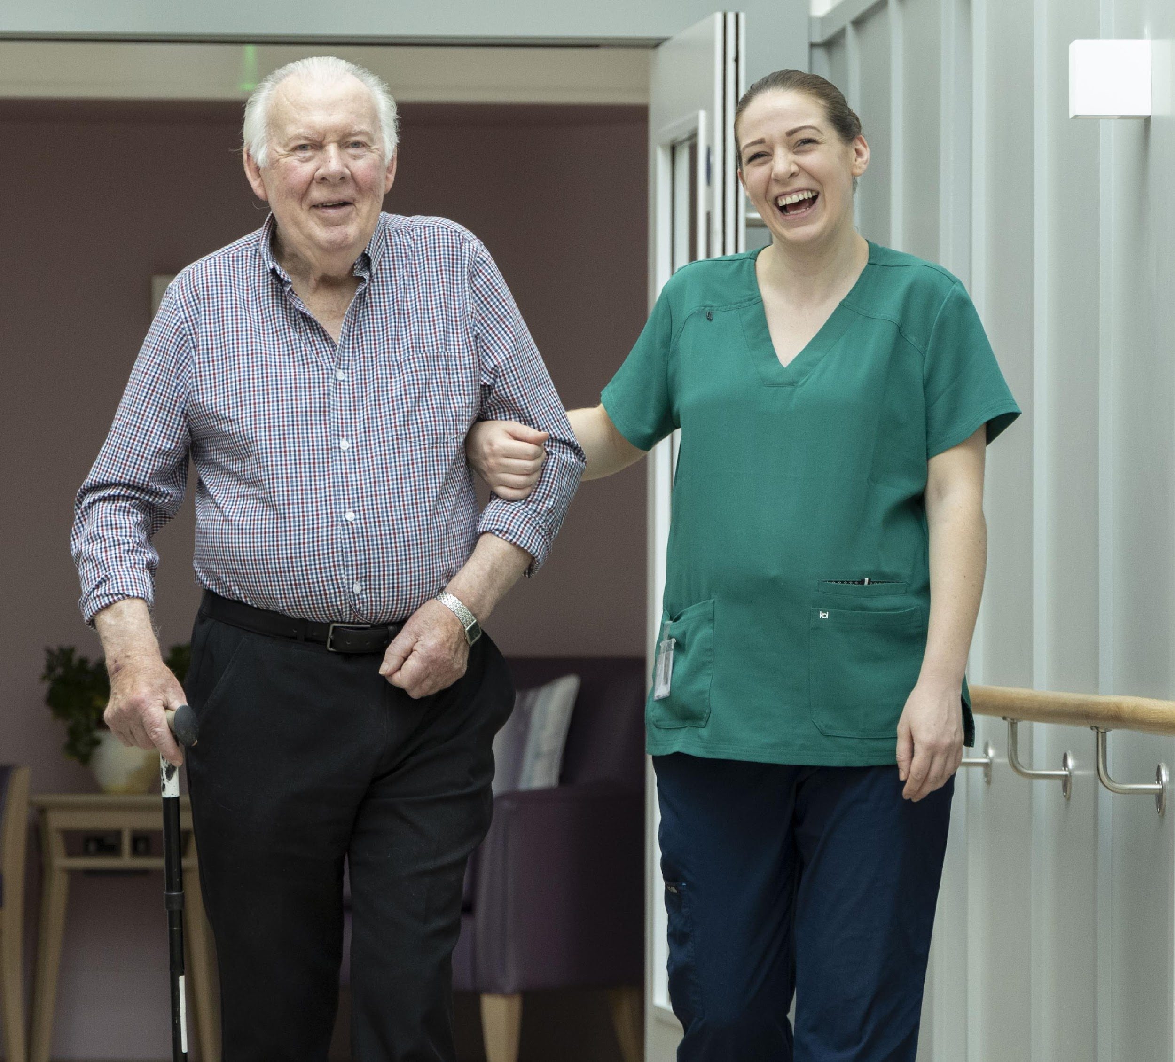
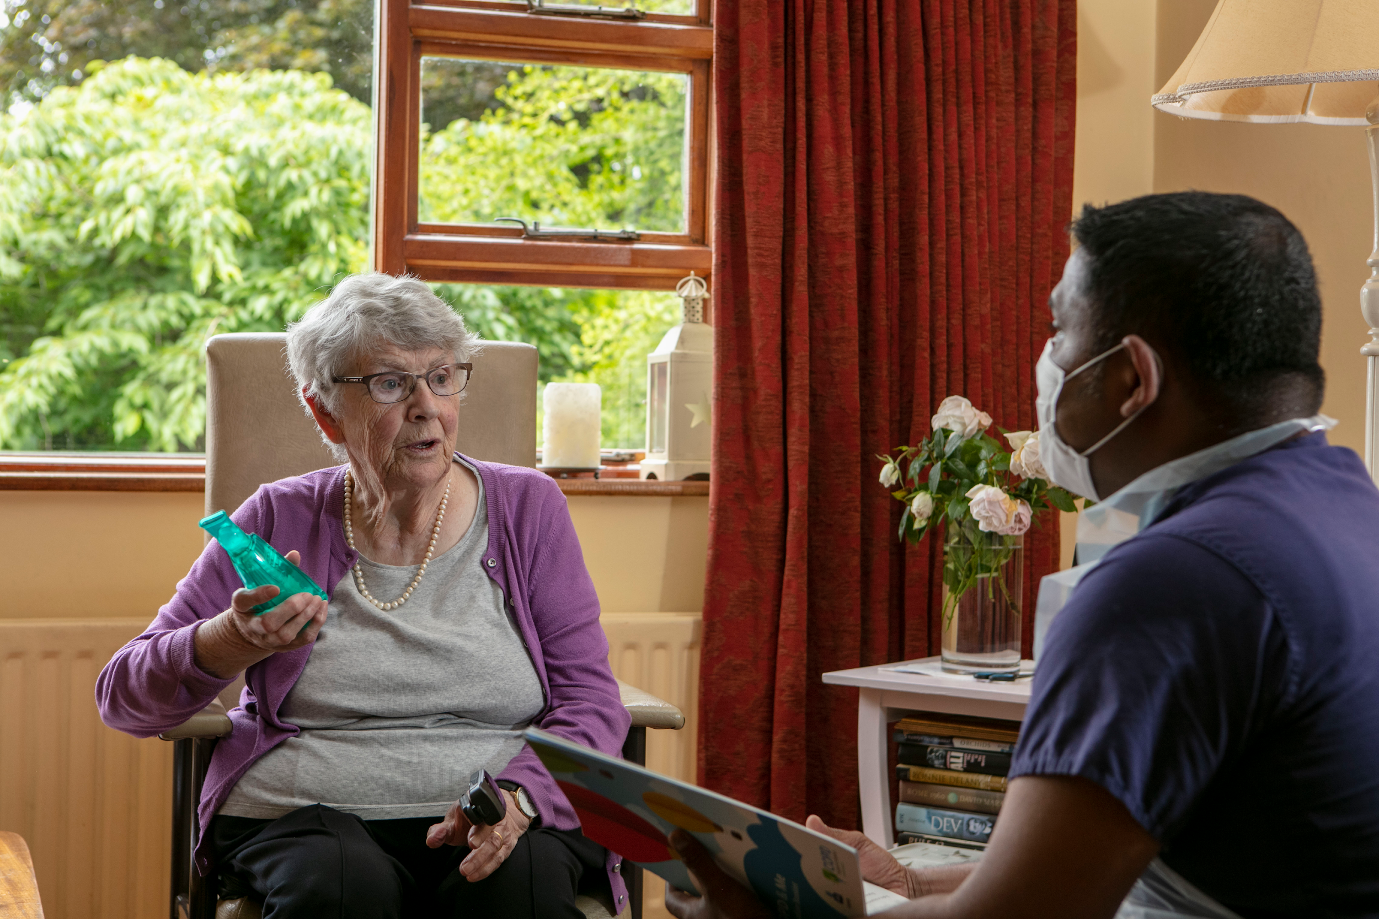
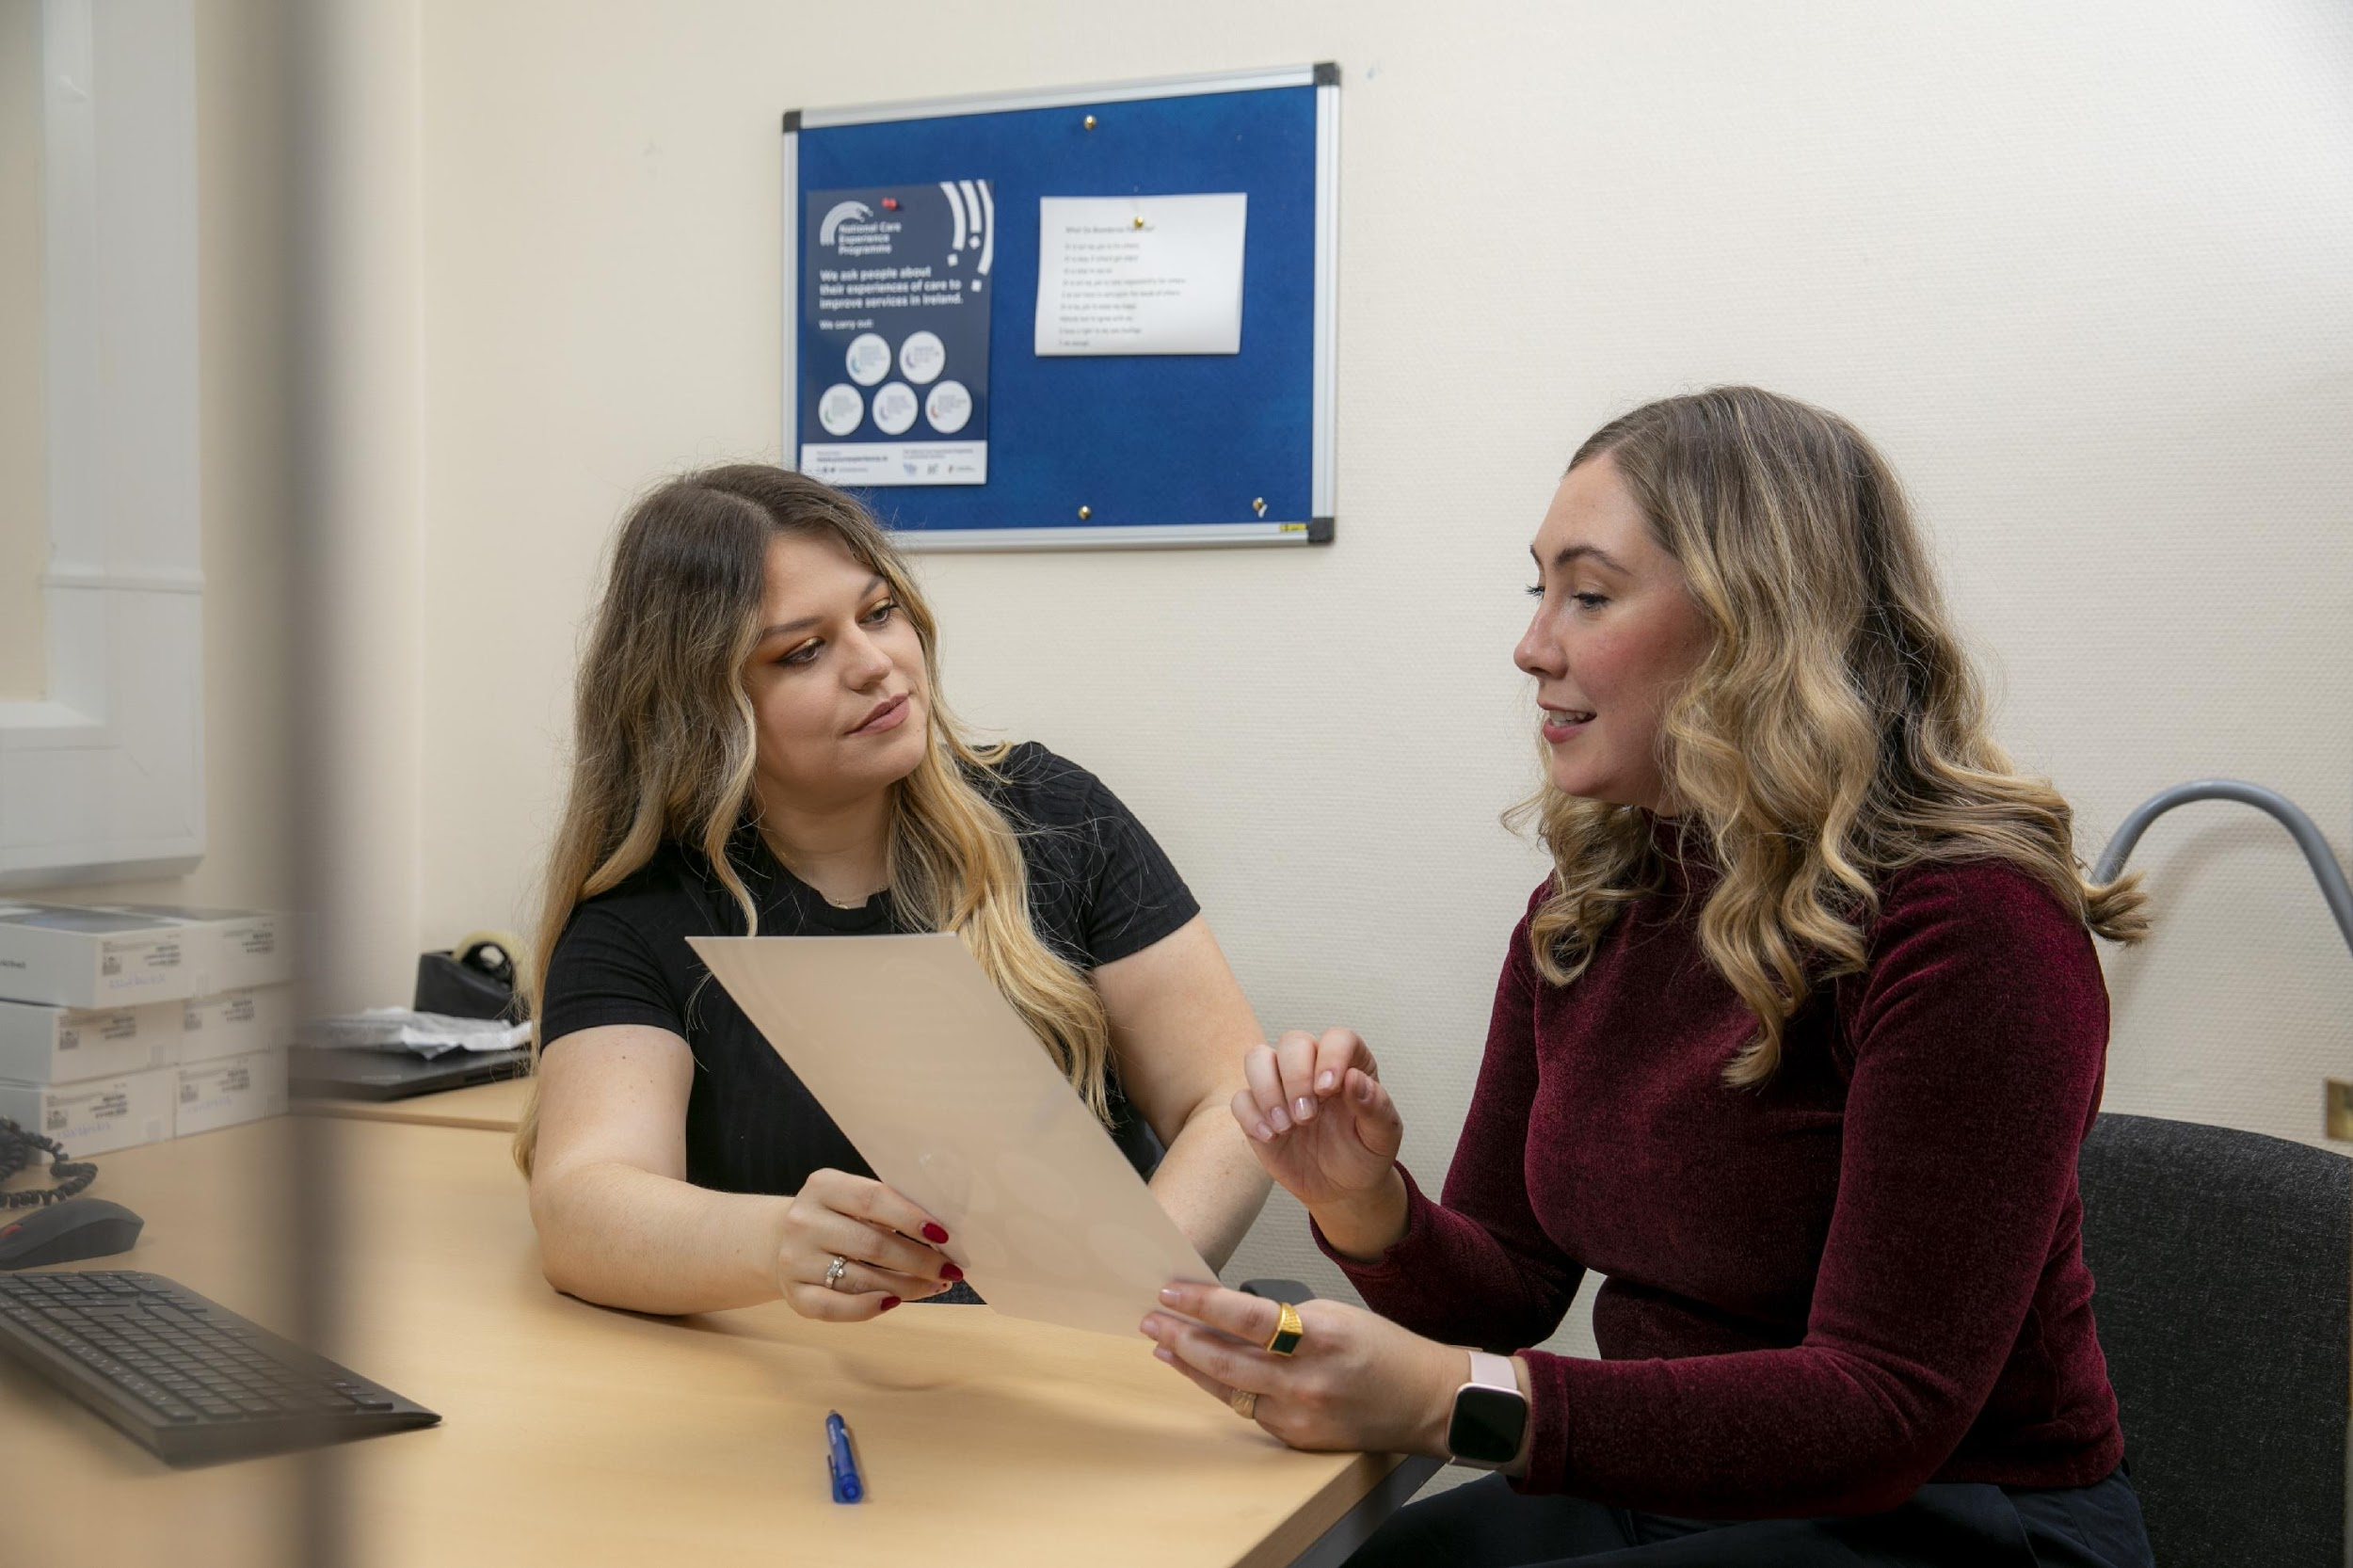
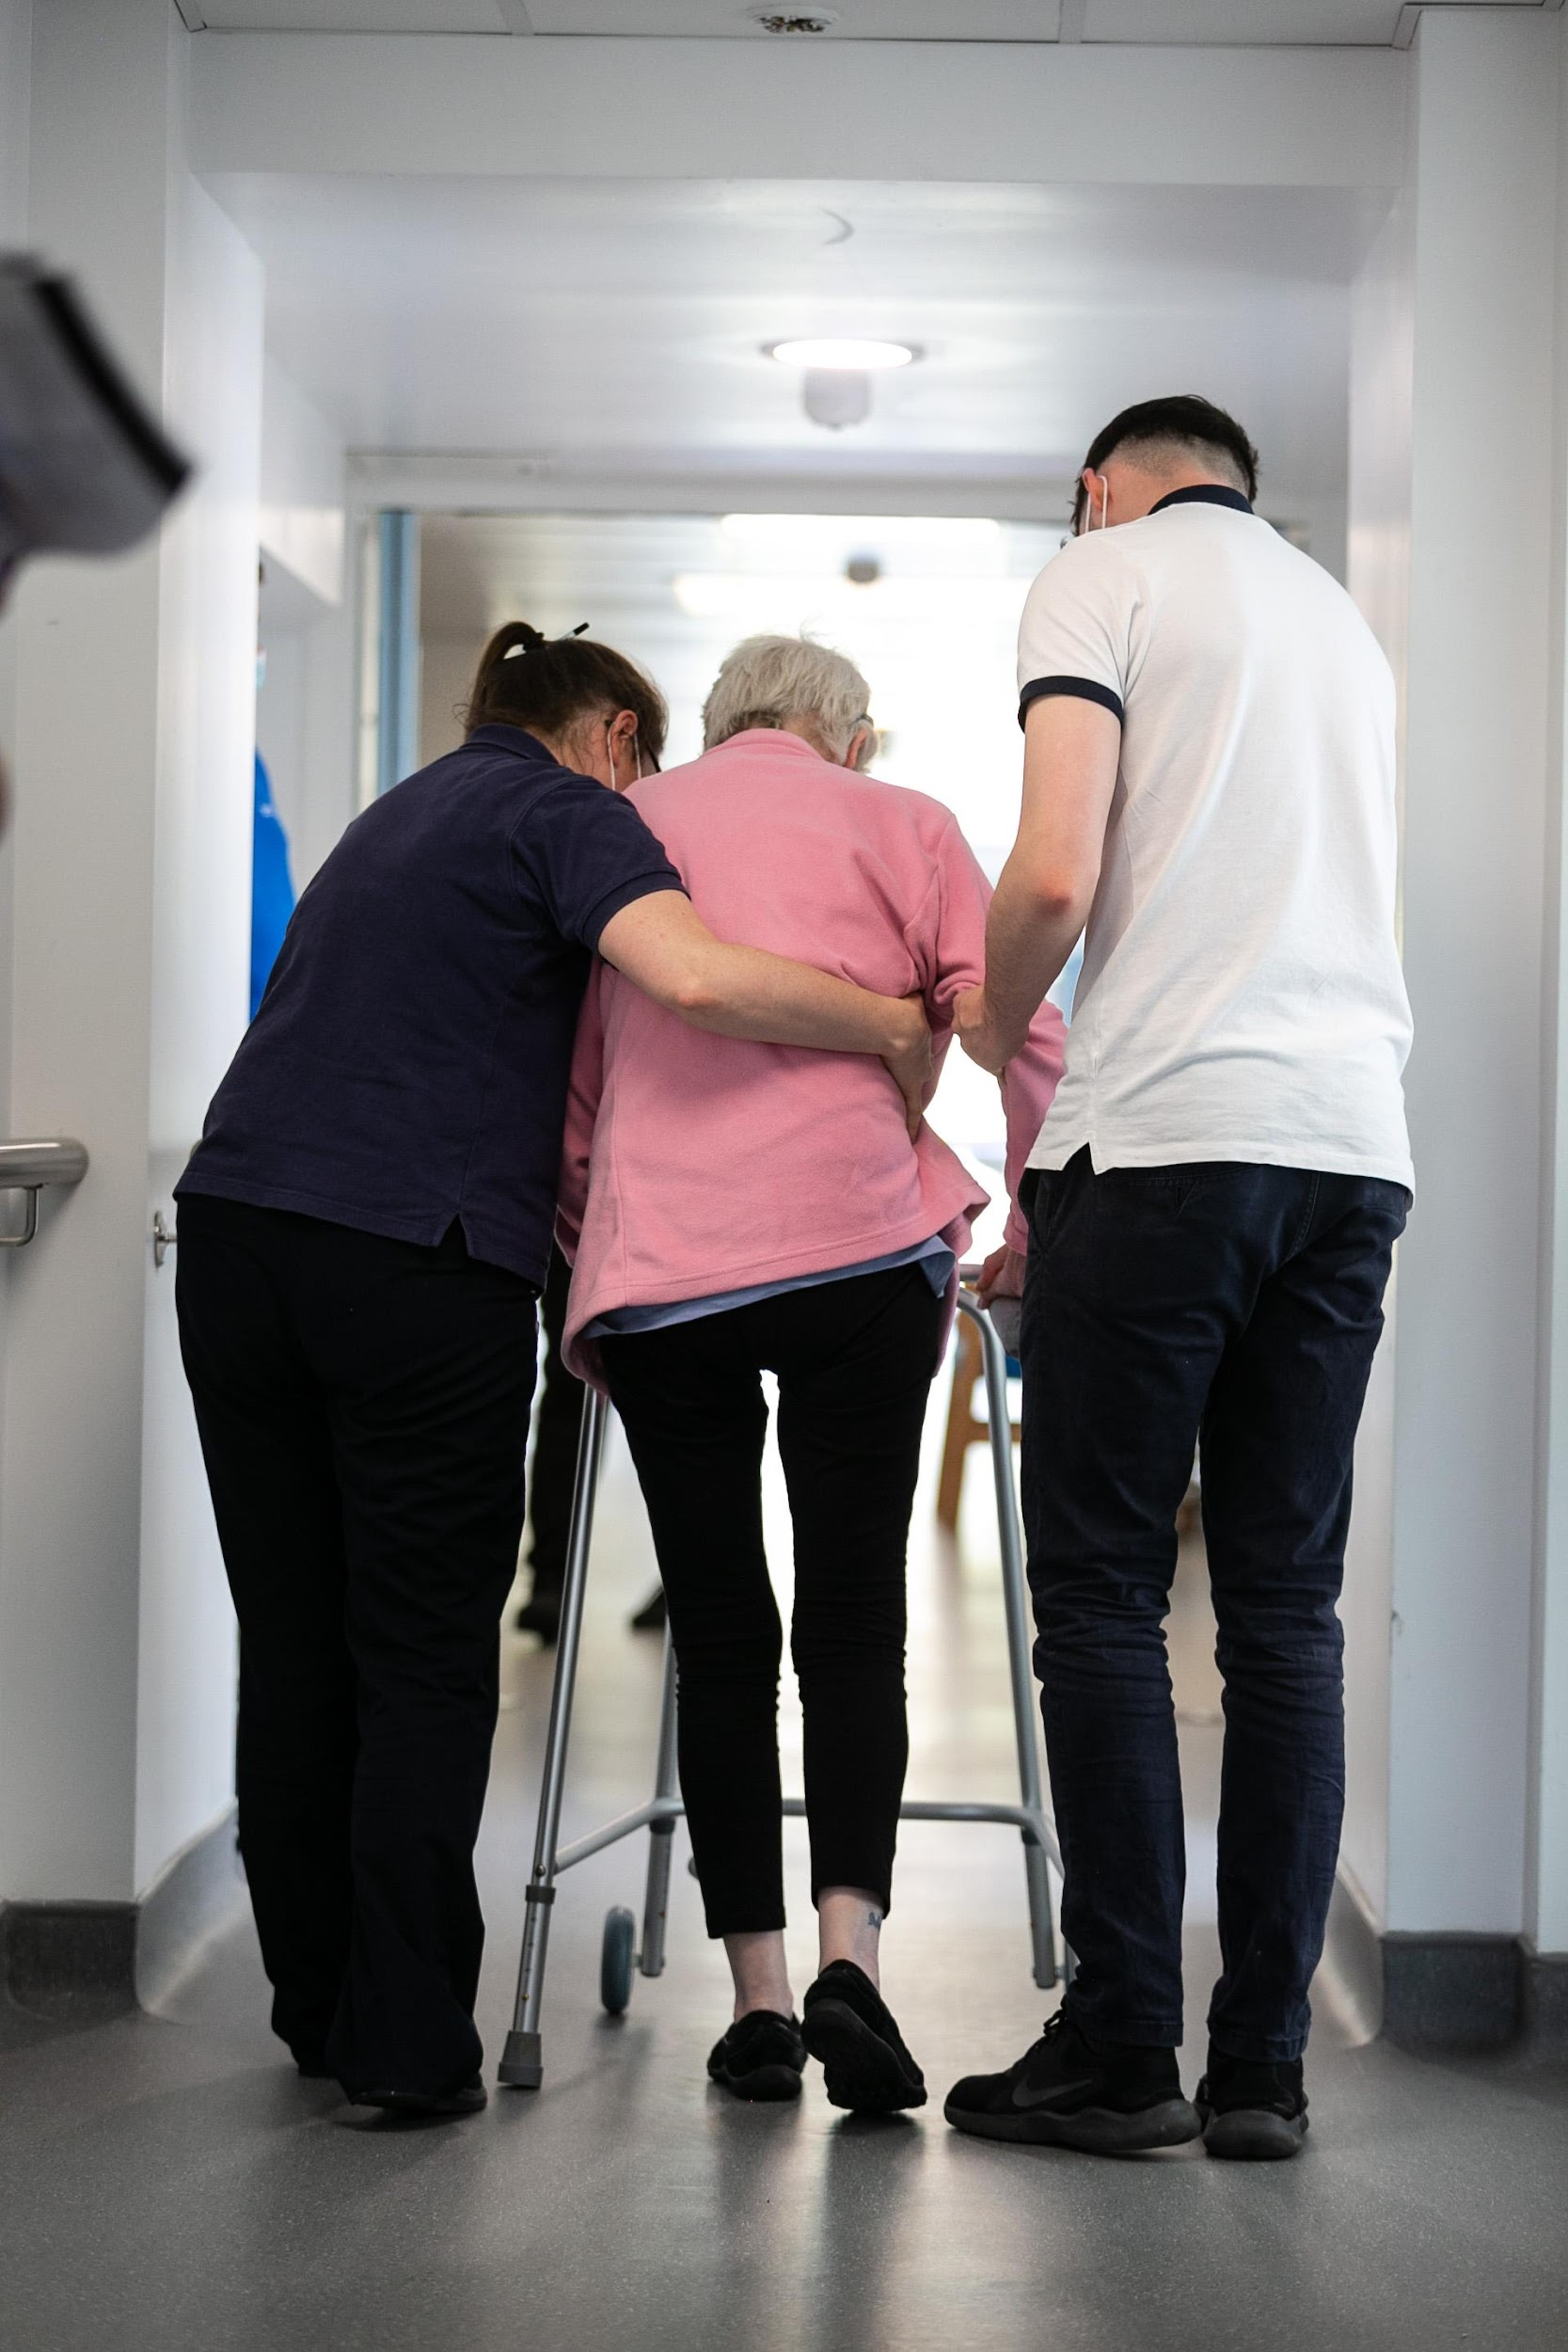
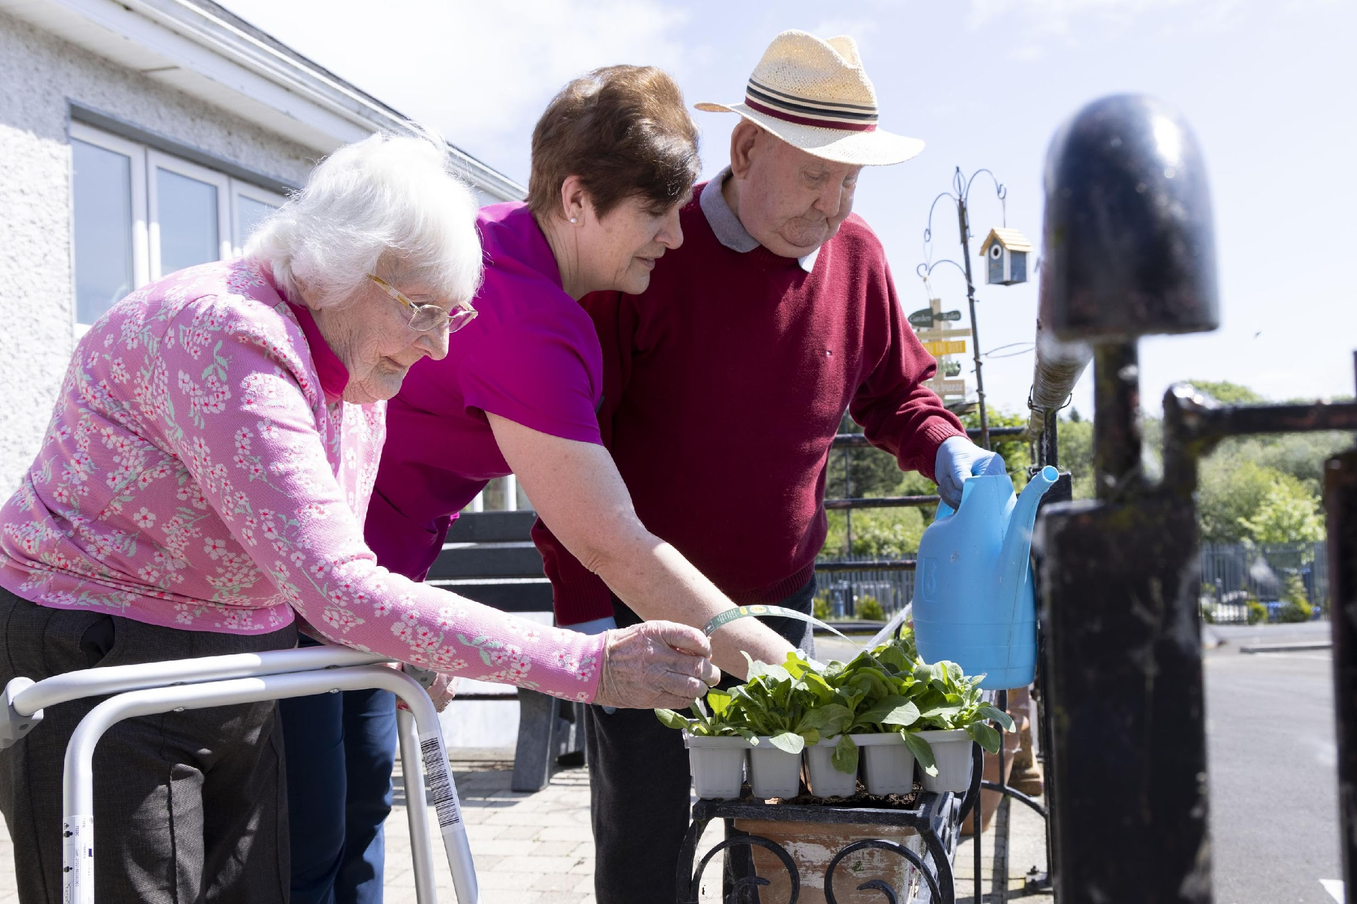
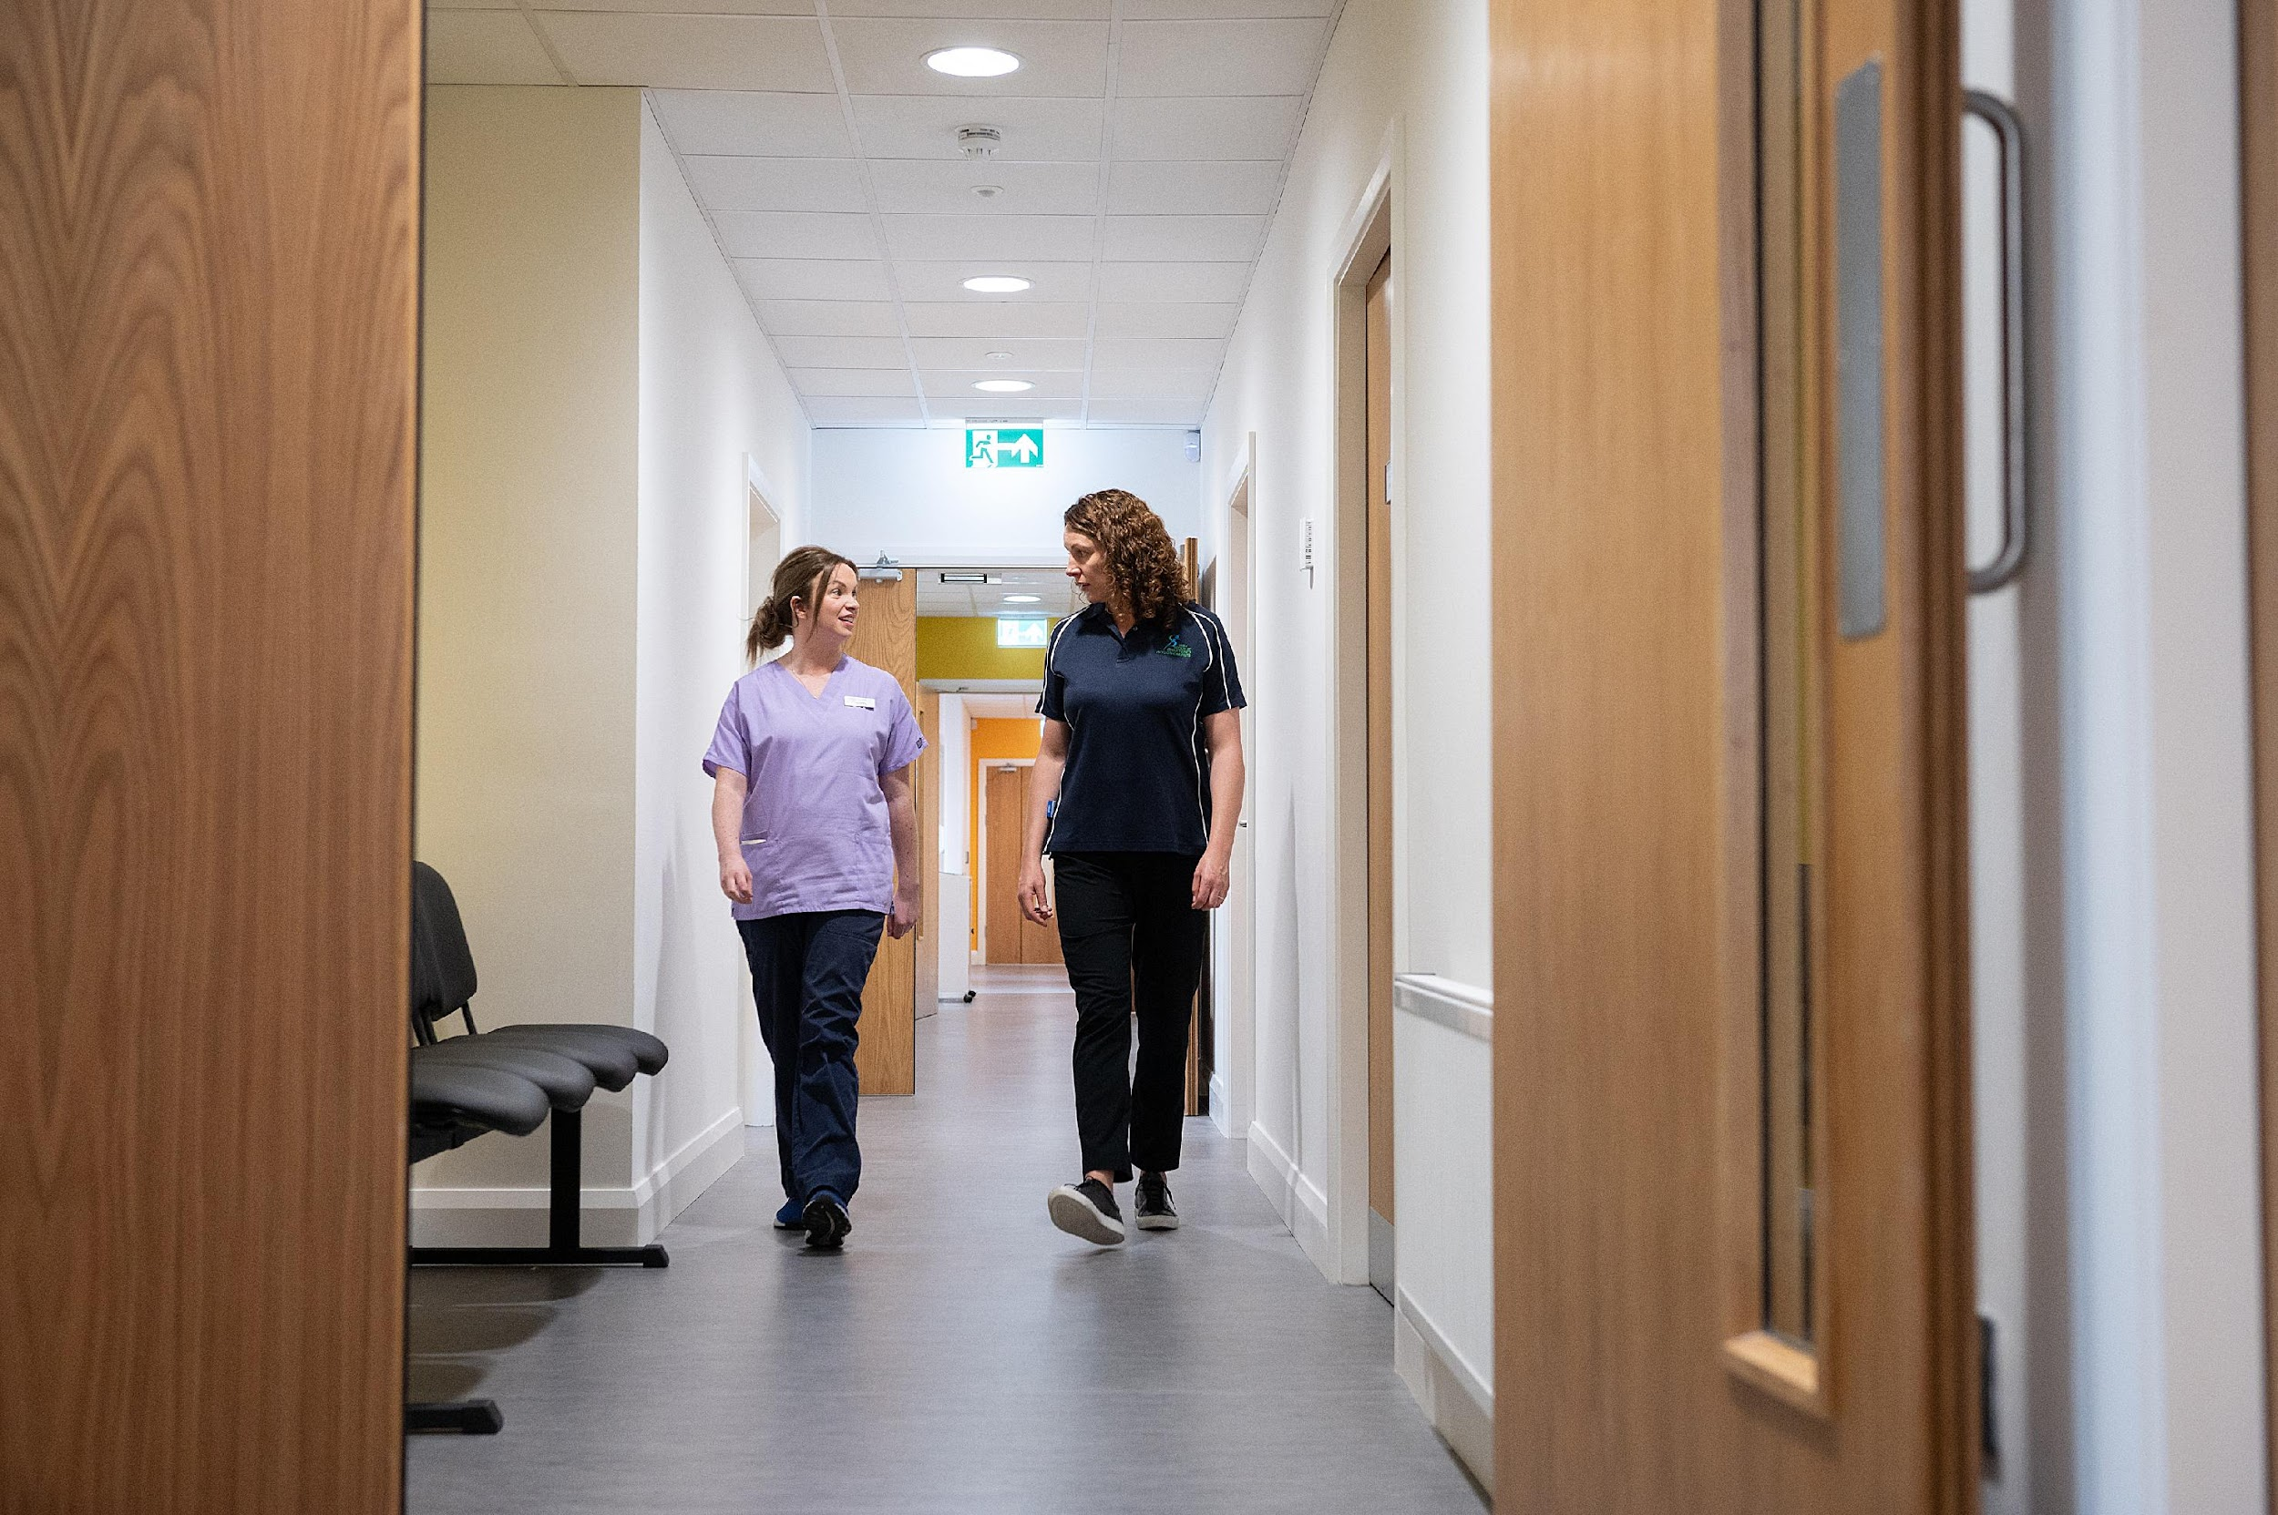
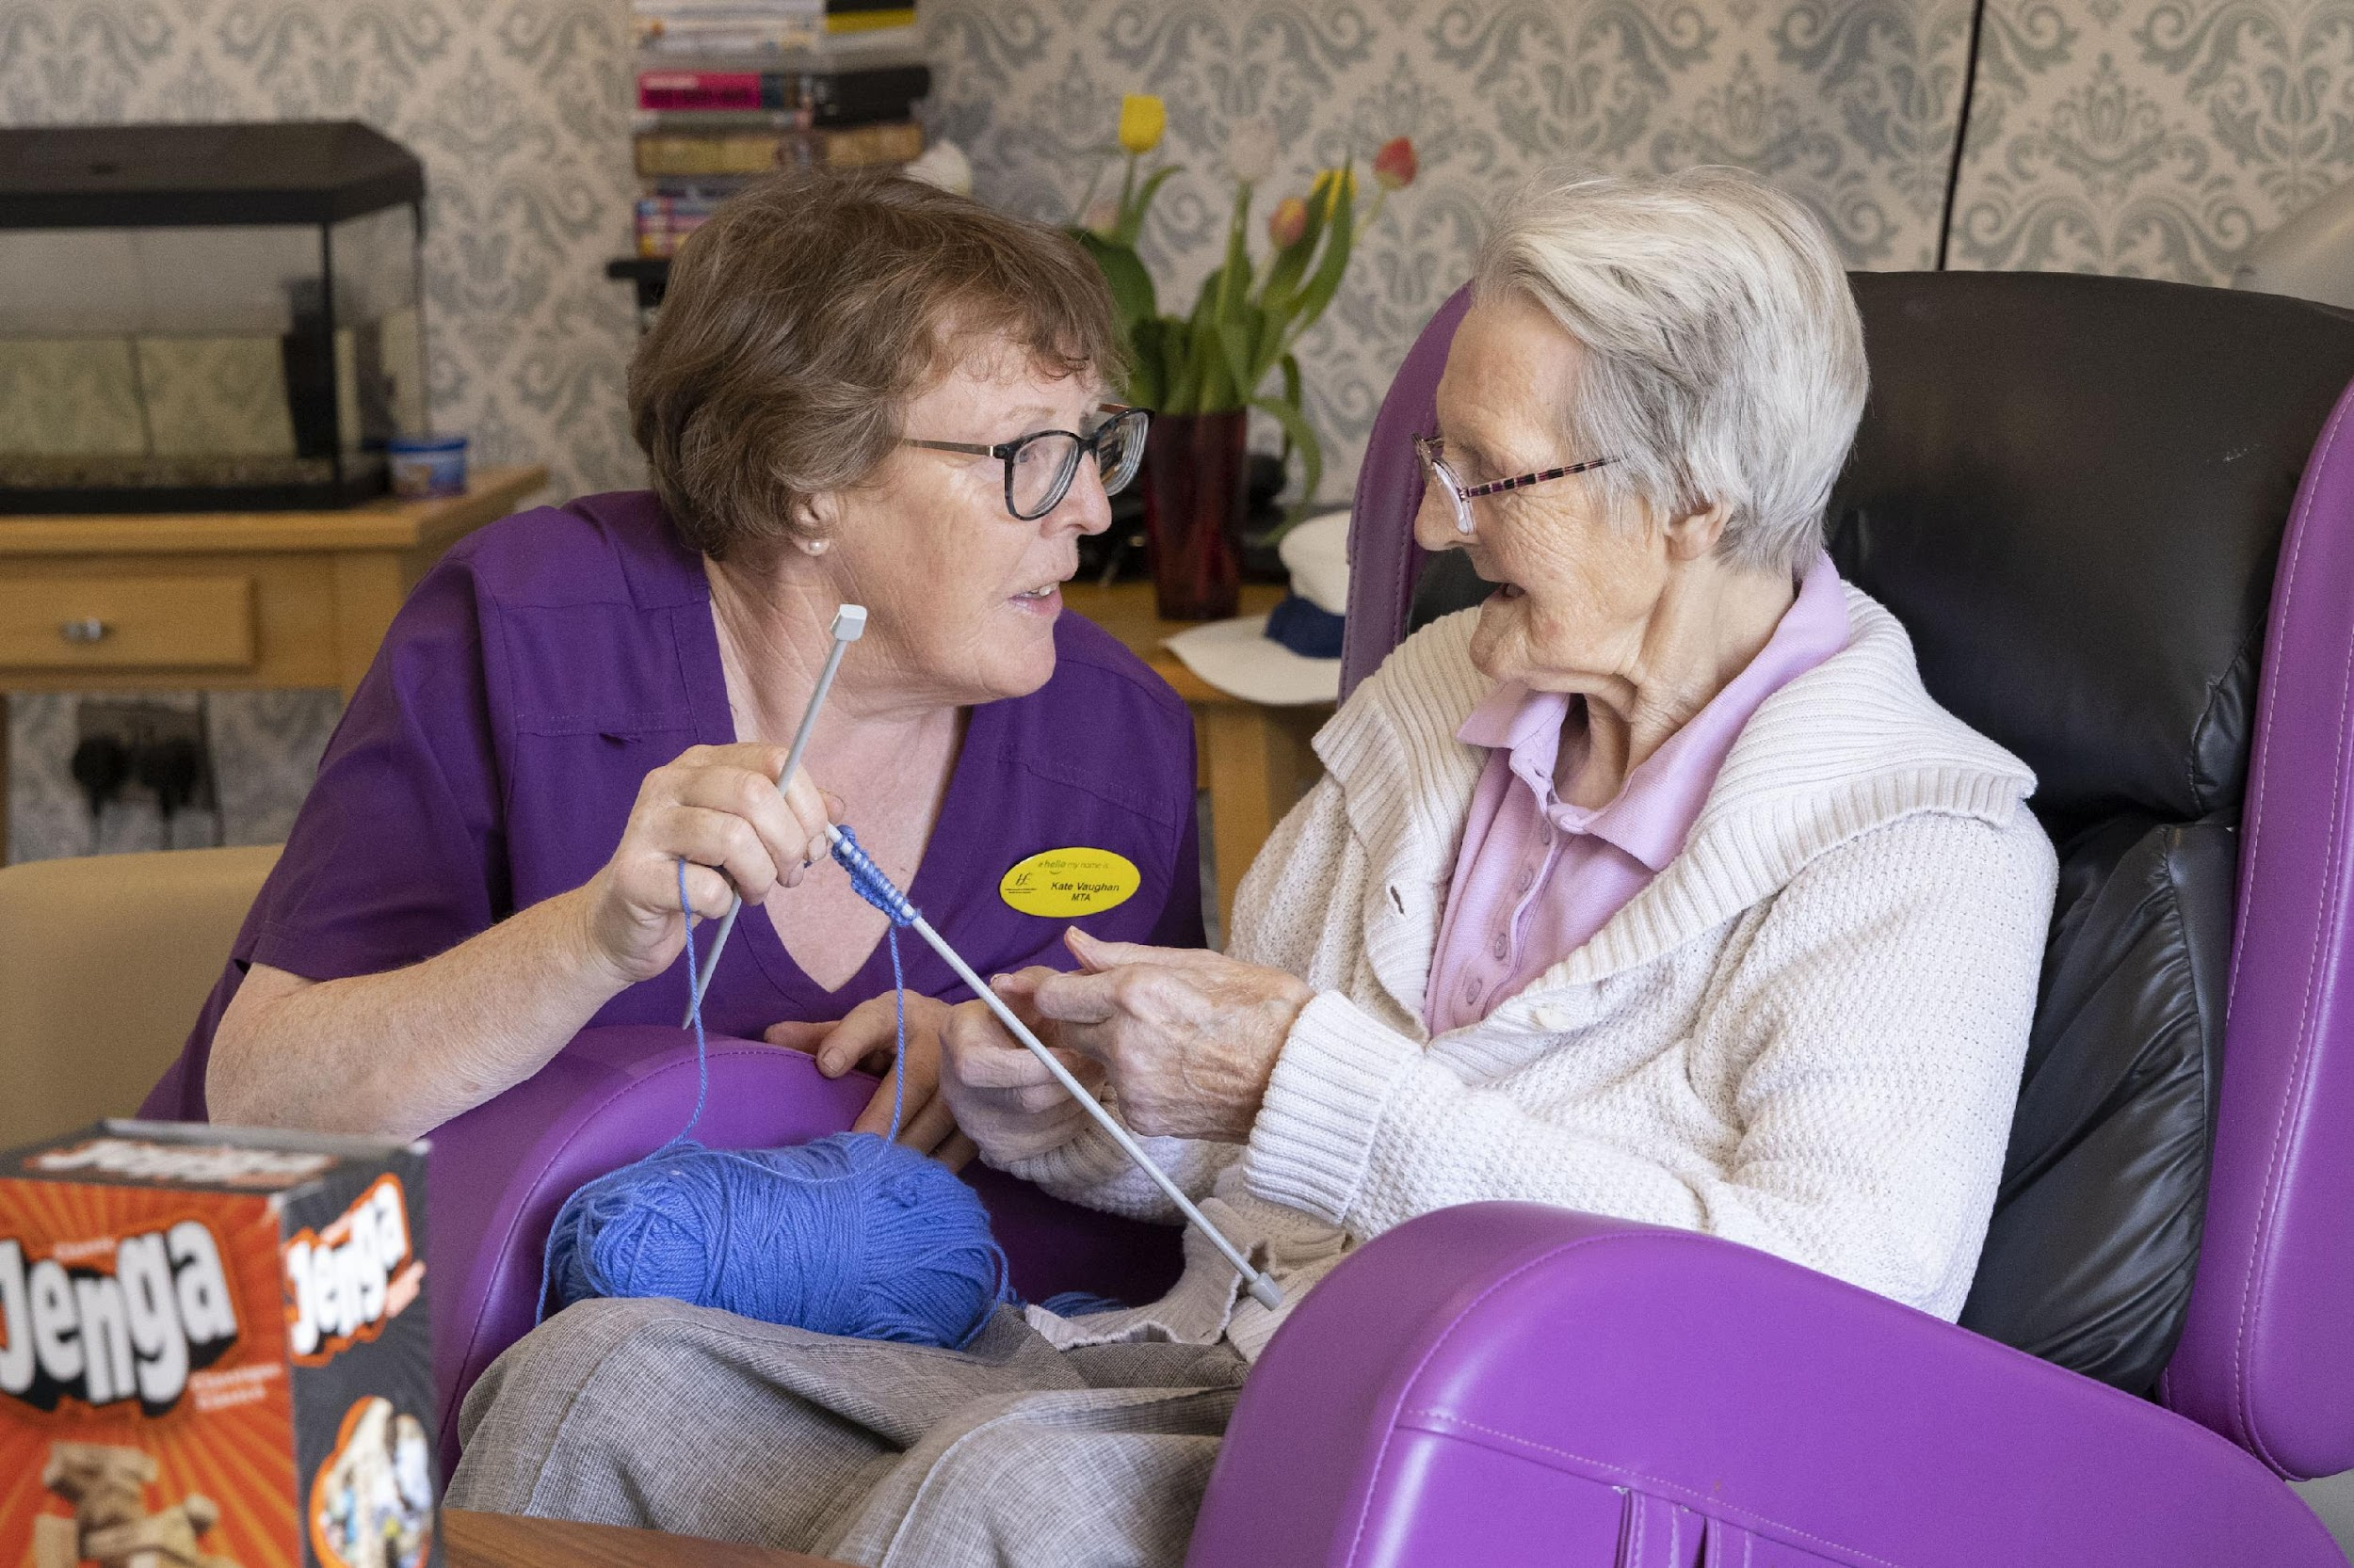
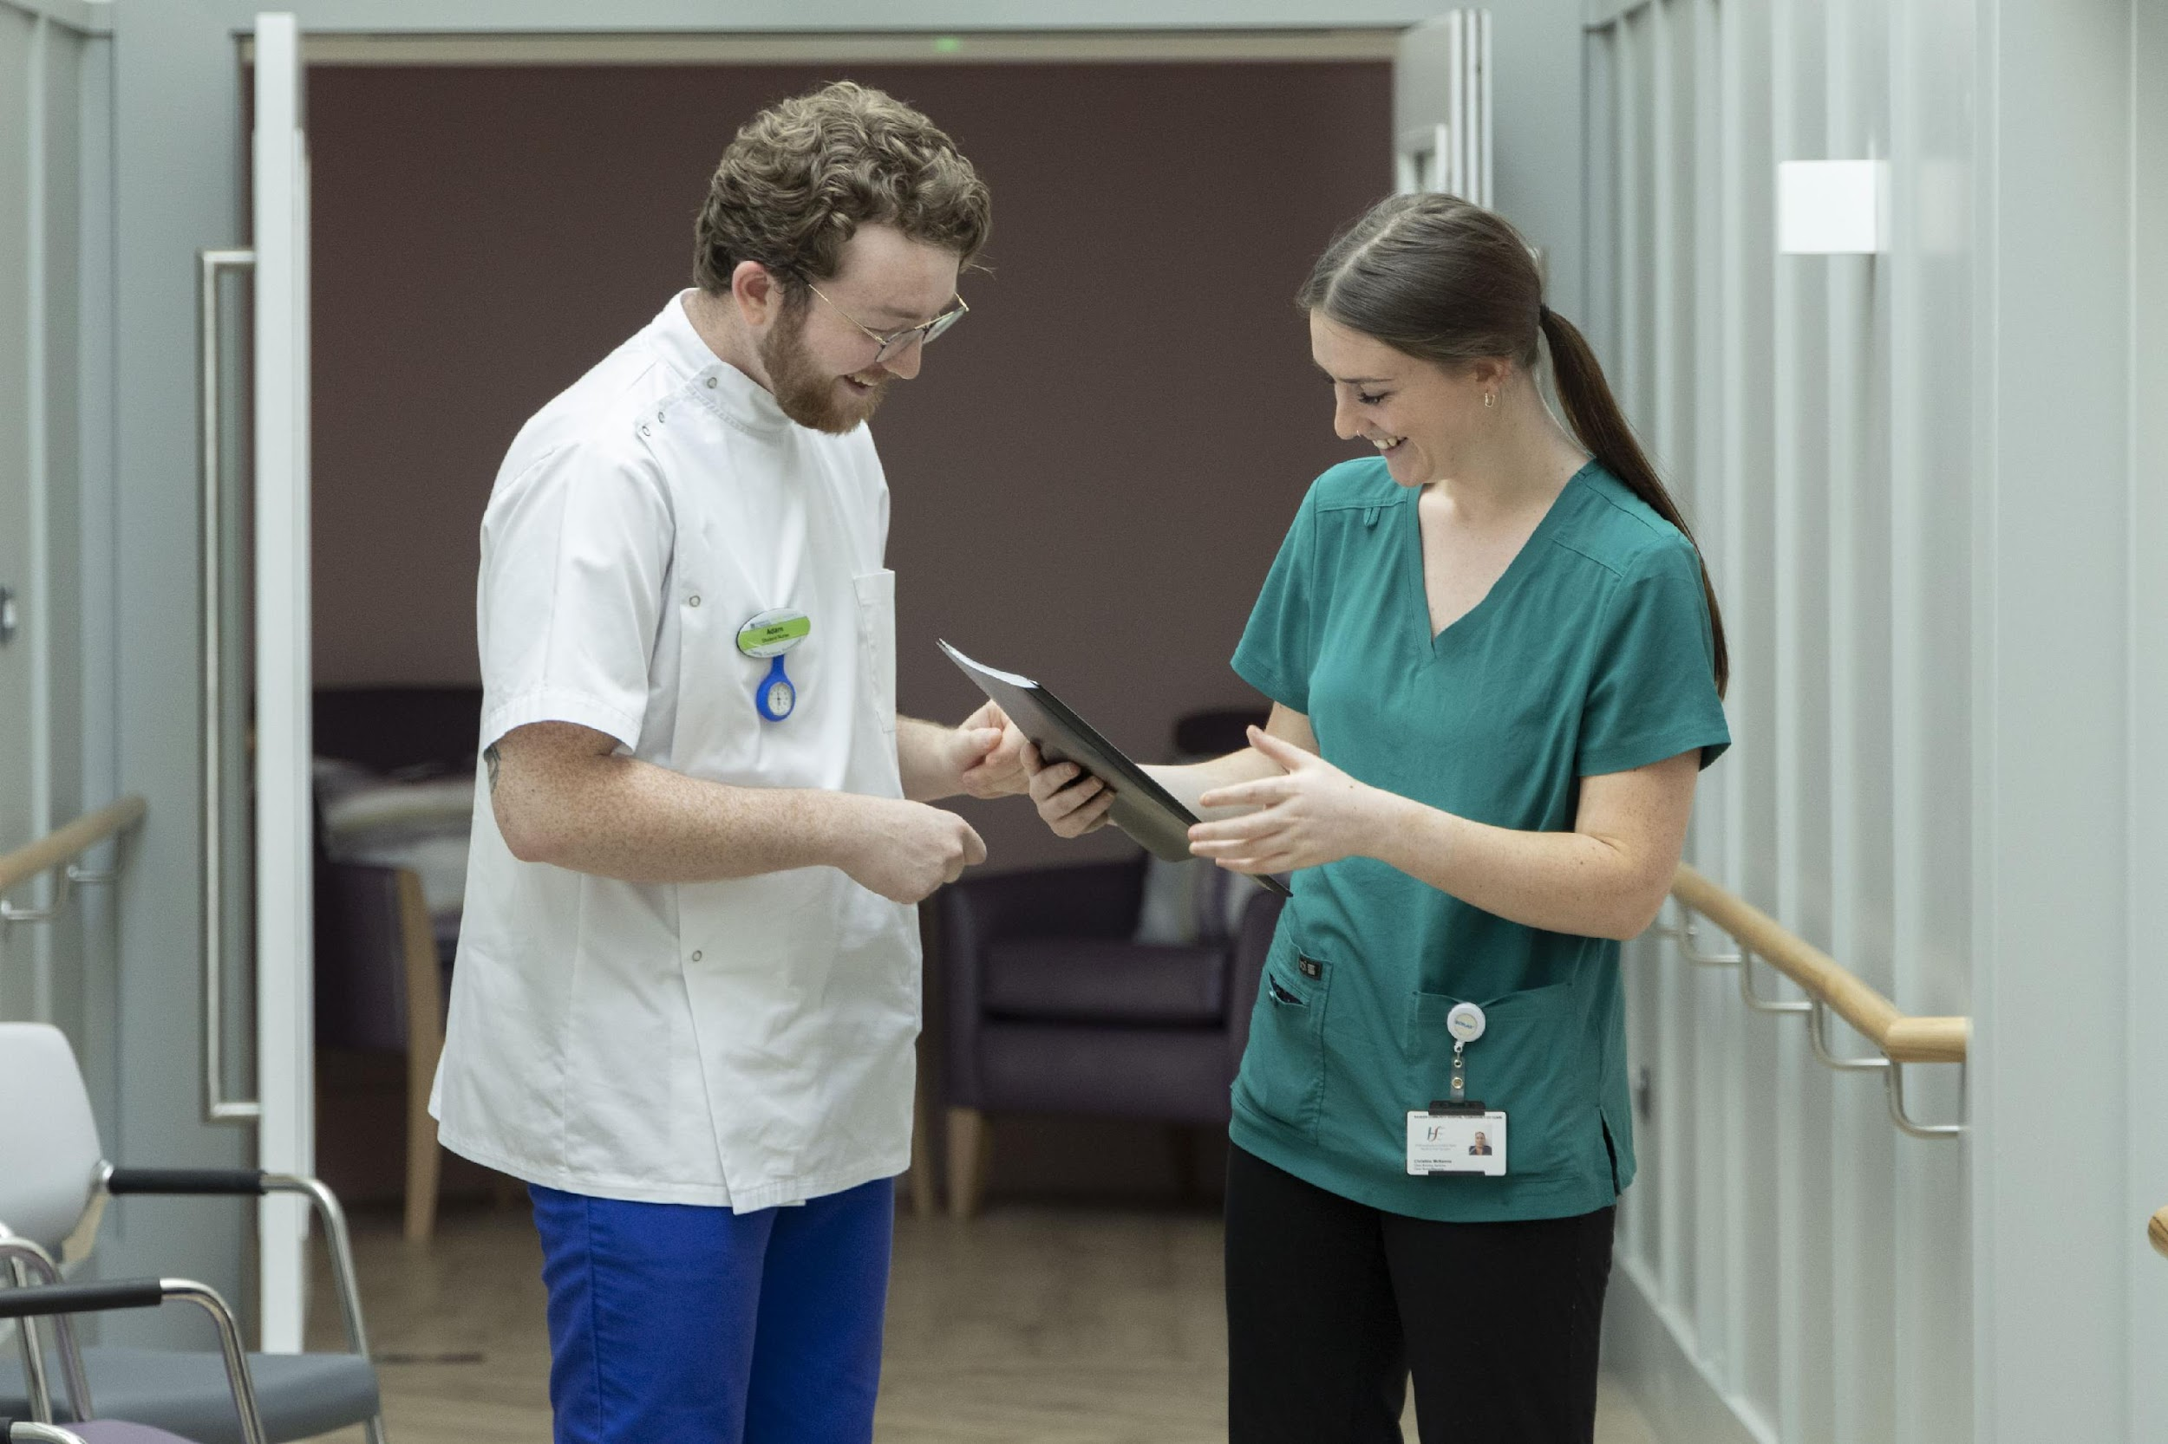
And…
I still do…and thanks to you and many Healthcare Workers around the country,
I am seeing those aspirations lived out every day.
12

Slide 13
Mrs O’Neill
Text in Arial Bold 16 point text
13

Slide 14
14

