Slide 1
Beyond the Wait, Waiting List Action Plan in Action:
Improving Access & Delivering Reform
5 September, Convention Centre Dublin
Sheila McGuinness
Director of Access, HSE Access and Integration
1

Slide 2
Creating a Catalyst for Change
Garry Corbet, CEO S A Partners
2

Slide 3
Introduction to S A Partners and myself
Making a positive impact since 1993
3

Slide 4
Creating a catalyst for change
Mindset
Motivation
Engagement
Action
Resilience
Creating a Catalyst for Change
What are the behaviours we need?
4

Slide 5
Creating a catalyst for change
What is a Behaviour?
A Behaviour can be Observed, Described & Recorded
It’s not what we think or what we feel or what we intend to do.
It’s the actions we take or don’t take!
“We cannot solve our problems with the same thinking we used when
we created them.”
~ Albert Einstein ~
Maybe we need to Think and Act / Behave differently!
5

Slide 6
Creating a catalyst for change
A growth mindset vs a fixed mindset.
A positive mindset.
Mindset
84%
Highlight a fact or statistic with a short statement
6

Slide 7
Creating a catalyst for change
Initiates action.
Sustains Momentum.
Motivation
84%
Highlight a fact or statistic with a short statement
7

Slide 8
Creating a catalyst for change
Ownership and commitment.
Turn intentions into action.
Engagement
84%
Highlight a fact or statistic with a short statement
8

Slide 9
Creating a catalyst for change
Create momentum & inspire others.
Fail, learn and move forward again.
Action
84%
Highlight a fact or statistic with a short statement
9

Slide 10
Creating a catalyst for change
Allows us to push forward.
Builds trust
Resilience
84%
Highlight a fact or statistic with a short statement
10

Slide 11
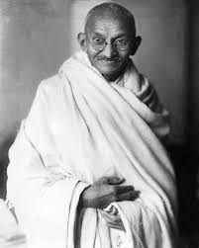
Mindset – Motivation – Engagement – Action - Resilience
“We but mirror the world. All the tendencies present in the outer world are to be found in the world of our body. If we could change ourselves, the tendencies in the world would also change. As a man changes his own nature, so does the attitude of the world change towards him. This is the divine mystery supreme. A wonderful thing it is and the source of our happiness. We need not wait to see what others do.” – Mahatma Gandhi
11

Slide 12
Experience with Implementing Integrated Care Pathways in Urology
Professor Eamonn Rogers, Consultant Urologist and
Co Lead of the National Clinical Programme in Surgery
12

Slide 13
Access to the Urology Haematuria Pathway
Integrated Care Pathways in Urology
3+ separate visits to the Acute Hospital OP Urology service
Challenges
Existing pathway has risks as this is a cancer pathway
High number of inappropriate referrals
Not clear who truly urgent cases are
There is a significant urology and cystoscopy waitlist
Bladder cancers can metastasize rapidly so rapid access to diagnosis is imperative
Patient journey without the pathway
Current
GP
Urology OP
Appointment with Consultant
IPDC admission and diagnostics
Diagnostic results
+/- further treatment
The Health service user develops haematuria
ANP and consultant- led service,
One-stop access to urology MDT
Rapid access haematuria diagnostics
Rapid commencement of appropriate treatment
Benefits
Urgent patients are seen, and cancers are diagnosed in a timely manner. 11% will have a cancer diagnosis
Rapid access haematuria diagnostics (same day cystoscopy, renal ultrasound, CT urogram)
Management closer to home
Community based acute supported multidisciplinary model of service delivery
Reduction in urology wait lists
Integrated
GP
Rapid Access/ One Stop Haematuria Service
Assessment and care planning with Urology multidisciplinary team
Care Pathway from GP to rapid access service
1 Visit to RAHS in majority of cases
13

Slide 14
Access to the LUTS Care Pathway
Integrated Care Pathways in Urology
Challenges
Significant wait times due to low priority of many LUTS referrals
Delayed treatment due to absence of streaming of referrals
Significant impact on patients' quality of life, with significant discomfort and often withdrawal from social activities
Patient journey without the pathway
Current max wait time of XX
GP
Urology OP
Appointment with Consultant Urologist
Current
The Health service user develops a urological issue
ANP will assess and organise same day diagnostics
AND Consultant advice available virtually
Pts with severe symptoms will be seen by consultant
Severe
Benefits
Management closer to home with timely access
GPs are supported and enabled to manage patients with mild and moderate symptoms
Significant improvements to quality of life
Evidence provided in Urology Model of care evidence shows a reduction of 17-20% of outpatient visits where LUTs pathway has been implemented
Moderate patients who do not respond to GP led
conservative
management
(6 week wait time)
ANP-Led Urology
Clinic
Integrated
GP
Urology OP
Appointment with consultant urologist
Care Pathway from GP to Integrated urology service
Immediate commencement of care
Severe
> 28 days commencement of care
14

Slide 15
Access to the Urology Continence Pathway
2+ separate visits to the Acute Hospital OP with Gynae/Urology
Significant Gynae/ Urology wait times due to low clinical priority of continence issues
Patient journey without the pathway
Urology OP
Appointment with Consultant
Follow Up appointment +/- diagnostics and inpatients stays
Current
GP
Person develops Continence Issues
Integrated Community
Continence Service
CNS and physio-led service, fast support/access to gynae/urology MDT as required
Nurse advisor clinic
Virtual advice
See, treat and refer if appropriate
Urology OP
Appointment with Consultant
GP
Modernised Care Pathway
Care Pathway from GP to integrated access service
It is estimated that 10% - 15% of patients on Urology waiting lists present with continence concerns. The majority of these can be managed conservatively in the community.
15

Slide 16
St. James’s Hospital Lean Transformation: Increasing Access to the Pain Service - an Improvement Journey
Stuart Garrett, Scheduled and Unscheduled Care Access Lead, SJH
16

Slide 17
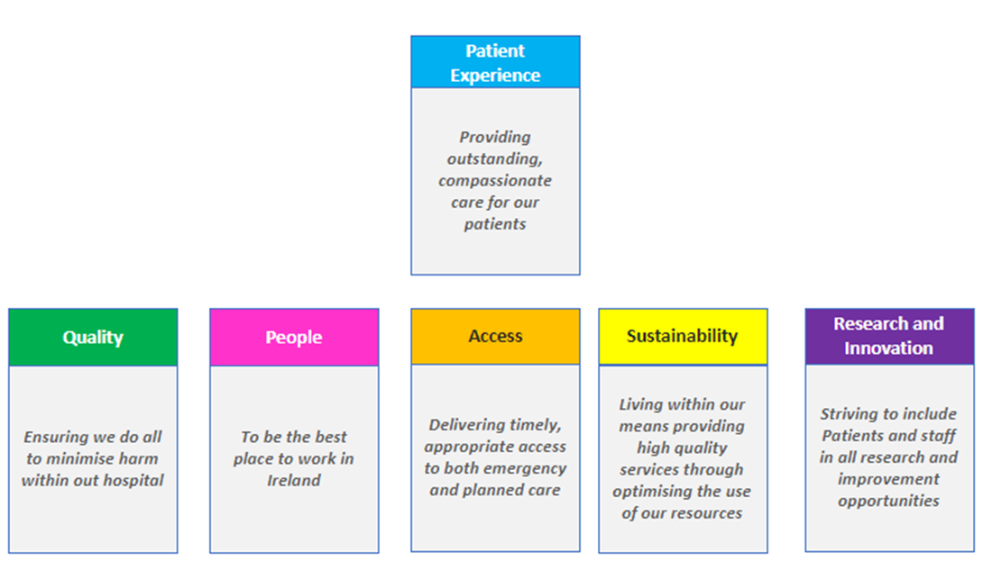
St. James’s Hospital Lean Transformation
Increasing access to the Pain Service - an improvement journey
Strategic Priorities
Stuart Garrett, Access Lead – Scheduled and Unscheduled Care
On behalf of:
The Pain Service in SJH
Fiona Keogan and the Lean Transformation Team
Aligning improvement initiatives with hospital strategic priorities ensures that operational efficiencies directly contribute to enhanced patient care
17

Slide 18
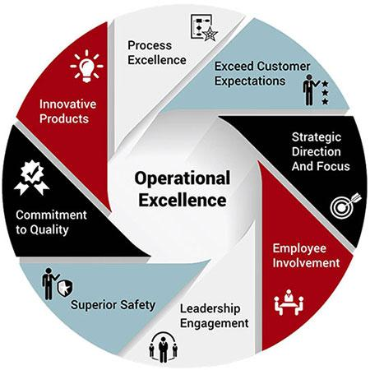
Operational Excellence
Underpins the transformation journey
Primary focus on the development of capability in service improvement and redesign, with a critical focus on the tenet of “Respect for People”
.
Operational Excellence Model
Lean Approach
1) Organisation’s Vision, Strategy, and Values
2) Embedded Improvement Methodology in Operational Delivery
3) Integrated Performance Management and Assurance System
Putting the patient first to deliver better health, better care and better value
18

Slide 19
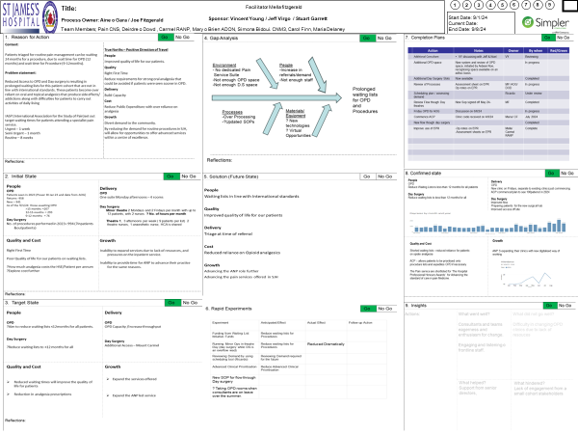
108
Lean Transformation in SJH
Outcomes and Impacts to Date
Multiple specialities/services supported via Lean Transformation Programme Office
Pan Hospital improvement programmes supported – Visual Hospital Management, Surgical Hub development, Day of Surgery Admissions Programme, Acute Frailty, Long Term Care Optimisation, Patient Flow, Ward Cohorting, Cancer Pathways and Oncology Day ward flow optimisation
Investment in SJH staff/resources for Lean Transformation:
108 staff received Lean ‘Yellow Belt Training’ via SETU May to Oct 2024
24 staff participated in a year long diploma in Operational Excellence delivered via SETU 2023 to 2024 with another programme to run 2024 to 2025
Lean Transformation Office Resources – x 4 WTEs (Director and x 3 Gr VIIs)
.
SJH Staff with Lean ‘Yellow Belts’ from Oct 2024
22
Staff completed the diploma in Operational Excellence
4
Lean Transformation office
resourced x 4 WTEs
19

Slide 20
Increasing Access to the Pain Service
Respect for people
Going to GEMBA
Met with all team members to understand the Pain service.
Respecting skills and competencies of staff
Staff and patient experience
Went to where the activity takes place and worked directly with the team to identify areas for improvement
Lean and Operational Excellence
Leveraged methodology/principles together with the pain service team
Reducing MUDA/Waste
Leveraging HSE Access funding and reform
Simple changes made a significant difference
Duplication
Over production and processing
Waiting time on list and clinic/procedures reduced
Digital optimisation pursued where possible
ATC funding:
Advanced clinical prioritisation (ACP) and Patient Initiated Review (PIR)
Weekend initiative lists to increase surgical volumes (n= 258 Feb to Aug 2024)
Planned access to Mt Carmel Surgical Hub
20

Slide 21
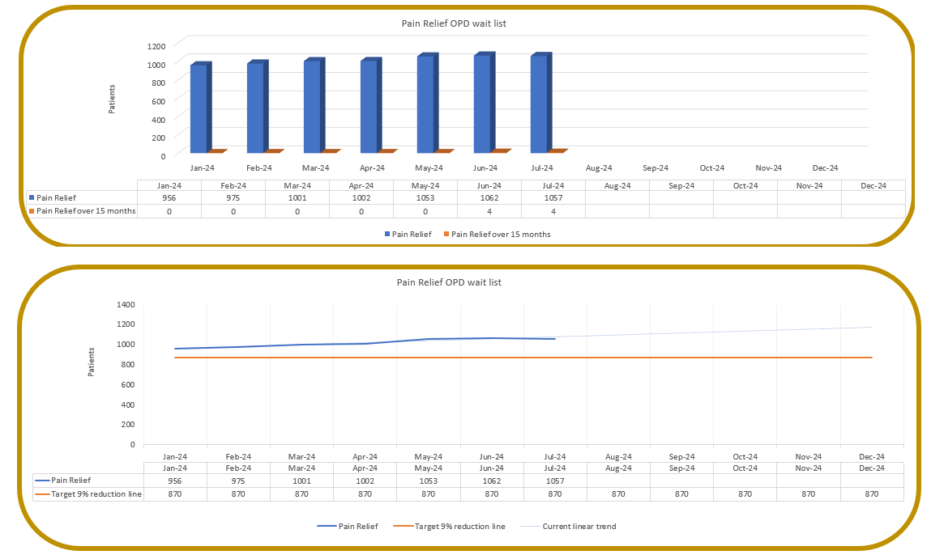
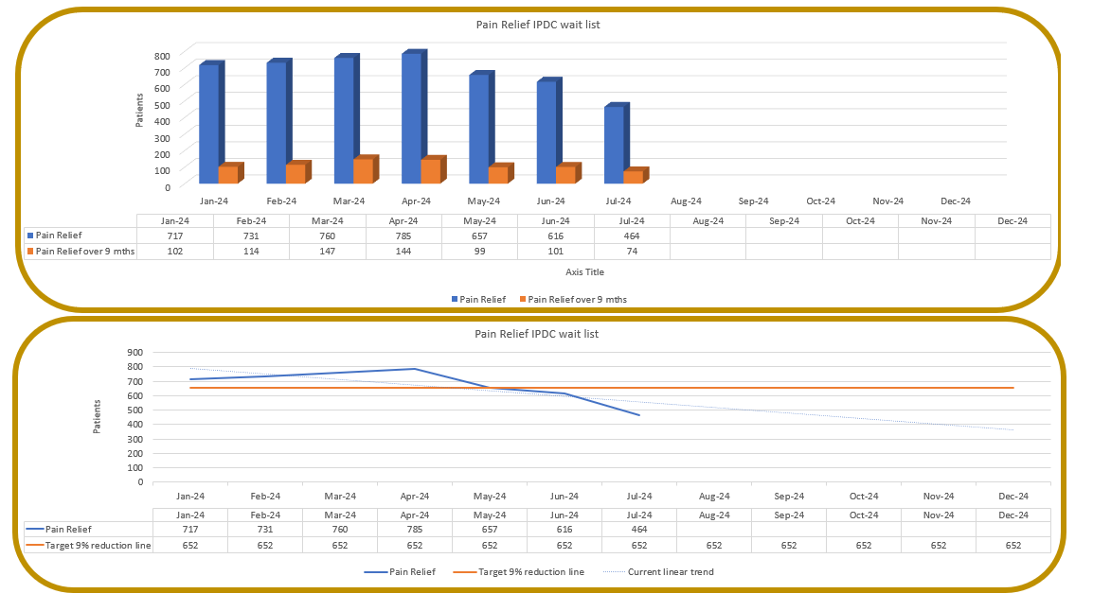
Increasing Access to the Pain Service -
Impact on NTPF waiting lists Aug 2023 versus Aug 2024
Increase in OPD referrals to Pain OPD waiting list 2021 to 2024 and increase in the rate of removals per month
NTPF OPD Waiting list Pain Aug 2023 n= 925 waiting to 12 mths
NTPF OPD Waiting list in Pain Aug 2024 n= 1,062 waiting to 18 mths
NTPF IPDC Waiting list Pain Aug 2023 n= 854 waiting to 36 mths
NTPF OPD Waiting list Pain Aug 2024 n= 462 waiting to 18 mths (54% reduction in volume waiting & 50% reduction in longest wait)
21

Slide 22
Robotic Process Automation in Galway University Hospital
Jean Boyle, Business Manager, Scheduled Care, GUH and
Carrie Fletcher, Scheduled Care Transformation Programme Manager, GUH
22

Slide 23
Robotic Process Automation
Assisting with Waiting List Management
Text in Arial Bold 16 point text
Ruadhan the Robot – Galway University Hospital’s Newest Team Member
Background
In late 2023, Galway University Hospitals Scheduled Care Team in conjunction with our IT department worked collaboratively to identify Scheduled Care processes that were of high volume but low complexity that could potentially become automated.
The following process were identified for automation:
Inpatient and Outpatient Waiting List Initial Suspensions
Extension of existing Inpatient and Outpatient Waiting List Suspension Periods
Inpatient and Outpatient Waiting List Removals
These processes were chosen due to our increasing referral rate, resource pressures and increased outsourcing of patients to private providers.
Following a data sharing agreement, a solutions architect approach was implemented with the Robotic Process Automation Project Team who introduced us to Ruadhan, our Robot.
23

Slide 24
Robotic Process Automation
Methodology & Roll Out
Methodology
Methodology:
The Project Team worked collaboratively to deliver on:
Process Mapping – current state
Project Initiation Document & Solution Test Document development & sign off
Process Mapping – future state
DPIA submission
UAT & Sign Off:
A series of User Acceptance Testing rounds were complete including;
Volume & Server Impact testing
Solution Design Document development & sign off
Local SOPs designed
Staff Training
Go Live!
The Automation Solution was deployed into our live Patient Administration System.
The RPA Team provided a period of Hypercare post go live to ensure any issues arising were resolved in a timely manner
UAT
User Acceptance Testing & Sign Off
Go Live!
Solution Deployed into our live Patient Administration System
24

Slide 25
74%
RPA Impact
Waiting List Suspension/Removal Outputs
Removal Success Rate
May 2024: 74% success rate for Removal automation with only a 26% manual intervention rate due to exceptions outlined by the service
95%
June 2024: 95% success rate for Suspension automation with only a 5% manual intervention rate
Suspension Success Rate
Conclusion & Benefits
Increased Turn Around Time – Enhancing Service User Experience
Ability to forecast versus fire fight resulting in accurate wait times
Resource Optimisation
Improved Data Quality
Improved GDPR adherence
25

Slide 26
ENTegrate: Creating Access for Patients When and Where They Need it
Aileen Igoe
Lean and Systems Redesign Lead - Mater Transformation
26

Slide 27
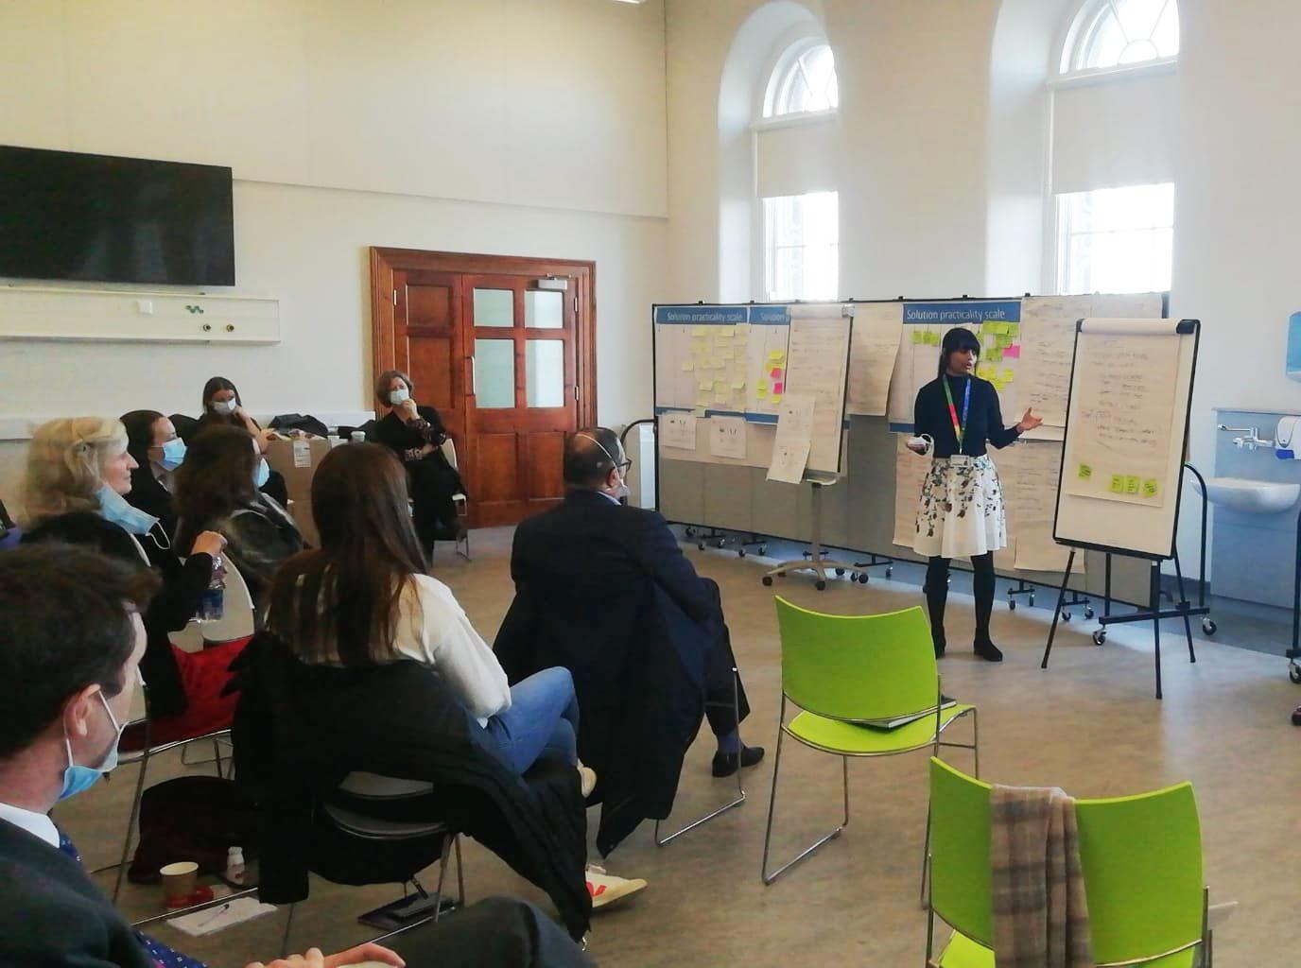
The Challenge
Text in Arial Bold 16 point text
Patients referred to the Mater Hospital with “routine” Rhinology conditions can be waiting for extended periods of time to be seen by an ENT consultant.
Fig: Demand and Capacity data as captured at a Value Stream Analysis event, Mater Hospital, December 2021
27

Slide 28
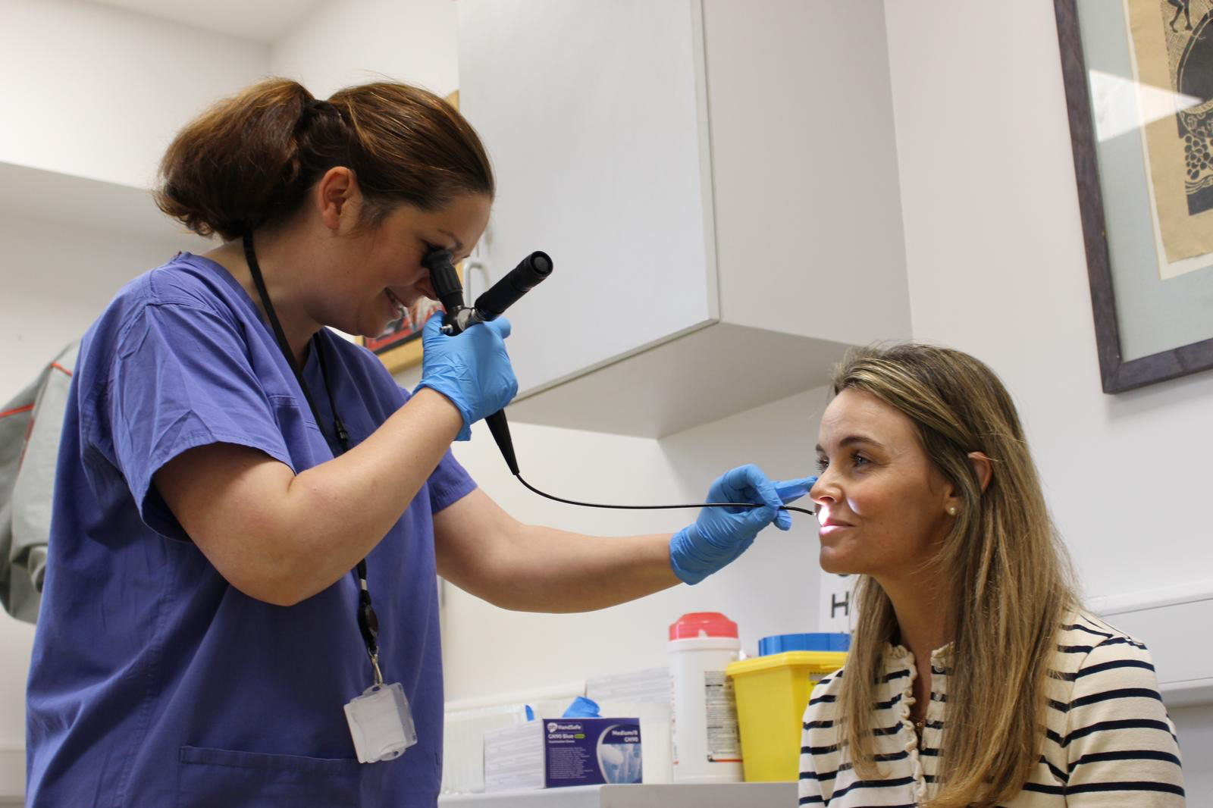
The Pilot
Text in Arial Bold 16 point text
Text in Arial Bold 16 point text
200 selected patients
A weekly, half-day community clinic
A monthly joint clinic attended by both the Consultant and GP
28
28

Slide 29
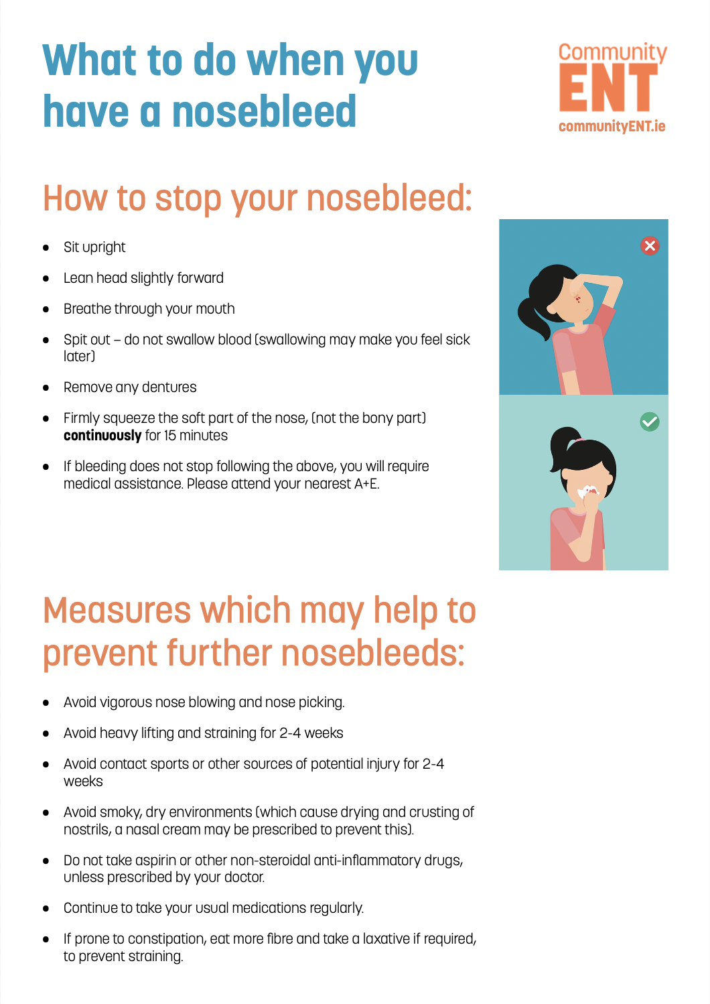
Service Design Approach
Patient-centred Education
29

Slide 30
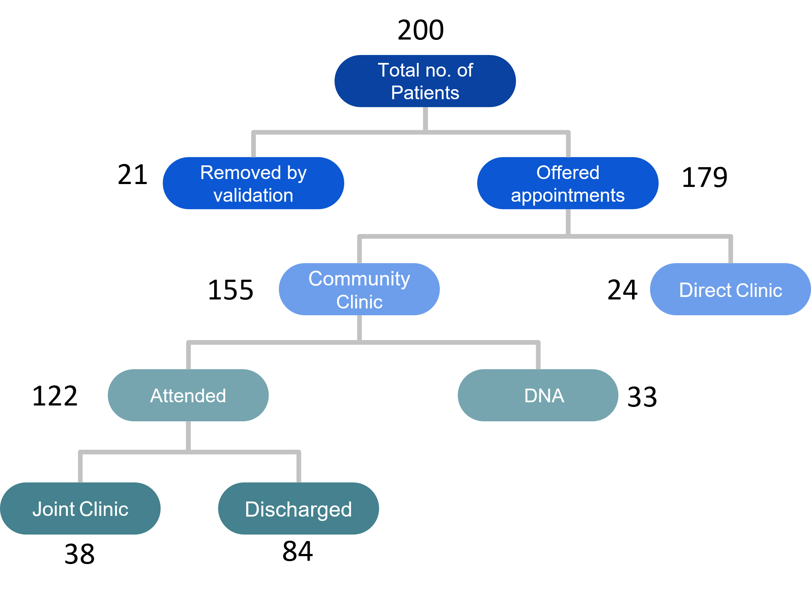
Results
ENTegrate pilot: April to October 2023
200
Patients removed from
the waiting list over 6 mths
69%
Community Discharge
rate
30

Slide 31
Mohamed Amin & Dr Cristina Warren
HSE SPARK Innovation Programme
The Mater Transformation Team
The administration teams in both the Mater Hospital and Grangegorman
Acknowledgements
Thank you
aigoe@mater.ie
www.matertransformation.ie
31

Slide 32
Transforming Diabetes Care: Reforming Delivery Systems for Improved Outcomes
Dr Tomás Patrick Griffin
MB BCh BAO, PGC, PG (DipEd), MSc, PhD, FRCPI.
Honorary Senior Lecturer in Medicine, University of Galway,
Consultant Diabetologist, GUH
Clinical Consultant in Diabetes Communication Technology University of Dundee,
Honorary Lecturer University of Leicester
32

Slide 33
New Diabetes Clinic Wait Times – July 2023
130
Galway University Hospital
Wait List for New Diabetes OPD
94
Number of people on diabetes waiting list
Roscommon University Hospital
Wait List for New Diabetes OPD
224
Wait Times
Total Wait List for New Diabetes OPD
33

Slide 34
Traditional Model of Diabetes Care
Modernised Care Pathways and ECC

Slide 35
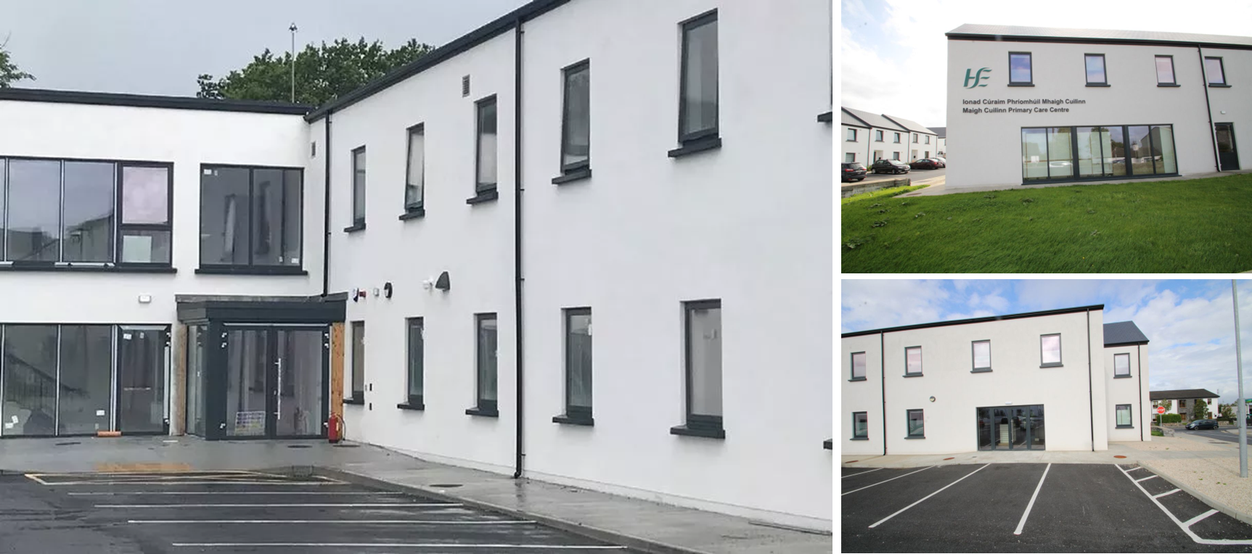
Integrating referrals to GUH for people living with Type 2 Diabetes
Galway City West Hub
Galway East and Roscommon Hub
GUH: New referrals divided into three based on location
Triage
Galway City West
Galway East and Roscommon
Other Referrals
Galway University Hospitals
Clinical Governance for the Wait List
Dr Tomás Griffin
Dr Abdullah Abdullah
GUH Hospital Consultants
Outcomes of Triage
Moycullen Primary Care Centre
Refer back to GP
With advice
Virtual contact
Galway City West Hub
Routine (4-6 weeks)
Urgent (<4 weeks)
Virtual
Galway University Hospital
Routine
Soon
Urgent
Refer back to GP
With advice
Virtual contact
Galway East and Roscommon Hub
Routine (4-6 weeks)
Urgent (<4 weeks)
Virtual
Galway University Hospital
Routine
Soon
Urgent
Roscommon University Hospital
Portiuncula University Hospital
Refer back to GP
With advice
Virtual contact
Refer to Mayo Hub
Galway University Hospital
Routine
Soon
Urgent
Tuam Primary Care Centre
35

Slide 36
Integrating referrals to RUH for people living with Type 2 Diabetes and re-evaluating existing referrals
Wait list
Re-triage wait list
New referrals
Combined ambulatory care hub and hospital triage
Roscommon University Hospital
Actively identify PwT2D in clinic suitable for specialist
ambulatory care hub
Community CNS attends
RUH Clinic
111 people with T2DM seen in community
Reduction in wait list
Boyle Primary Care Centre
36

Slide 37
Changing Activity in Galway City/West Integrated Care Hub
 | Year 2023 |  |  |  |  |  | Total | Year 2024 |  |  |  |  |  | Total | Year on Year Change
 | Jul | Aug | Sep | Oct | Nov | Dec | 6- months | Jan | Feb | Mar | Apr | May | Jun | 6- months
IC Consultant | 0 | 21 | 29 | 46 | 59 | 11 | 166 | 56 | 157 | 109 | 286 | 158 | 121 | 887 | 534%
CNS (acute IC team) | N/A | N/A | N/A | N/A | N/A | N/A | N/A | N/A | N/A | N/A | 107 | 108 | 44 | 259 | N/A
ANP (acute IC team) | 0 | 0 | 0 | 0 | 0 | 0 | 0 | 0 | N/A | N/A | 32 | 122 | 34 | 188 | N/A
CD-CST ANP | 0 | 0 | 0 | 0 | 0 | 0 | 0 | 0 | N/A | N/A | 52 | 44 | 13 | 109 | N/A
CD-CST CNS | 104 | 157 | 125 | 103 | 123 | 144 | 756 | 165 | 238 | 194 | 173 | 211 | 158 | 1139 | 150%
CD-CST Dietetic Service | 9 | 23 | 12 | 21 | 19 | 15 | 99 | 19 | 24 | 25 | 38 | 39 | 15 | 160 | 162%
CD-CST Podiatry Service | 131 | 108 | 114 | 142 | 126 | 93 | 714 | 159 | 148 | 111 | 171 | 232 | 177 | 998 | 140%
Consultant-led MDT Meeting | 5 | 8 | 2 | 4 | 6 | 0 | 25 | 3 | 29 | 51 | 24 | 220 | 46 | 373 | 1492%
Diabetes Prevention Programme | 0 | 0 | 0 | 0 | 0 | 0 | 0 | 0 | 0 | 0 | 0 | 0 | 55 | 55 | N/A
Diabetes Self-Management Education | 30 | 43 | 72 | 97 | 85 | 24 | 351 | 13 | 32 | 25 | 26 | 20 | 20 | 136 | 62%
Grand Total | 279 | 360 | 354 | 413 | 418 | 287 | 2111 | 415 | 628 | 515 | 909 | 1154 | 683 | 4304 | 204%
37

Slide 38
New Diabetes Clinic Wait Times
July 2023 v August 2024
79%↓
Galway University Hospital
Wait List for New Diabetes OPD
79% ↓
68%↓
63%↓
79%↓
68%↓
Number of people on diabetes waiting list
Eliminated
Eliminated
Roscommon University Hospital
Wait List for New Diabetes OPD
280%↑
93%↓
74%↓
Galway University Hospitals
Roscommon University Hospitals
No Person Waiting Longer than 6 months
Reduction in Overall Wait List
For New Diabetes OPD
38

Slide 39
Panel Discussion - Enablement
Tony Canavan, Garry Corbet, Prof. Eamonn Rogers, Stuart Garrett, Jean Boyle & Carrie Fletcher, Dr Tomás Griffin and Aileen Igoe with Sheila McGuinness
39

Slide 40
Panel Discussion - Reform
Tony Canavan, Dr Tomás Griffin and Aileen Igoe
with Sheila McGuinness
40

