Slide 1
Integrated Healthcare: Advancing Health Service Reform
5 September, Convention Centre Dublin
David Walsh
National Director of Community Operations, HSE
Derval McDonagh
CEO, Inclusion Ireland

Slide 2
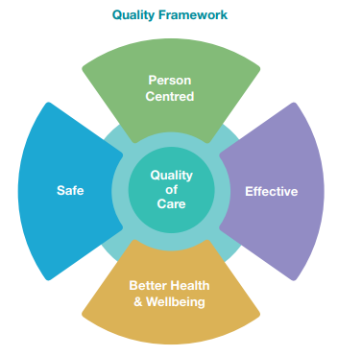
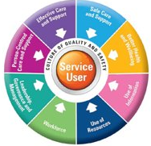
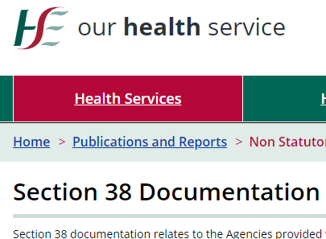
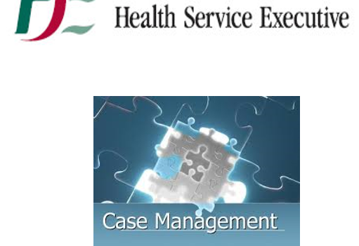
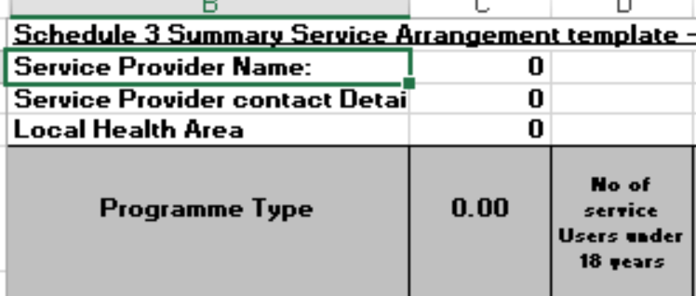
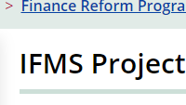
The Component Part of our System
Quality and Safety
Policy and Rights
Governance and Accountability

Slide 3
Census facts and statistics
Inclusion Ireland
“ specialised “ support and community support
Slainte care, Regional Health Areas
and the UNCRPD
‹#›

Slide 4
What we sometimes hear
Voice of children and families
“When I meet a professional with my child, I have to repeat the same story over and over. I gave a nurse her hospital passport once and I was so blown away by the difference it made...it took her two minutes to read it but it totally changed the experience, we had photos of her at her birthday in there , she was able to support her to relax by talking about her party”
‹#›

Slide 5
What we hear
Voice of children and families
“ I wish that people would be more honest. I would way prefer knowing that the service is non-existent and not waste my precious family time on fighting for something . Honesty is a kindness”.
‹#›

Slide 6
What we hear
Voice of children and families
“ I want people to see my son as his full and brilliant self. Yes, he needs support, we all do we are all human, but because he is non-speaking people think he doesn’t pick up on what they are saying. He may not understand the words, but he understands when people are talking negatively about him. Imagine what that feels like ?
‹#›

Slide 7
What we hear
Voice of children and families
“ I rang my dentist to say that my son is non-speaking, and it really helps if he could send a photo of the waiting room and the surgery beforehand to us so we could support J to be more comfortable. They refused saying “ we don’t do that, but we are thinking of creating a social story in the future “. J wouldn’t go into the appointment, so we had to use the time to take the pictures ourselves and re book another time”
‹#›

Slide 8
Importance of Integrated Care
Abundance vs scarcity
Hope vs hopelessness
Why is integrated care important?
Empowerment vs helplessness
Innovation vs stagnation
Active vs passive

Slide 9
Two roads diverged...
Which one will we choose?
The system says....
The person says....

Slide 10
How can we improve?
Skills
Systems
Relationship
Values
Attitudes
Beliefs
Participation

Slide 11
What changes in the experience of
the person?
Supported rather than “ falling through the cracks”
Confident rather than disempowered
Hopeful not despairing
Trusting not adversarial

Slide 12
Panel Discussion - Reform of Disability Services
Sean O’Rourke (Chair),
David Walsh, Kate Killeen White, Colm Ó’Conaill, Derval McDonagh, Jacqui Browne
‹#›

Slide 13
Case Study:
Joe O’Keefe
‹#›

